Slide 1
Tutorial 5
Quiz 7 & HW 4
Presenter: Peter​ Zhang
2/18/2026

Slide 2
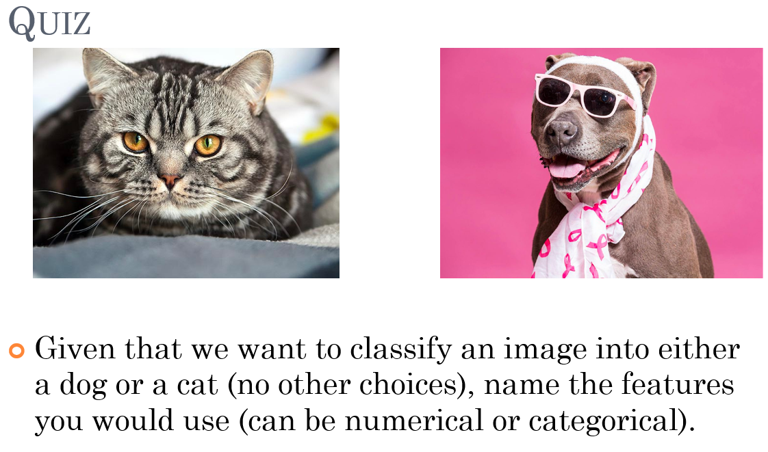
Quiz 7

Slide 3
Why do we use Sigmoid/Logistic function as our classification function? (Select all that apply)
Produces a value between 0 and 1
A partial function with domain [0, +inf)
Produces a value between -1 to 1
A total function with domain (-inf, inf)
Integrates to 1 from –inf to inf
Differentiable

Slide 4
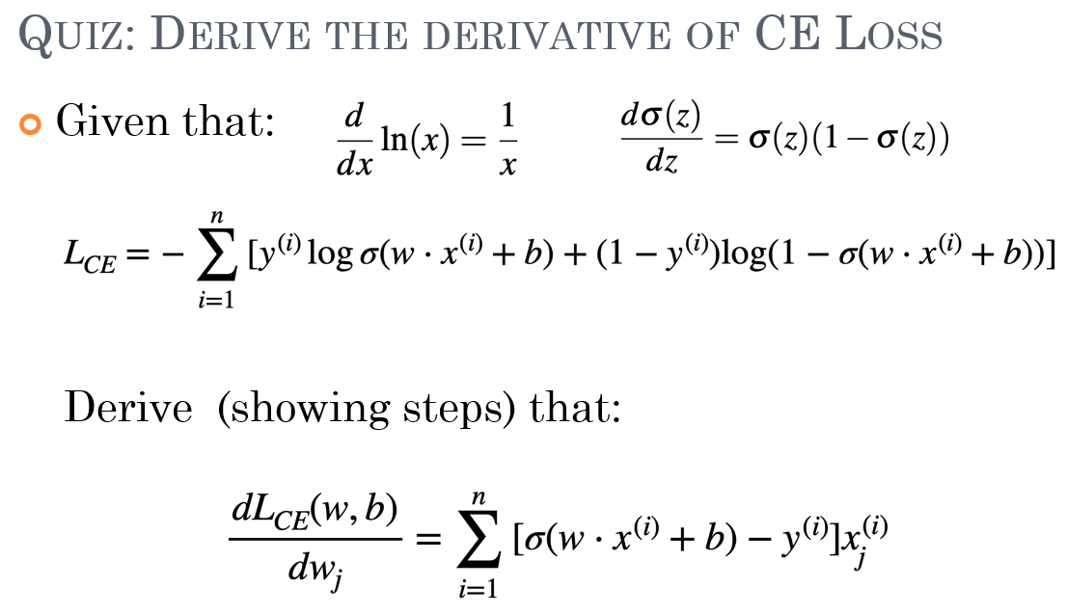

Slide 5
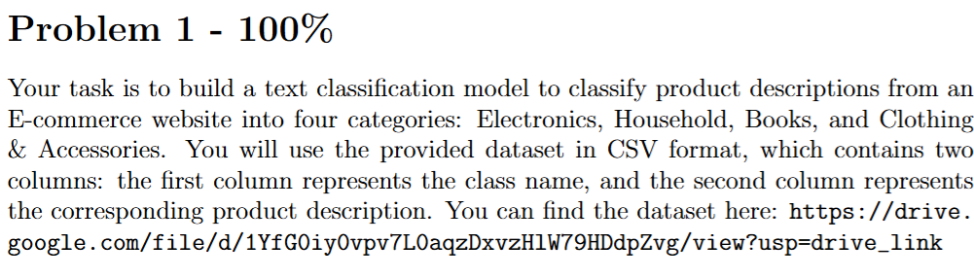
Step 1 Data Exploration
Step 2 Feature Extraction
Step 3 Model Training
Step 4 Model Evaluation
Step 5 Documentation and Submission

Slide 6
Thank You

