Slide 1
Tutorial 2
Quiz 2 & HW 1
Presenter: Peter​ Zhang
1/21/2026

Slide 2
Quiz
In your opinion, which of the following tasks is more challenging to NLP, machine translation or dialogue system? Why?
Rule-Based Machine Translation (RBMT)
Statistical Machine Translation (SMT)
Neural Machine Translation (NMT)
Input: a single sentence in the source language
Output: a sentence in the target language with equivalent meaning

Slide 3
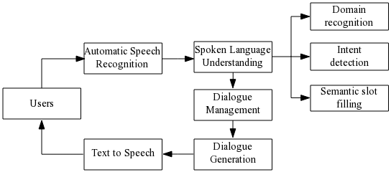
Speech Dialogue system:

Slide 4
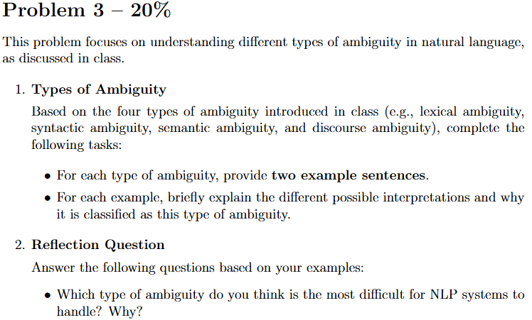
HW 1

Slide 5
Lexical Ambiguity:
I went to the bank.
There is a bat in the room.
Syntactic Ambiguity:
I saw the man with a telescope.
Old men and women were evacuated first.
Semantic Ambiguity:
Every student read a book.
John didn’t pass the exam because he studied.
Discourse Ambiguity:
John met Bob after he finished the project.
The trophy doesn’t fit in the suitcase because it is too big.

Slide 6
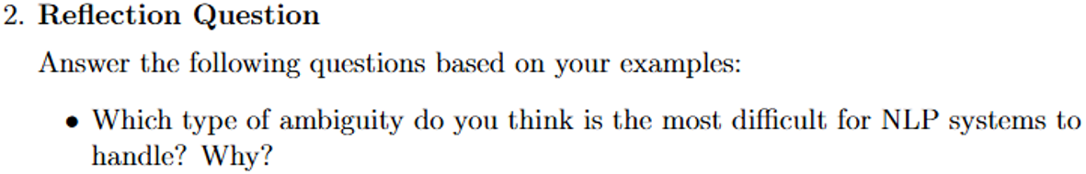
Discourse Ambiguity (Complex):
Requires context beyond a single sentence
Involves long-range dependencies and reference resolution
Requires world knowledge and reasoning

Slide 7
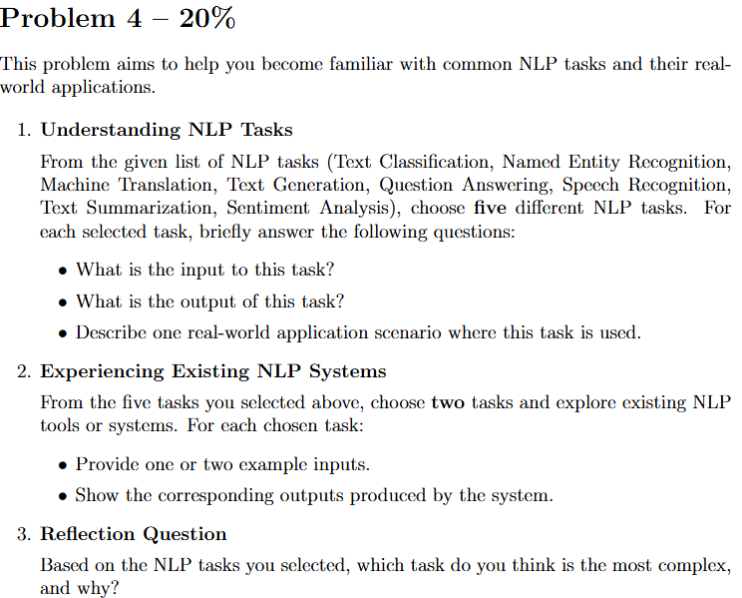

Slide 8
Text Classification
Input: A text document (e.g., email, review, article)
Output: One or more category labels
Application: Spam detection, topic classification of news articles
Named Entity Recognition (NER)
Input: A sentence or document
Output: Named entities with labels (e.g., PERSON, LOCATION, ORGANIZATION)
Application: Information extraction from news, resumes, or legal documents
Machine Translation
Input: A sentence in a source language
Output: A translated sentence in a target language
Application: Google Translate, multilingual communication tools
Text Generation
Input: A prompt or context text
Output: Generated text continuation
Application: Chatbots, story generation, content writing assistants

Slide 9
Question Answering
Input: A question (and optionally a context document)
Output: An answer in text form
Application: Search engines, virtual assistants (e.g., Siri, Alexa)
Speech Recognition
Input: Audio signal containing speech
Output: Transcribed text
Application: Voice assistants, automatic subtitles, dictation software
Text Summarization
Input: A long document or article
Output: A shorter summary capturing key information
Application: News summarization, document preview systems
Sentiment Analysis
Input: A text expressing opinions or emotions
Output: Sentiment label (positive, negative, neutral)
Application: Product review analysis, social media monitoring

Slide 10
General Questions
Usually, homework will be released every Wednesday, and the due date will be the following Monday at 11:59 PM.
Quizzes will count toward the total score (10%).
Students who participate in the tutorial and present their own homework will receive bonus points (up to 5%).
No homework this week!

Slide 11
Thank You

