Slide 1
Natural Language Processing Tutorials
Become a natural language processing expert
Supervised by Dr. Kenny Zhu
TAs: Essam Abdelghany

Slide 2
Pop Quiz
Reminder in tutorials we recap on lecture via pop quiz, learn technologies discuss hard problems in assignments, demonstrate practical aspects of content learnt in lecture

Slide 3
Pop Quiz
1) Information retrieval is finding documents………..
a) From within a large collection of documents
b) To satisfy information need
c) That are unstructured in nature
d) All of the above
Take notes as quizzes may not be posted in solved form.

Slide 4
Pop Quiz
2) Term-document incidence matrix………..
a) Maps each word to the documents it appeared in
b) Counts the number of occurrences of each word
c) Maps each document to the out of vocabulary terms
d) Help us find documents satisfying Boolean queries in terms of words

Slide 5
Pop Quiz
3) Term-document matrix is inefficient because………..
a) Maps each word to a vector as long as the number of documents
b) Does not map each word to a set as large as the relevant documents
c) Impossible to store 0s and 1s efficiently as binary
e) All of the above
Take notes as quizzes may not be posted in solved form.

Slide 6
Pop Quiz
4) To approach Boolean queries with inverted index………..
a) Instead of AND do Intersection
b) Instead of OR do union
c) Instead of NOT, make list of documents empty
e) All of the above

Slide 7
Pop Quiz
5) Issues with scoring with raw frequency for ranked retrieval………..
Document containing 10x the frequency is not 10x more relevant or important
Favors longer documents
c) Does not give any priority to rare terms (is VS. arachnocentric )
e) All of the above
Take notes as quizzes may not be posted in solved form.

Slide 8
Pop Quiz
6) The inverse document frequency of a term………..
a) Is higher the more rare the term is
b) Is the inverse proportion of documents in which the term appeared
c) Is the inverse proportion of terms in which document appeared
d) None of the above
Take notes as quizzes may not be posted in solved form.

Slide 9
Lect. Quiz
Reminder in tutorials we recap on lecture via pop quiz, learn technologies discuss hard problems in assignments, demonstrate practical aspects of content learnt in lecture

Slide 10
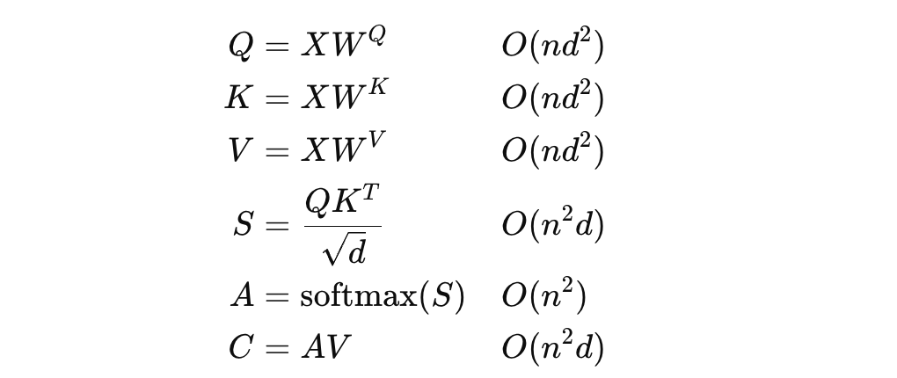
Lecture Quiz
$\left(n,d\right)∗\left(d,d\right)⇒nd^{2} computations$
Need to dot for product every pair of words
Softmax each cell in attention matrix
$\left(n,n\right)∗\left(n,d\right)⇒n^{2}d computations$

Slide 11
Lecture Quiz
Concatenation: extending the set of features
Adding: injecting information or pattern into existing features
If we add the different and potentially irrelevant features from attention outputs we may lose or distort information (eg, adding weight and height)
Meanwhile, adding a single position feature/pattern to each feature (e.g., body weight, body water) is okay (body weight-position, body water-position)

Slide 12
Lecture Quiz
From Paper: Positional encoding is not the same as context: A study on positional encoding for Sequential recommendation

Slide 13
AssignmentDiscussion
Reminder in tutorials we recap on lecture via pop quiz, learn technologies discuss hard problems in assignments, demonstrate practical aspects of content learnt in lecture

Slide 14
Assignment Discussion
Recall:

Slide 15
Assignment Discussion
Recall:
Now let’s consider each term
Recall

Slide 16
Assignment Discussion
Now let’s consider each term
Recall
Here $h_{t}$ is a function of $W_{hx}, h_{t−1},h_{t−2},…$ where each $h_{t−i}$ is also a function in $W_{hx}.$
Thus, by chain rule:
The term in blue can be easily computed because every $hᵢ$ is a direct function in $W_{hx}$

Slide 17
Assignment Discussion
For the term in black, $h_{t}$ is a function in $h_{t−1}$ is a function in $h_{t−2}$…
Back to
This yields:
$$\frac{∂L}{∂W_{hx}}=\sum_{t=1}^{T}{\frac{∂L_{t}}{∂y_{t}}.\frac{∂y_{t}}{∂h_{t}}}\left(\sum_{i=1}^{t}{\left(\prod_{j=i+1}^{t}{\frac{∂h_{j}}{∂h_{j−1}}}\right)\frac{∂h_{i}}{∂W_{hx}}}\right)$$

Slide 18
Assignment Discussion
$$\frac{∂L}{∂W_{hx}}=\sum_{t=1}^{T}{\frac{∂L_{t}}{∂y_{t}}.\frac{∂y_{t}}{∂h_{t}}}\left(\sum_{i=1}^{t}{\left(\prod_{j=i+1}^{t}{\frac{∂h_{j}}{∂h_{j−1}}}\right)\frac{∂h_{i}}{∂W_{hx}}}\right)$$
Consider the contribution of the fourth word to the update:
First term too small. Only short-term dependencies easily captured.
What’s the culprit in your view?

Slide 19
Thank You

