Slide 1
Natural Language Processing Tutorials
Become a natural language processing expert
Supervised by Dr. Kenny Zhu
TAs: Essam Abdelghany

Slide 2
Pop Quiz
Reminder in tutorials we recap on lecture via pop quiz, learn technologies discuss hard problems in assignments, demonstrate practical aspects of content learnt in lecture

Slide 3
Pop Quiz
1) Issues with LSTMs and RNNs………..
a) Hard to capture long-term dependencies
b) Hard or impossible to parallelize
c) Vanishing or exploding gradients
d) All of the above
Take notes as quizzes may not be posted in solved form.

Slide 4
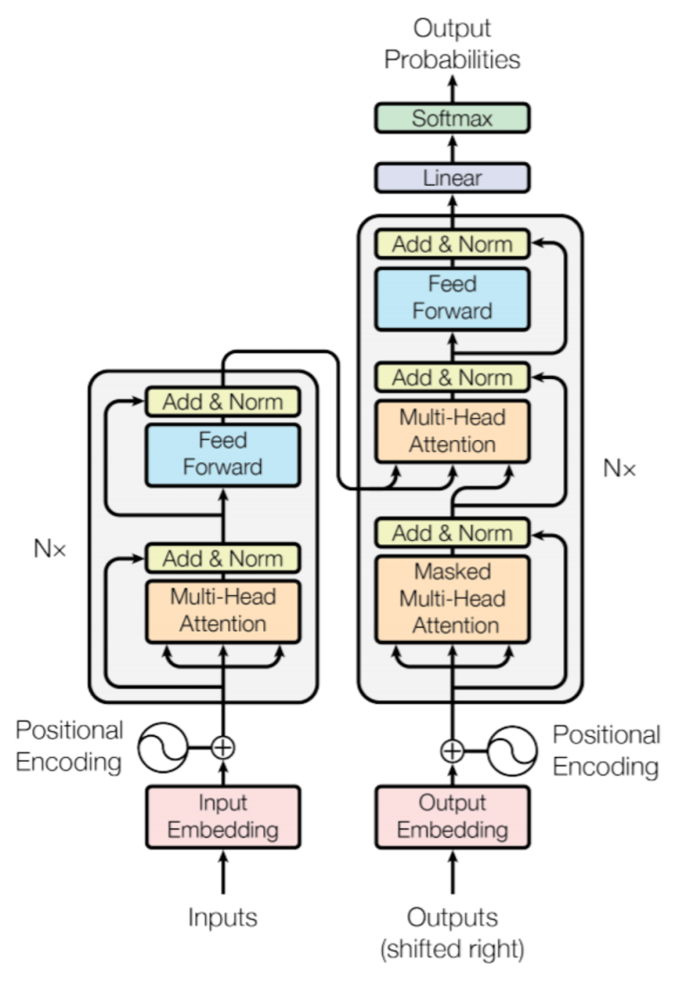
Pop Quiz
2) Novel Deep Learning Blocks in Transformer………..
a) Add & Norm
b) Multi-Head Attention
c) Feedforward
d) Positional Encoding
e) All of the above
Take notes as quizzes may not be posted in solved form.

Slide 5
Pop Quiz
3) In the self-attention computation………..
a) Each vector in the sequence is mapped into query, key and value
b) The output is a sequence of context vectors where each vector is a weighted combination of keys (and corresponds to original sequence)
c) The output is a sequence of context vectors where each vector is a weighted combination of values (and corresponds to original sequence)
e) All of the above
Take notes as quizzes may not be posted in solved form.

Slide 6
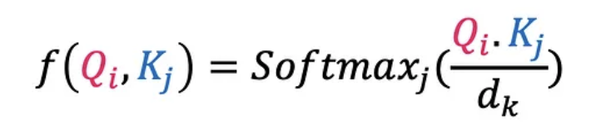
Pop Quiz
4) In the output context vectors from self-attention………..
a) The weights are decided based on a dot product between query and all keys
b) The weights sum to 1 due to Softmax
c) The dot product is normalized in the Softmax to avoid gradient issues
e) All of the above
Take notes as quizzes may not be posted in solved form.

Slide 7
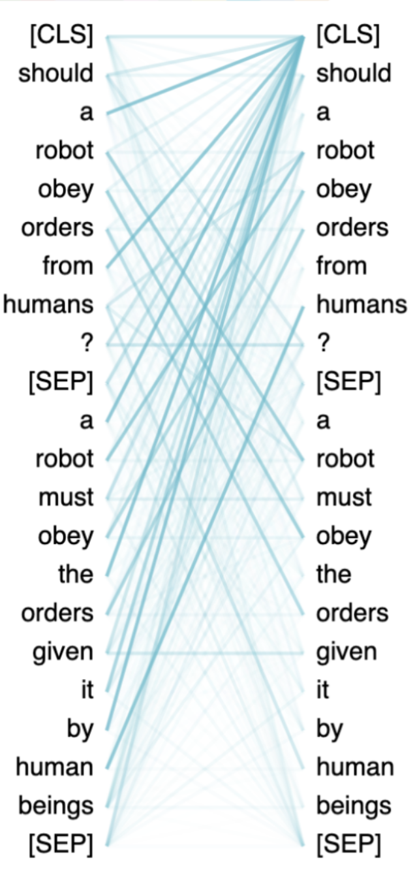
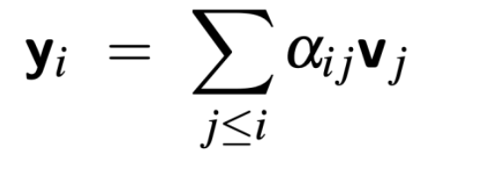
Pop Quiz
5) To make attention unidirectional………..
For a given query with index (i) set all attention scores for keys (j)>(i) to zero
b) For a given query with index (i) set all attention scores for keys (j)<(i) to zero
c) Use Masked Self Attention
e) None of the above
Take notes as quizzes may not be posted in solved form.

Slide 8
Pop Quiz
6) Purpose of layer normalization………..
a) Accelerate and improve training of the network
b) Bring inputs to a standard normal space
c) Bring inputs to 0 –1 range
d) None of the above
Take notes as quizzes may not be posted in solved form.

Slide 9
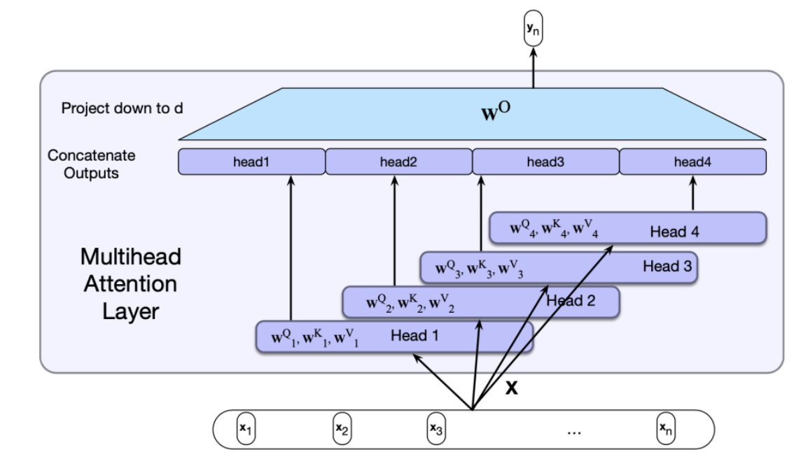
Pop Quiz
7) Purpose of different heads in multi-head attention………..
a) Be able to minimize multiple loss functions
b) Be able to process multiple inputs
c) Learn different relations or features among words
d) None of the above
Take notes as quizzes may not be posted in solved form.

Slide 10
Pop Quiz
7) Purpose of positional encoding in transformers………..
a) Reordering the input sequence reorders the attention outputs only
b) To increase the present position information
c) Learn different relations or features among words
d) None of the above
Take notes as quizzes may not be posted in solved form.

Slide 11
Lect. Quiz
Reminder in tutorials we recap on lecture via pop quiz, learn technologies discuss hard problems in assignments, demonstrate practical aspects of content learnt in lecture

Slide 12
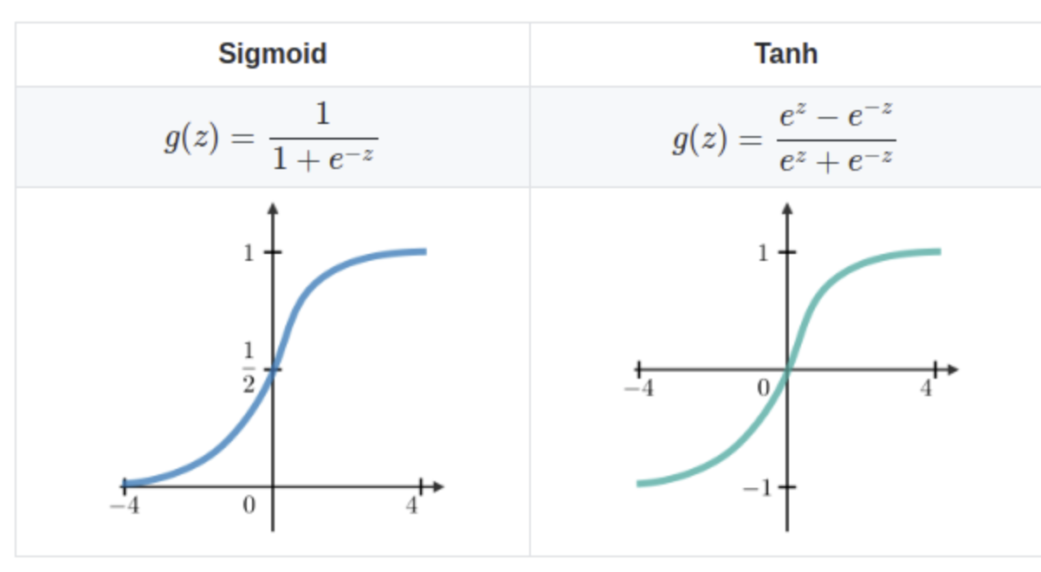
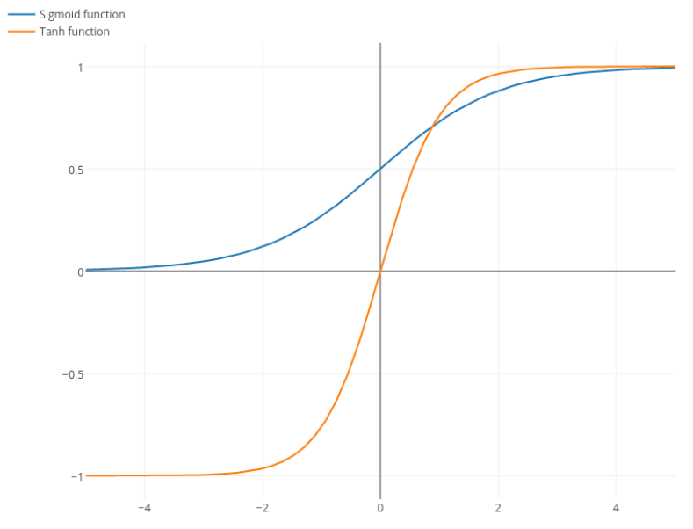
Lecture Quiz
Andrew Ng says that using the logistic function (commonly know as sigmoid) really only makes sense in the final layer of a binary classification network. Others add that averaging at zero is helpful.

Slide 13
Lecture Quiz
Rederive for truncated backpropagation through time:

Slide 14
AssignmentDiscussion
Reminder in tutorials we recap on lecture via pop quiz, learn technologies discuss hard problems in assignments, demonstrate practical aspects of content learnt in lecture

Slide 15
Assignment Discussion

Slide 16
Assignment Discussion

Slide 17
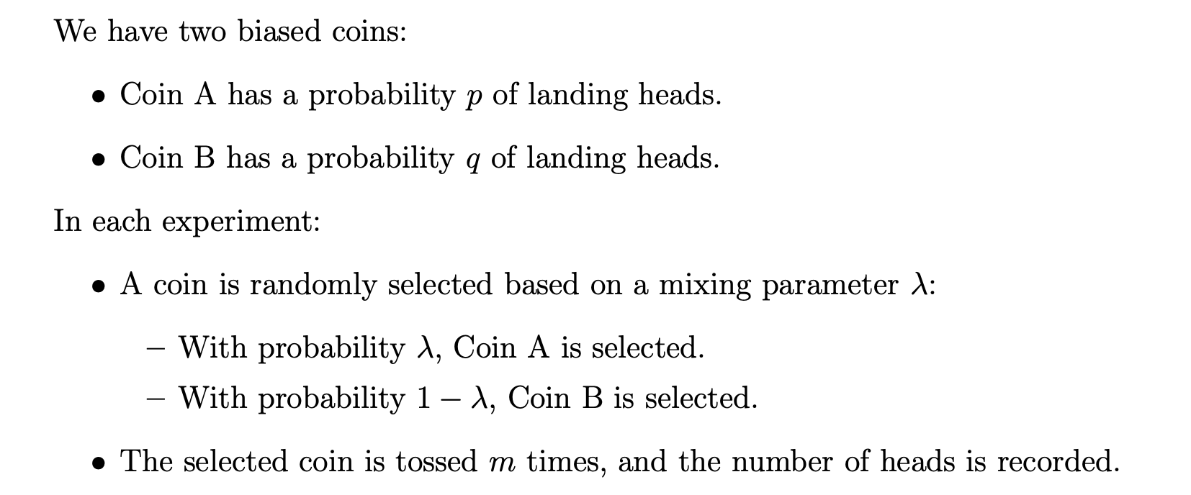
Assignment Discussion
Example Output:
(HTHTHHHHHH), (TTHTHTHTHT), (HHHHTHTHHH), …

Slide 18
Assignment Discussion
Let $x_{i}$ be the number of heads in the experiment.
Expectation:
Can simplify:
$$γ_{i}=P\left(x_{i} | Coin A\right)$$
$${1−γ}_{i}=P\left(x_{i} | Coin B\right)$$
All of these are parameters we observe every experiment,

Slide 19
Assignment Discussion
Let $x_{i}$ be the number of heads in the experiment.
Expectation:
Can simplify:
$$γ_{i}=P\left(x_{i} | Coin A\right)$$
$${1−γ}_{i}=P\left(x_{i} | Coin B\right)$$
All of these are parameters we observe every experiment,

Slide 20
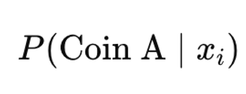
Assignment Discussion
Maximization:
Based on our expectation per experiment, we need to update the parameters (we have three of them):
The probability of using the first coin in general is the average probability of seeing it across all experiments.
For instance, if two experiments and in the first one we see it with probability 0 and in the next one we see it with probability 1 then overall with probability 0.5
For the other two parameters:

Slide 21
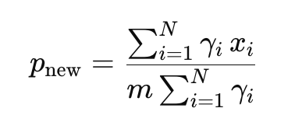
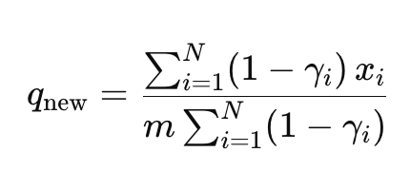
Assignment Discussion
Maximization:
For the other two parameters:
Denominator: get the total number of tosses that the coin effectively contributed to
Numerator: get the total number of heads that the coin effectively contributed to

Slide 22
Assignment Discussion

Slide 23
Thank You

