Slide 1
Natural Language Processing Tutorials
Become a natural language processing expert
Supervised by Dr. Kenny Zhu
TAs: Essam Abdelghany

Slide 2
Pop Quiz
Reminder in tutorials we recap on lecture via pop quiz, learn technologies discuss hard problems in assignments, demonstrate practical aspects of content learnt in lecture

Slide 3
Pop Quiz
1) Fundamental differences between FFNN and RNN………..
a) RNN can effectively handle an input sequence
b) It’s impossible to apply FFNN given an input sequence
c) FFNN $h=f(Wx+b)$ but RNN uses $h_{t}=f(Wx_{t}+W_{h}h_{t−1}+b)$
d) All of the above
Take notes as quizzes may not be posted in solved form.

Slide 4
Pop Quiz
2) Match the RNN configurations above to corresponding example task ………..
a) POS Tagging
b) Language modelling
c) Classify a single word as positive or negative
d) Sentiment analysis of a given sentence
e) Translation
Take notes as quizzes may not be posted in solved form.

Slide 5
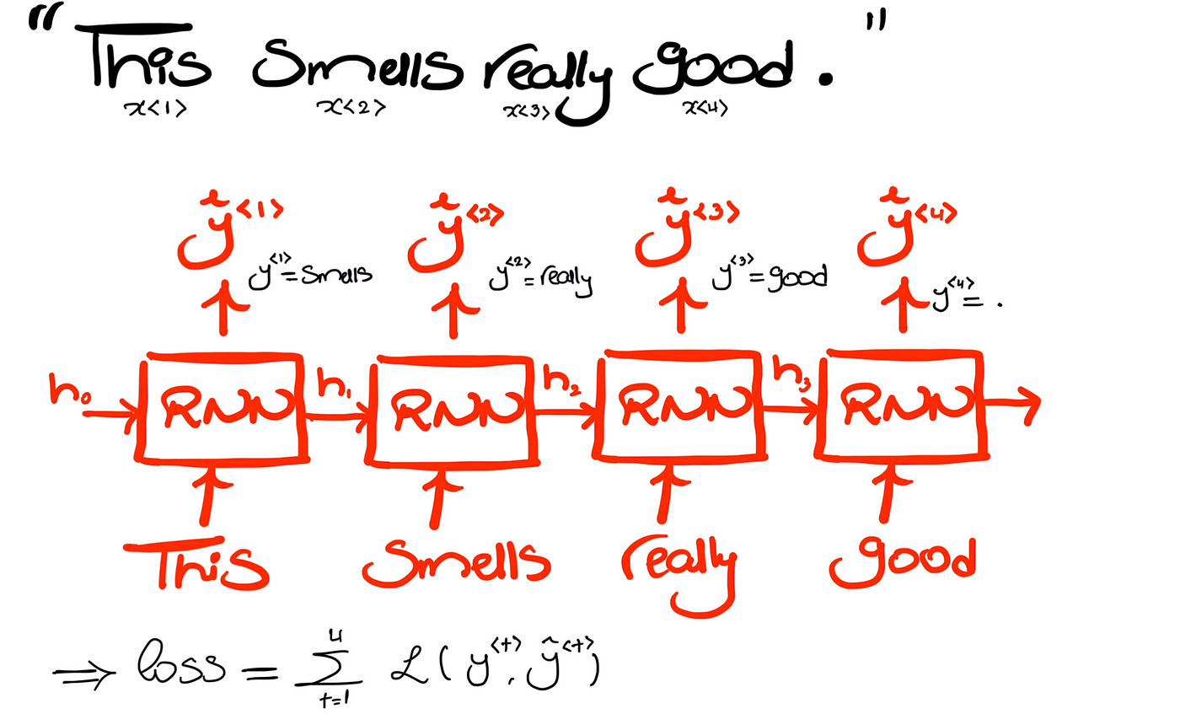
Pop Quiz
Language modelling RNNs

Slide 6
Pop Quiz
3) In language modelling with RNNs………..
a) Classification where the number of classes is equal to the size of the vocabulary
b) At any iteration we get $P(w_{t}|w_{t−1}, w_{t−2},…,w_{1})$ with no n-gram approximation
c) The runtime in training is proportional to the sequence length
e) All of the above
Take notes as quizzes may not be posted in solved form.

Slide 7
Pop Quiz
4) Differences between backpropagating in RNNs and FFNNs………..
a) For each timestep in RNN, it’s similar to having another hidden layer that shares weights with the previous one
b) FFNN do not typically compute loss in multiple hidden layers but RNNs compute them in multiple time steps
c) In FFNN, cross-entropy loss is often used
e) All of the above
Take notes as quizzes may not be posted in solved form.

Slide 8
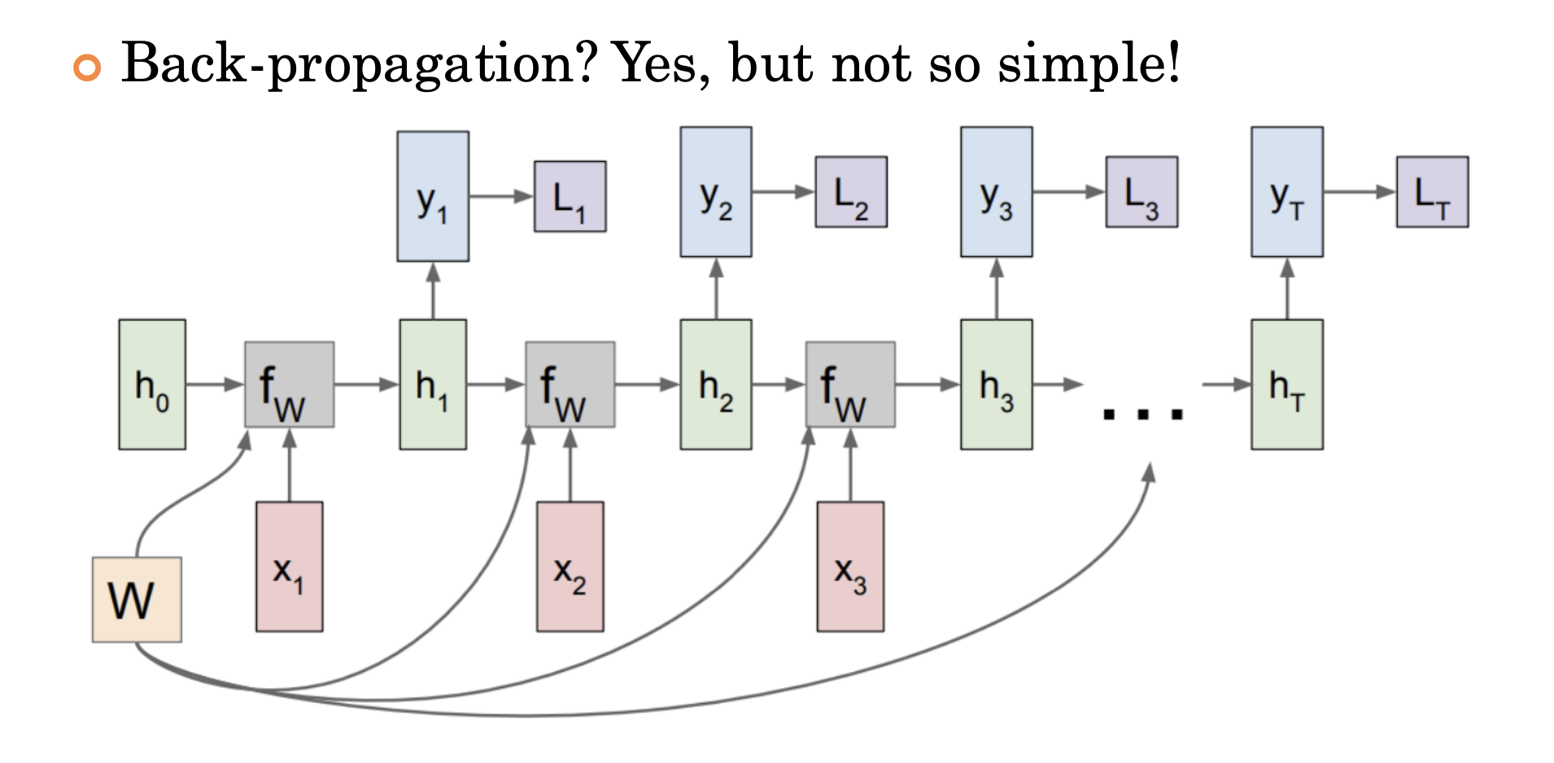
Pop Quiz
Take notes as quizzes may not be posted in solved form.

Slide 9
Pop Quiz
5) The issues with backpropagation through time………..
a) Gradients may vanish when $t$ is large
b) Gradients may explode when $t$ is large
c) Model may converge to a local minimum of the objective
e) All of the above
Take notes as quizzes may not be posted in solved form.

Slide 10
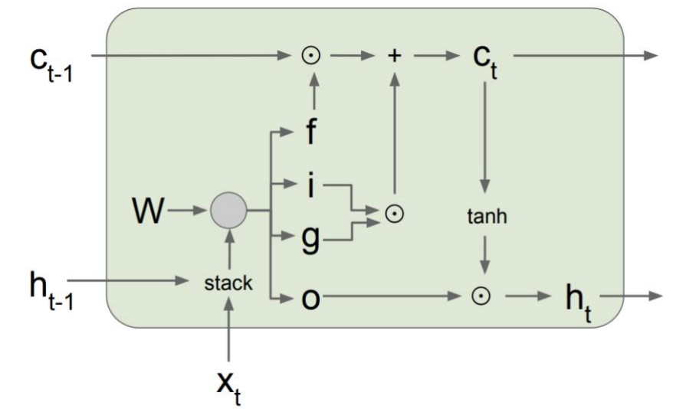
Pop Quiz
6) The gates used in an LSTM………..
a) Forget get (how much to erase)
b) Input gate (how much to write)
c) Recall gate (how much to recall)
d) Output gate (how much to reveal)
Take notes as quizzes may not be posted in solved form.

Slide 11
Lect. Quiz
Reminder in tutorials we recap on lecture via pop quiz, learn technologies discuss hard problems in assignments, demonstrate practical aspects of content learnt in lecture

Slide 12
Lecture Quiz
One Candidate Solution:
No information about $λ$ at all so keep the prior $0.5$
Ie, approximately half of the trials are by coin 1 and the other half by coin 2
Less likely for the same coin to give out HHH at times and TTT at other times rather than one of these consistenly
Thus, can assume $p_{1}=1$ and $p_{2}=0$ or vice versa

Slide 13
Lecture Quiz
Suppose the observed sequence have T elements
Suppose there are $K$ possible hidden states (for each element)
$T=1$ then $K$ possible $Y$s
$T=2$ then $K^{2}$ possible $Y$s…
$T=3$ then $K^{3}$ possible $Y$s…
For a sequence of length $T$ we have $K^{T}$ possible $Y$s

Slide 14
AssignmentDiscussion
Reminder in tutorials we recap on lecture via pop quiz, learn technologies discuss hard problems in assignments, demonstrate practical aspects of content learnt in lecture

Slide 15
Assignment Discussion
Hidden States: NN (Noun) VB (Verb) JJ (Adjective) RB (Adverb)
Observations: [cats, jump, high, apples, grow, red, run, quickly, dogs]
Number of Parameters: 4x4+4+4x9

Slide 16
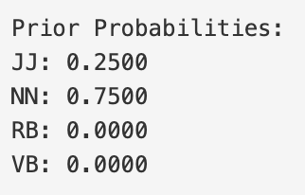
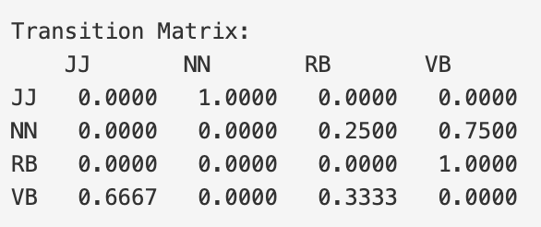
Assignment Discussion
3 of the NN transitions are NN → VB: "cats → jump", "apples → grow", "cats → run"
At the start one times
At the start three times
We have 3 total transitions starting from VB 2 of these are VB → JJ: "jump → high", "grow → red"

Slide 17
Assignment Discussion
3 total occurrences of JJ in the training data "red" appears with JJ tag twice: once in "grow red" and once in "red dogs"
We have 4 total occurrences of NN in the training data "cats" appears with NN tag twice: "cats jump" and "cats run"

Slide 18
Assignment Discussion
Initially employ priors and emissions:
CATS
Quickly
Jump
0.25*0
0
0
JJ
JJ
JJ
0.75*0.5
0
0
NN
NN
NN
0*0
1
0
RB
RB
RB
0*0
0
0.25
VB
VB
VB

Slide 19
Assignment Discussion
Then at each cell in the next column, take the maximum Viterbi value multiplied by transition:
CATS
Quickly
Jump
0.25*0
0
0
JJ
JJ
JJ
P(RB|JJ)=0
0.75*0.5
0
0
NN
NN
NN
P(RB|NN)=0.25
0*0
P(RB|RB)
0.75*0.5*0.25
0
RB
RB
RB
P(RB|VB)
0*0
0
0.25
VB
VB
VB
Same at all other nodes…

Slide 20
Assignment Discussion
Boom; it got to be NN, RB, VB:
CATS
Quickly
Jump
0.75*0.5
NN
1
RB
0.25
VB
VB
VB

Slide 21
Assignment Quiz

Slide 22
Assignment Quiz

Slide 23
Thank You

