Slide 1
Programming Language Concepts Tutorials
Become a Programming Languages Designer
Supervised by Dr. Kenny Zhu
TAs: Essam Abdelghany

Slide 2
Pop Quiz
Reminder in tutorials we recap on lecture, discuss assignments, discuss project or programming and solve practice problems.

Slide 3
Pop Quiz
1) The evaluation of (try $\left(λx :bool.x\right) error$ with fls) fls tru……….
Yields tru
Yields fls
Yields error
Yields x

Slide 4
Pop Quiz
2) The evaluation of try $\left(λa:int,b:int. if b==0 then raise DIV_ZERO else a/b\right) 2 0$ with e………
DIV_ZERO
e DIV_ZERO
$∞$
$2∞$

Slide 5
Pop Quiz
3) Possible choices for t_exn………
Natural number as in C
String (can be more efficient)
Extensible variant type (as in ML)
All of the above

Slide 6
Pop Quiz
4) The memory store M from last lecture………
Involves call stack, static area and heap
Involves call stack and heap
Involves heap only
Involves data segment
How about call stack only?

Slide 7
Pop Quiz
5) Garbage occurs when………
An allocated block of heap has no value (undefined)
An allocated block of heap is allocated but has no reference
A block of memory is no longer allocated but still has a reference
A block of memory is allocated and has a reference
Duality…

Slide 8
Pop Quiz
6) Problems due to widow memory words include………
Potential crash or undefined behavior for the program upon access
Cycle memory words will remain allocated
Lost memory because address takes space
Not possible to form sentences with insufficient words

Slide 9
Pop Quiz
7) Which of the following are criteria for the perfect garbage collector………
Must collect garbage at a specific frequency
Must have excellent spatial locality of reference
Incremental to meet real-time constraints
Handles data structures comprehensively

Slide 10
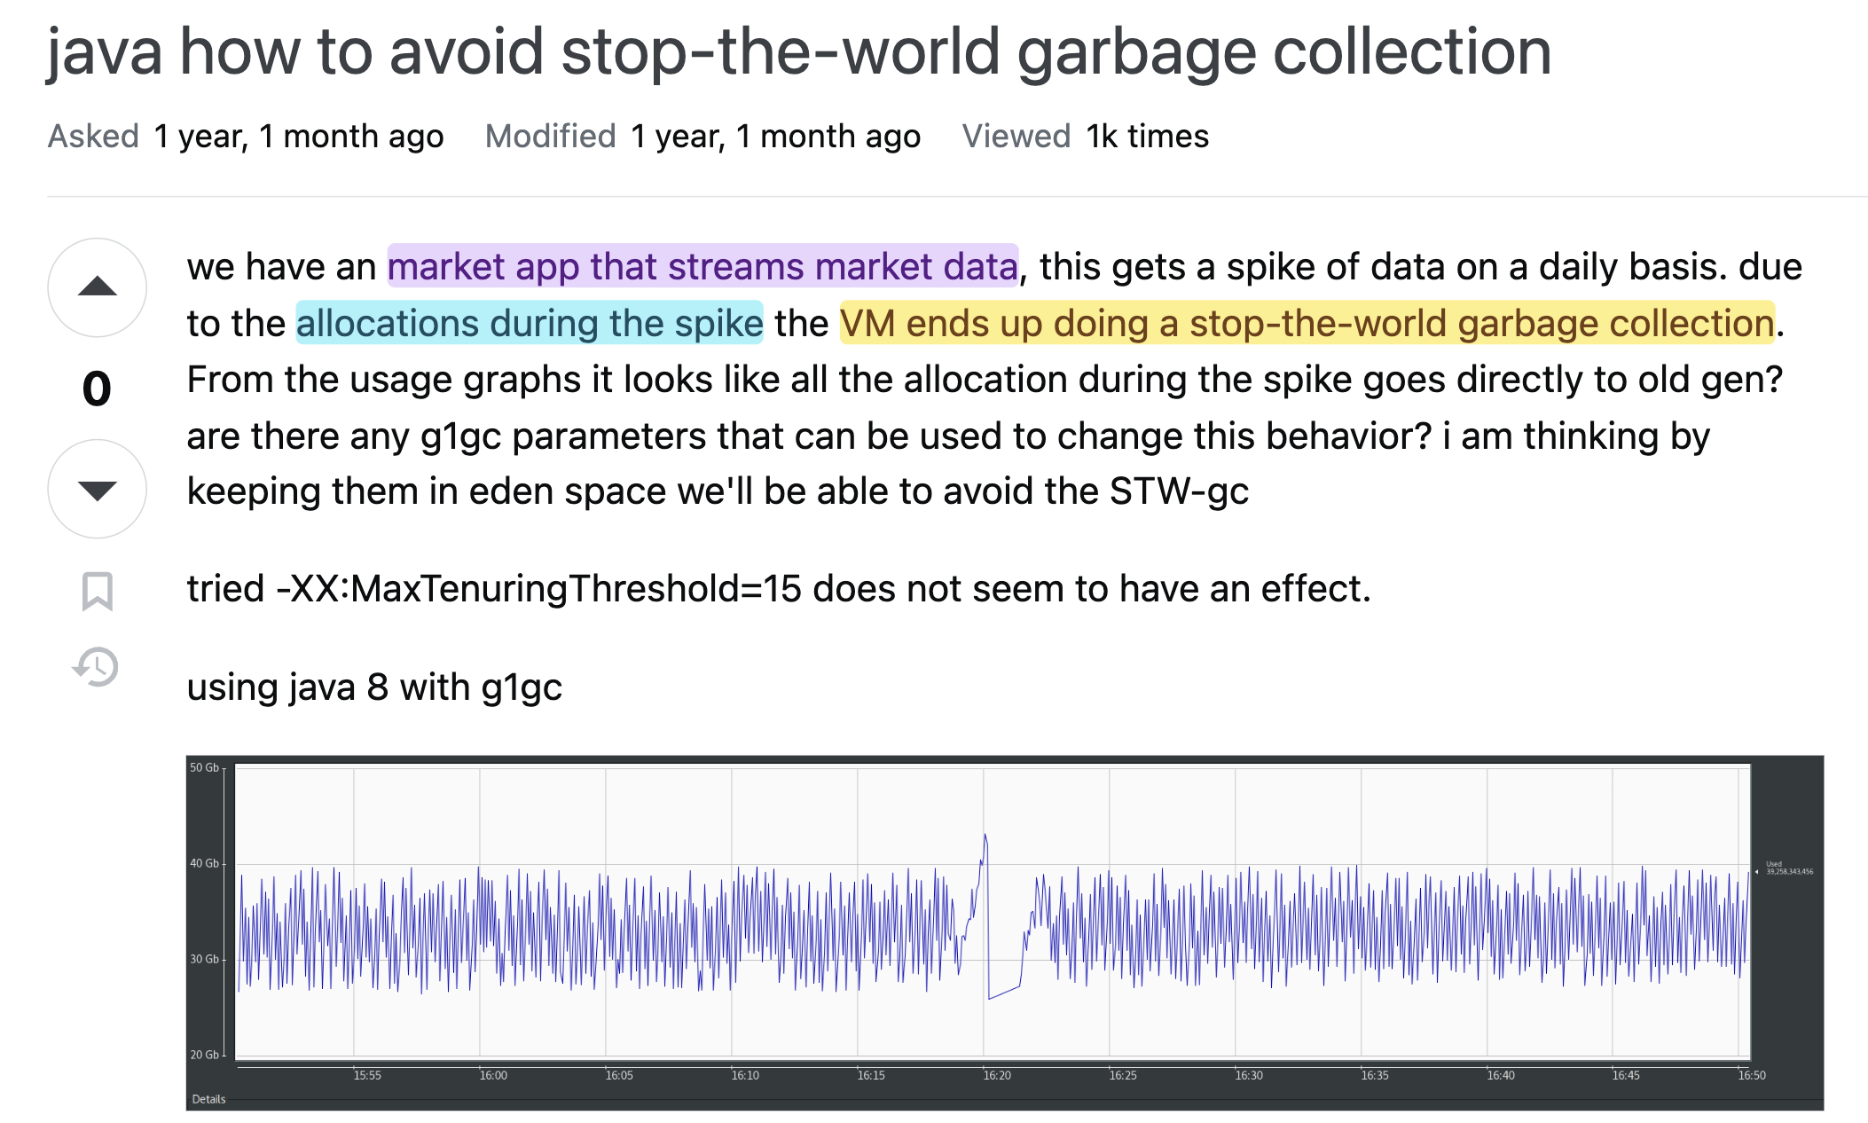
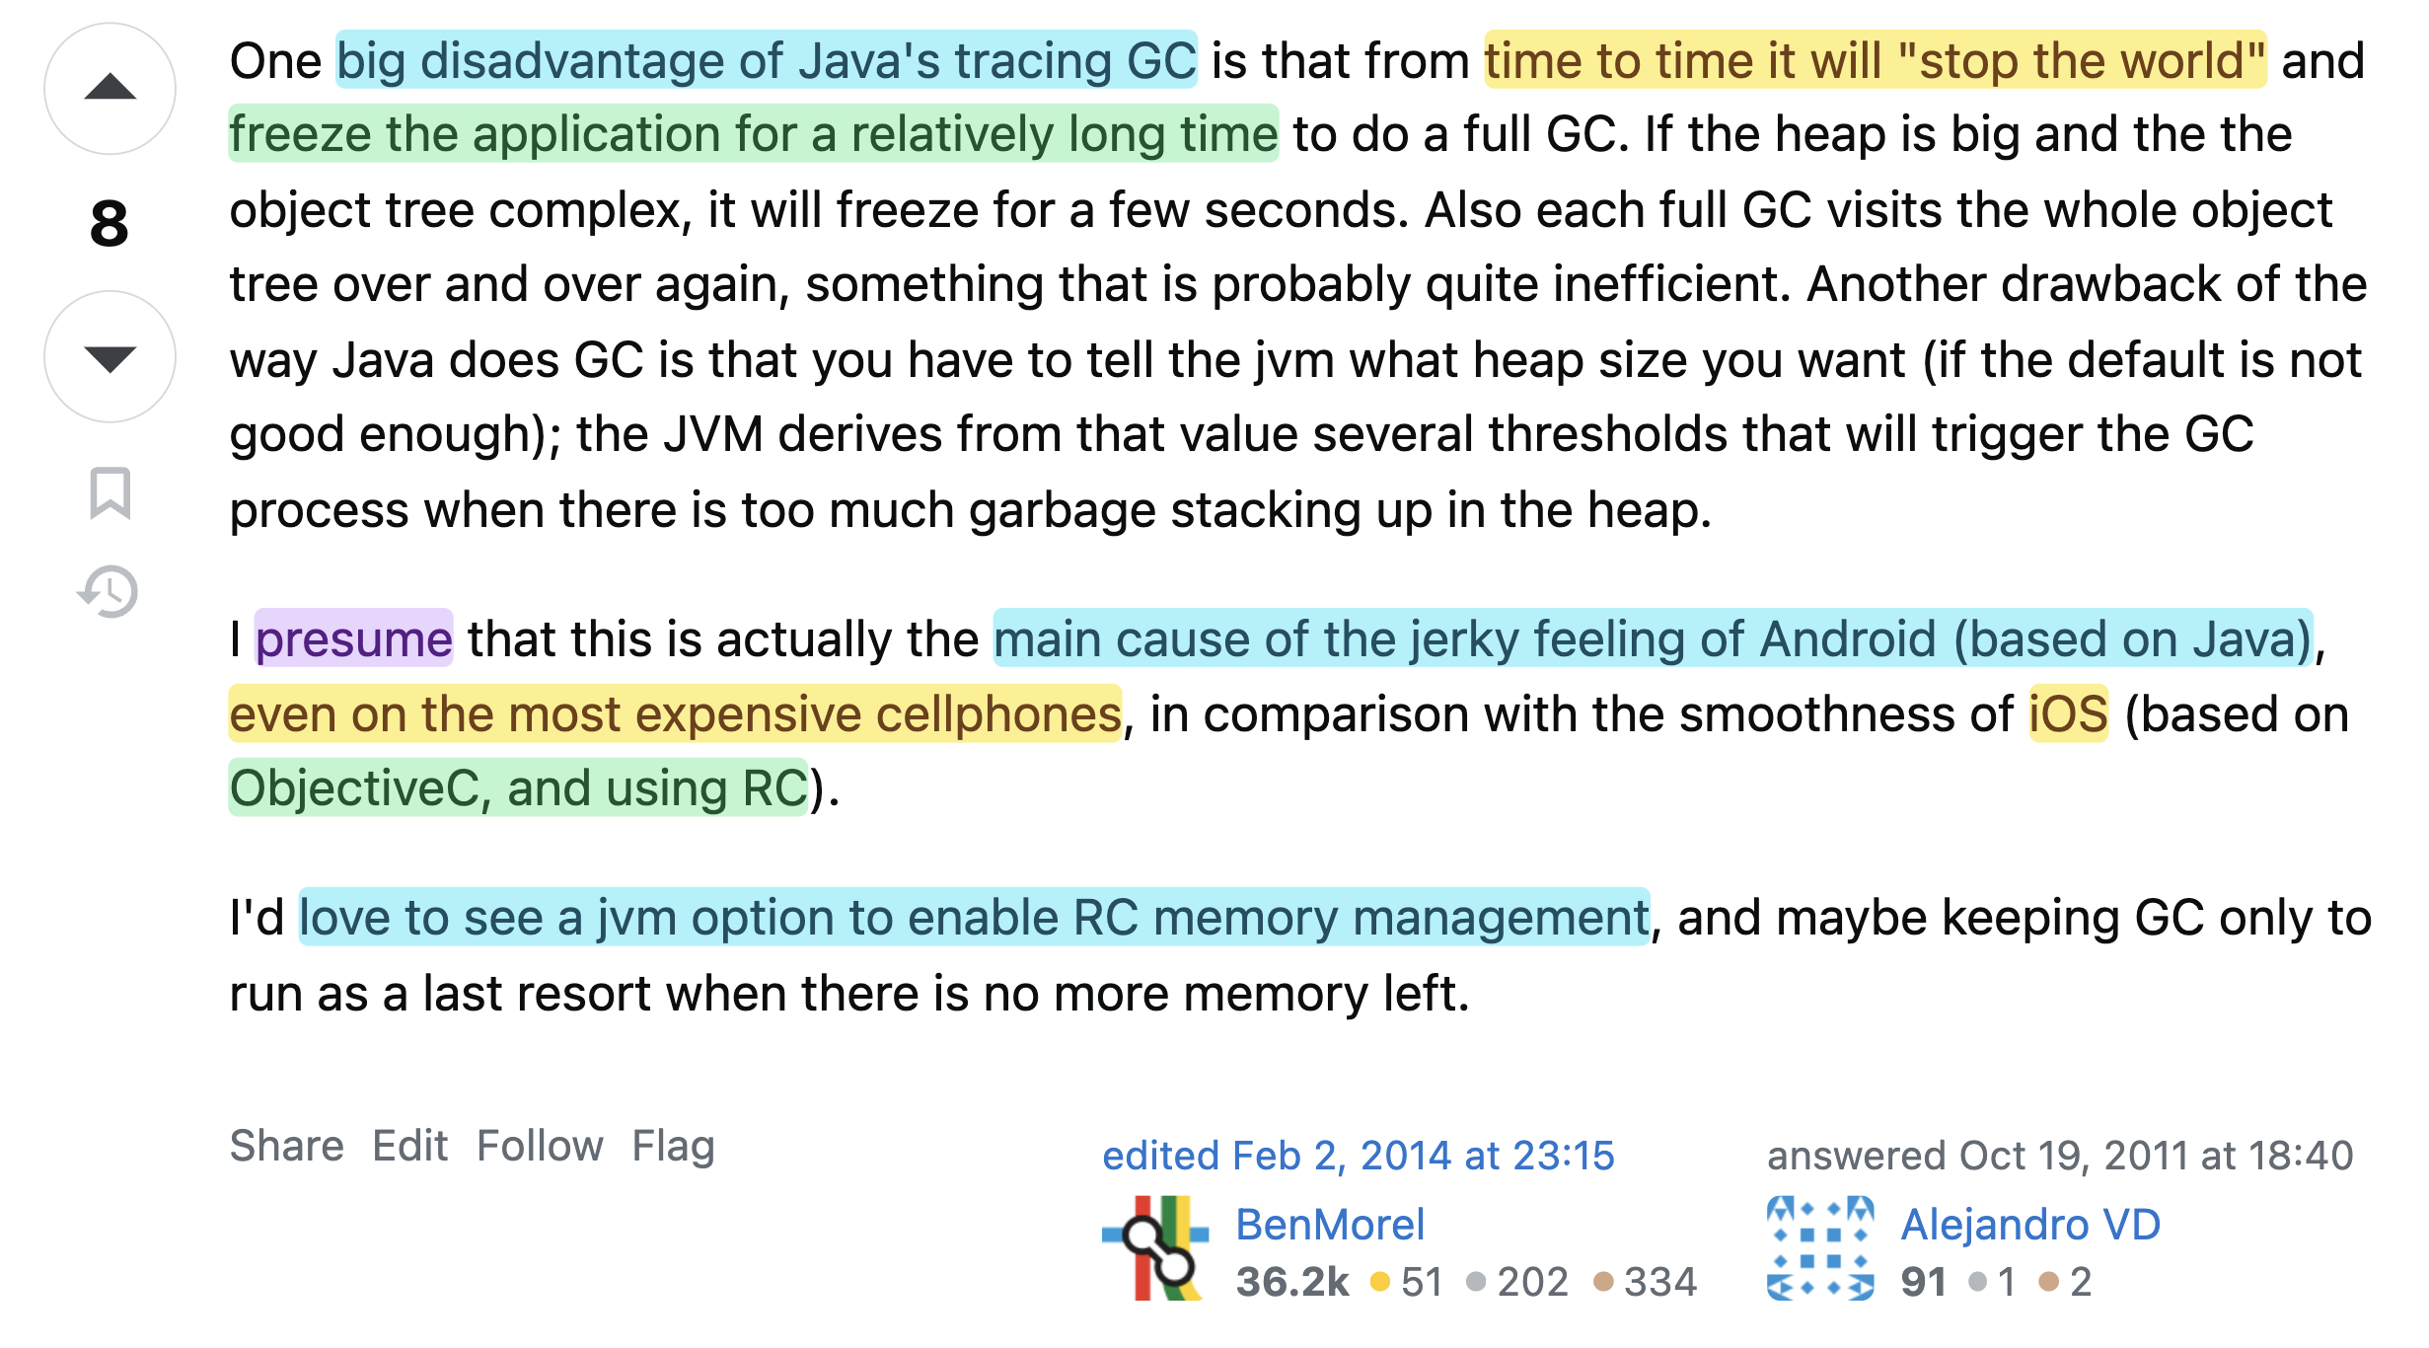
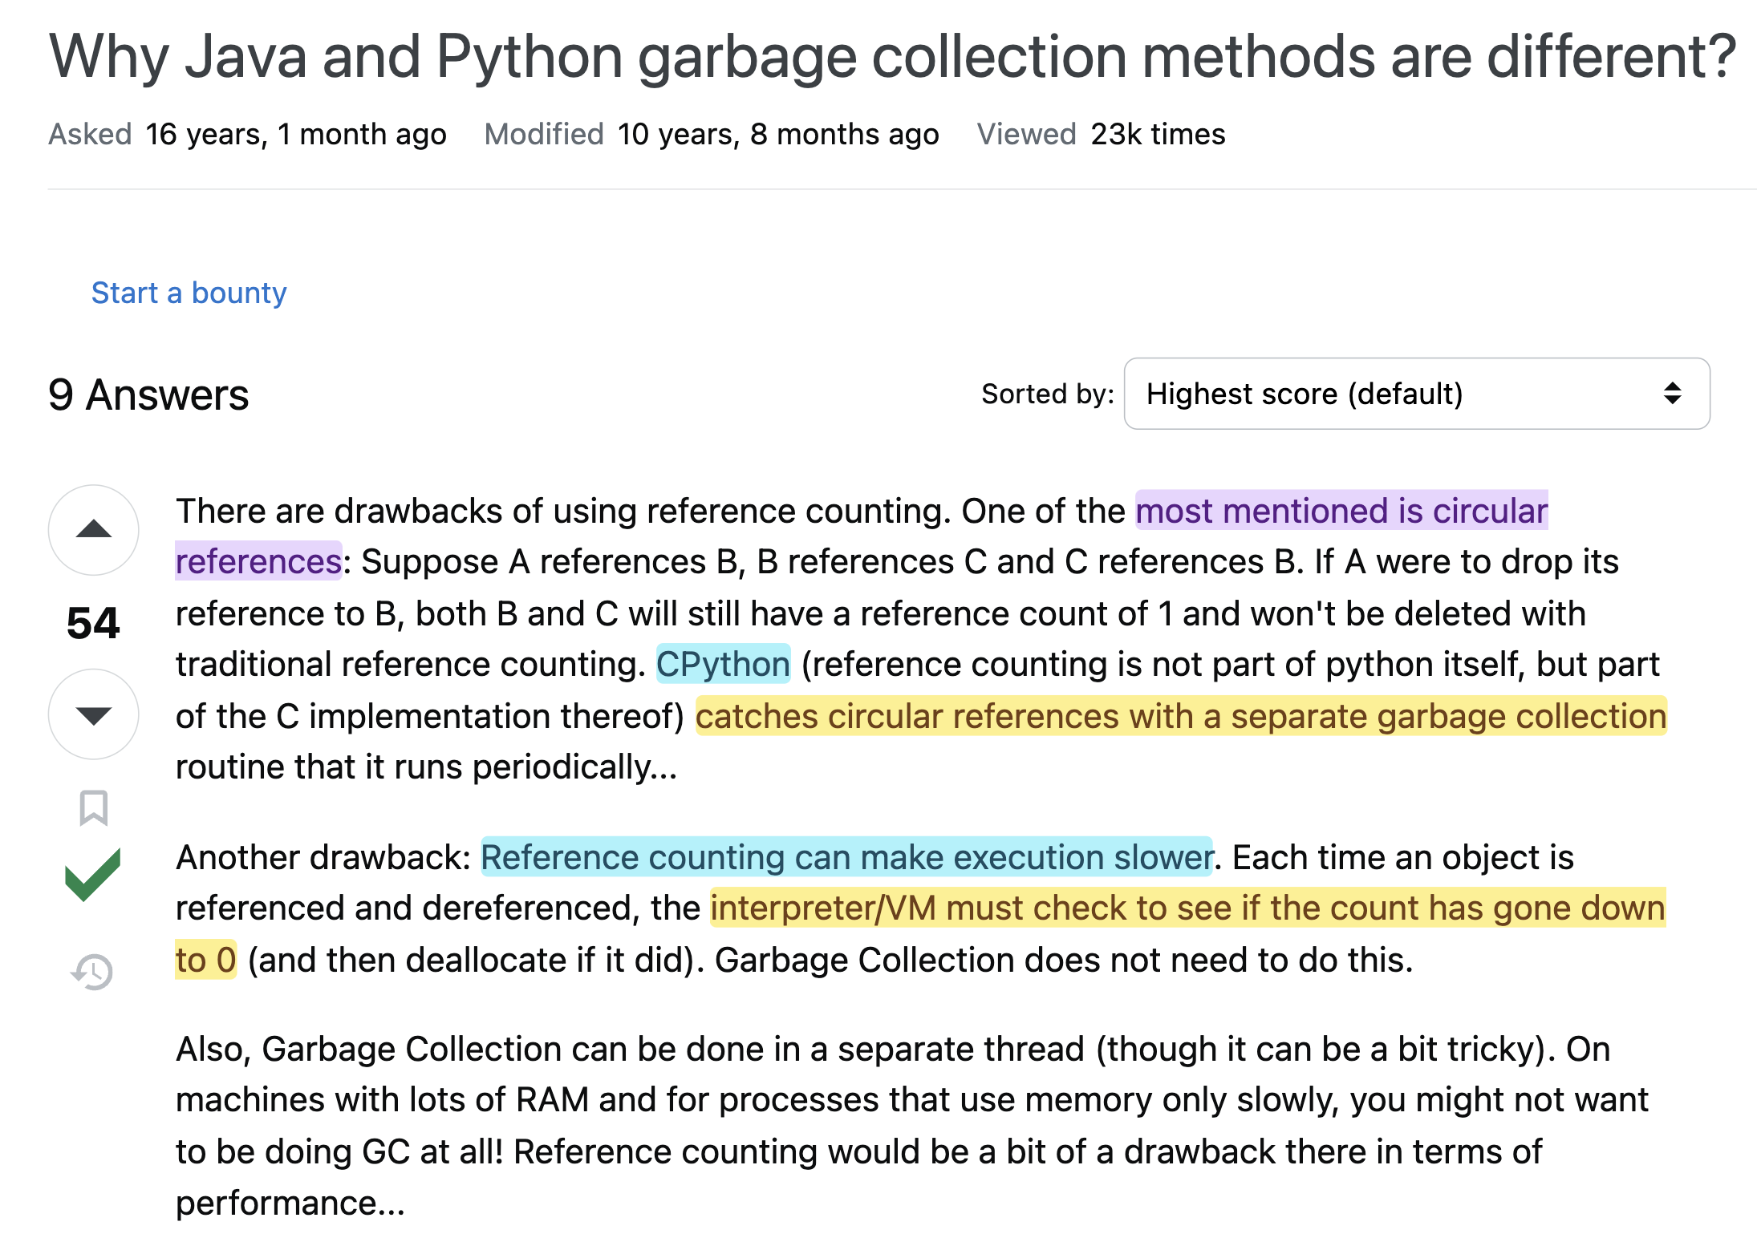
GC Talk

Slide 11
Assignment Solution

Slide 12
Assignment Solution
Well-typedness | an expression $e$ is well-typed, if there exists some type $t$, such that $e:t$
Progress | If $e$ well-typed then it is either a value $v$ or can take an evaluation step $e→e^{′}$
Preservation | If a well-typed expression (with $type t$) takes a step of evaluation, then the resulting expression is also well typed with $type t$

Slide 13
Assignment Solution
Well-typedness | an expression $e$ is well-typed, if there exists some type $t$, such that $e:t$
Progress | If $e$ well-typed then it is either a value $v$ or can take an evaluation step $e→e^{′}$
Preservation | If a well-typed expression (with $type t$) takes a step of evaluation, then the resulting expression is also well typed with $type t$
Given expression: $\left(λx :bool.x\right) error$
Well-typed:
$$Γ├ \left(λx:bool.x\right):bool→bool \\ Γ├ error:t (unspecified;wild card so bool matches)$$

Slide 14
Assignment Solution
Well-typedness | an expression $e$ is well-typed, if there exists some type $t$, such that $e:t$
Progress | If $e$ well-typed then it is either a value $v$ or can take an evaluation step $e→e^{′}$
Preservation | If a well-typed expression (with $type t$) takes a step of evaluation, then the resulting expression is also well typed with $type t$
Given expression: $\left(λx :bool.x\right) error$
Well-typed:
$$Γ├ \left(λx:bool.x\right):bool→bool \\ Γ├ error:bool$$
$Γ├ \left(λx :bool.x\right) error:bool$ (by typing rule)
QED.

Slide 15
Assignment Solution
Well-typedness | an expression $e$ is well-typed, if there exists some type $t$, such that $e:t$
Progress | If $e$ well-typed then it is either a value $v$ or can take an evaluation step $e→e^{′}$
Preservation | If a well-typed expression (with $type t$) takes a step of evaluation, then the resulting expression is also well typed with $type t$
Given expression: $\left(λx :bool.x\right) error$
Progress:
Yes, it can take an evaluation step $e→e^{′}$. In particular, we get:
$$error$$
QED.

Slide 16
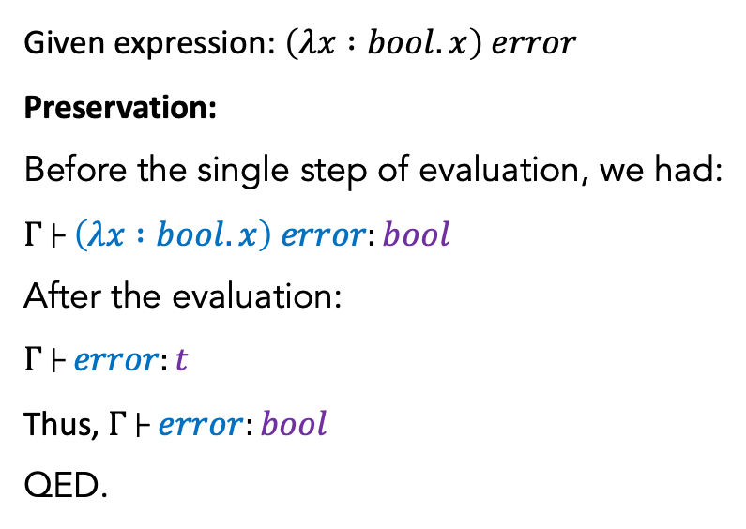
Assignment Solution
Well-typedness | an expression $e$ is well-typed, if there exists some type $t$, such that $e:t$
Progress | If $e$ well-typed then it is either a value $v$ or can take an evaluation step $e→e^{′}$
Preservation | If a well-typed expression (with $type t$) takes a step of evaluation, then the resulting expression is also well typed with $type t$
Given expression: $\left(λx :bool.x\right) error$
Preservation:
Before the single step of evaluation, we had:
$$Γ├ \left(λx :bool.x\right) error:bool$$
After the evaluation: $$Γ├ error:t$$
Thus, $Γ├ error:bool$
QED.

Slide 17
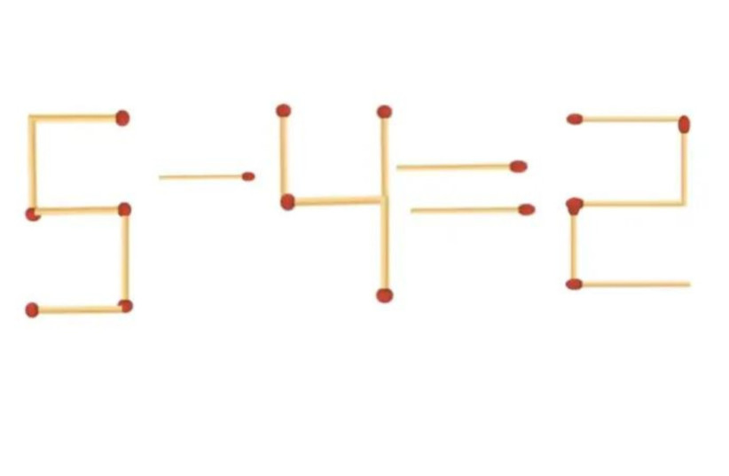
Assignment Solution
Move two matches only to
Make it correct.

Slide 18
Assignment Solution
$$e::=…∣do e_{2}​ while e_{1}$$
$$\frac{ }{\left(M,do e_{2} ​while e_{1}​\right)→\left(M,e_{2}​;if e_{1}​ then \left(do e_{2} ​while e_{1}​\right) else\left( \right)\right)}(E−DoWhile)$$
$$\frac{Σ;Γ├{ e}_{2}:unit Σ;Γ├ e_{1}:bool}{Σ;Γ├ do e_{2}​ while e_{1}:unit}$$

Slide 19
Assignment Solution
$$e::=…∣do e_{2}​ while e_{1}$$
$$\frac{ }{\left(M,do e_{2} ​while e_{1}​\right)→\left(M,e_{2}​;if e_{1}​ then \left(do e_{2} ​while e_{1}​\right) else\left( \right)\right)}(E−DoWhile)$$
$$\frac{Σ;Γ├{ e}_{2}:unit Σ;Γ├ e_{1}:bool}{Σ;Γ├ do e_{2}​ while e_{1}:unit}$$
Obvious!
Do this first anyway!
If $e_{1}$ then repeat

Slide 20
Assignment Solution
$$\frac{ }{\left(M,do e_{2} ​while e_{1}​\right)→\left(M,e_{2}​;if e_{1}​ then \left(do e_{2} ​while e_{1}​\right) else\left( \right)\right)}(E−DoWhile)$$
$$x= ref 0 in \\ do \left(x :=!x + 1\right) while \left(!x < 3\right)$$
$x≔!x+1; \left(do x≔!x+1 while \left(!x < 3\right)​\right)$ $M=[l_{x}↦1]$
$x≔!x+1; x≔!x+1;\left(do x≔!x+1 while \left(!x < 3\right)​\right)$ $M=[l_{x}↦2]$
$$x≔!x+1;x≔!x+1; x≔!x+1;() M=[l_{x}↦3]$$

Slide 21
Assignment Solution
Memory | Expression
. | $$let x = ref 5 in let y = ref (! x ∗ 2) in x := (! x ) − 2; y := (! y ) + (! x ) ; ! y$$
$$(l_{x}↦5)$$ | $$let x =l in let y = ref (!x∗ 2) in x := (! x ) − 2; y := (! y ) + (! x ) ; ! y$$
$$(l_{x}↦5)$$ | $$let y = ref (!l_{x}∗ 2) in l_{x}:= (!l_{x}) − 2; y := (! y ) + (!l_{x} ) ; ! y$$
$$(l_{x}↦5, l_{y}↦10)$$ | $$let y =l_{y} in l_{x}:= (!l_{x}) − 2; y := (! y ) + (!l_{x} ) ; ! y$$
$$(l_{x}↦5, l_{y}↦10)$$ | $$l_{x}:= (!l_{x}) − 2;l_{y} := (!l_{y} ) + (!l_{x} ) ; !l_{y}$$
$$(l_{x}↦3, l_{y}↦10)$$ | $$\left( \right);l_{y} := \left(!l_{y} \right)+ \left(!l_{x} \right); !l_{y}→l_{y} := \left(!l_{y} \right)+ \left(!l_{x} \right); !l_{y}$$
$$(l_{x}↦3, l_{y}↦13)$$ | $$\left( \right); !l_{y}→!l_{y}→13$$
Memory leak until program ends…

Slide 22
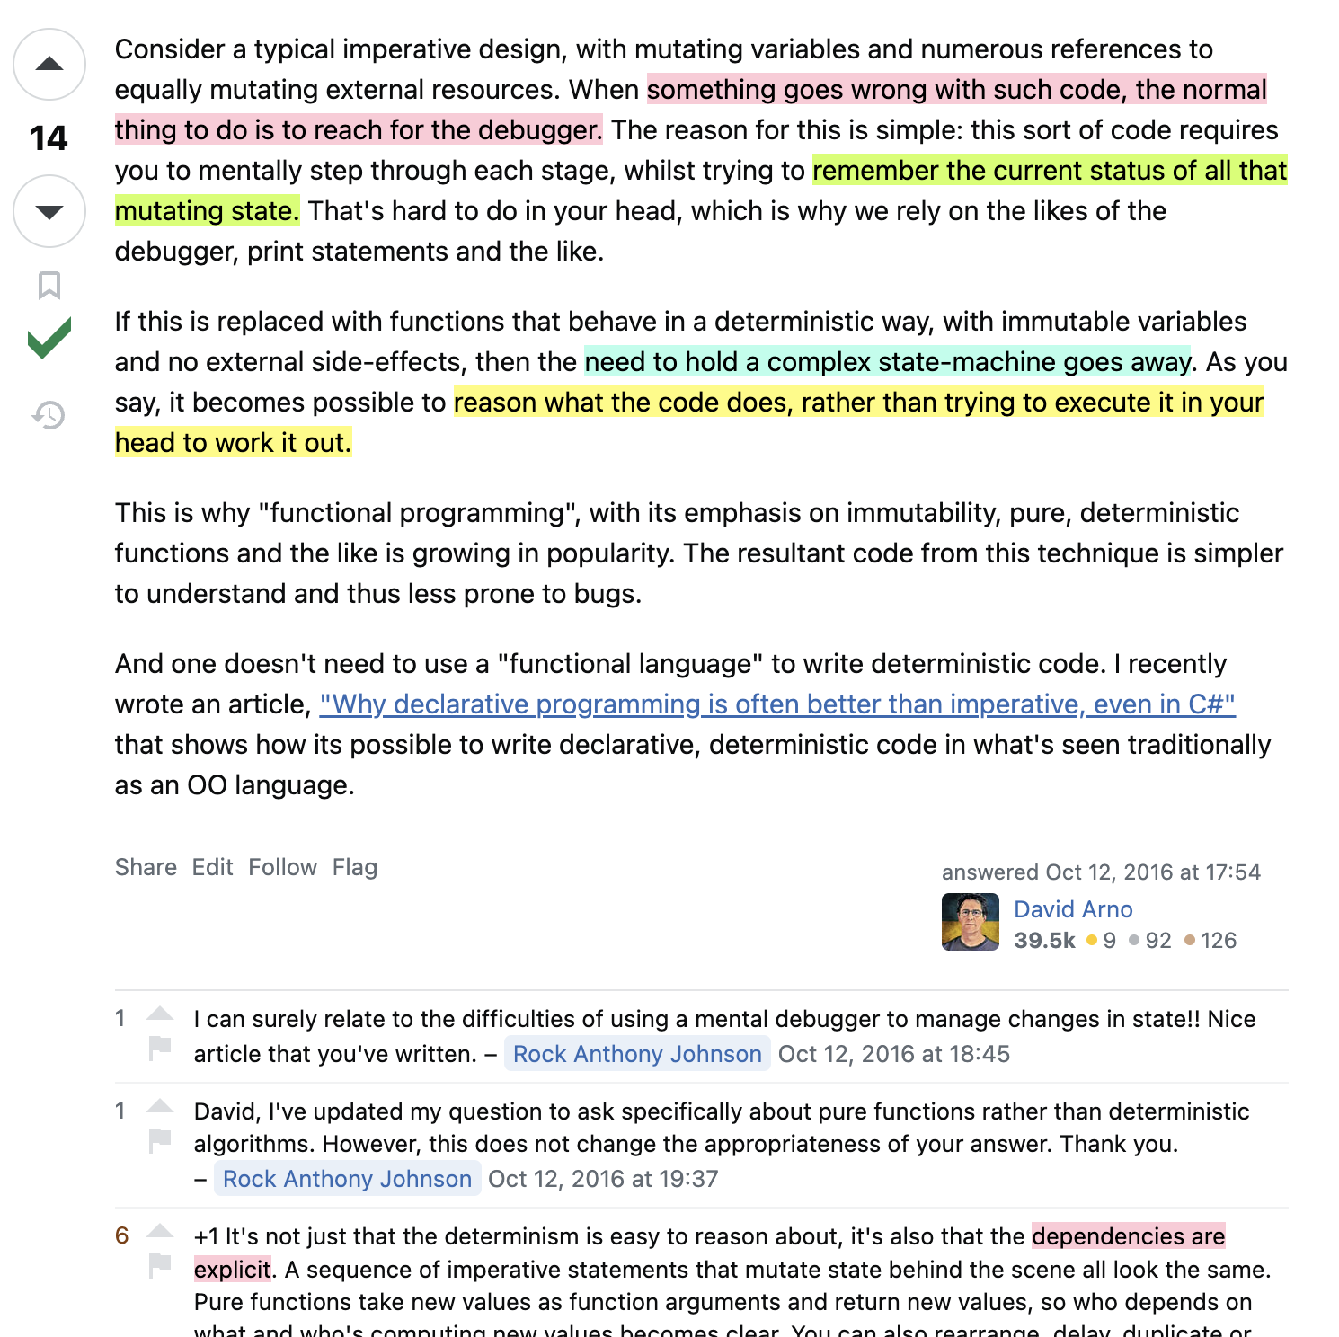
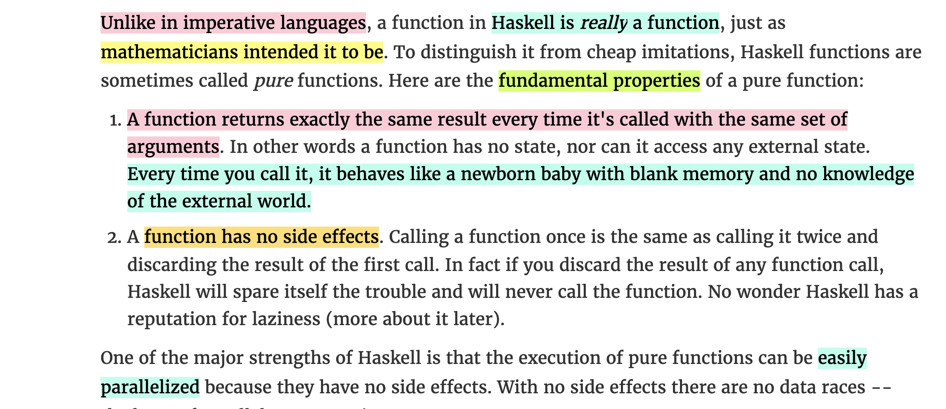
Assignment Solution
Sources: School of Haskell and StackExchange

Slide 23
Thank You

