Slide 1
Programming Language Concepts Tutorials
Become a Programming Languages Designer
Supervised by Dr. Kenny Zhu
TAs: Essam Abdelghany

Slide 2
Project Intro
Building the SimPL Programming Language

Slide 3
Building SimPL
Multi-paradigm programming language (functional and imperative)
A dialect of the ML programming language
Has support for variable declaration and control structures (branching, looping, recursion) and advanced data structures
Supports common binary and unary operations
Supports type inference

Slide 4
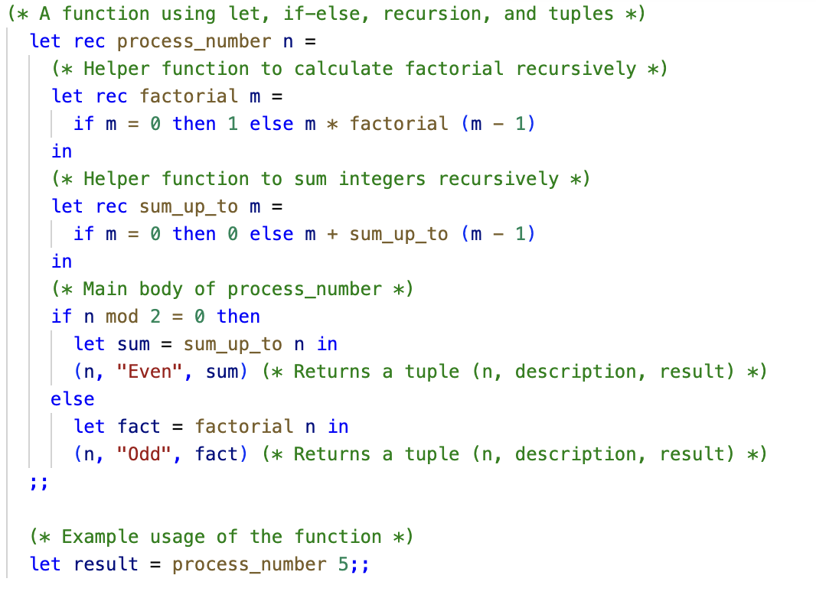
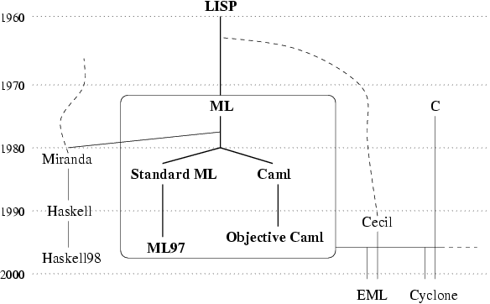
ML Background
From Washington.edu course page
1973: ML invented towards research in automated theorem provers. Eventually, they found it was more useful as programming language.
Example ML code. You will build a simpler version of ML called SimPL.

Slide 5
SimPL Examples

Slide 6
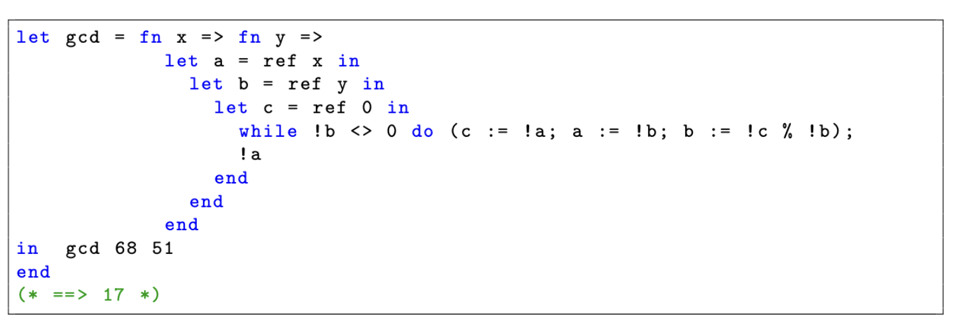
SimPL Examples

Slide 7
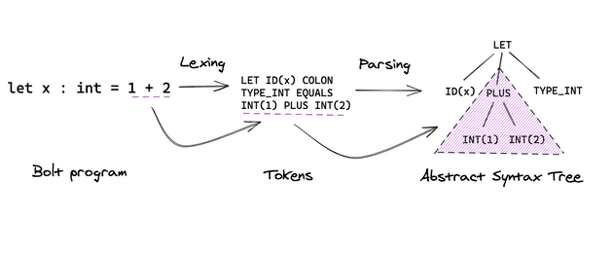
Compilers Background
Compiler uses to
generates code in
target language
Interpreter typically
execute code with
target language
From mukulrathi.com blog
Lexer and parser implement for us for free!
What to do with AST nodes?

Slide 8
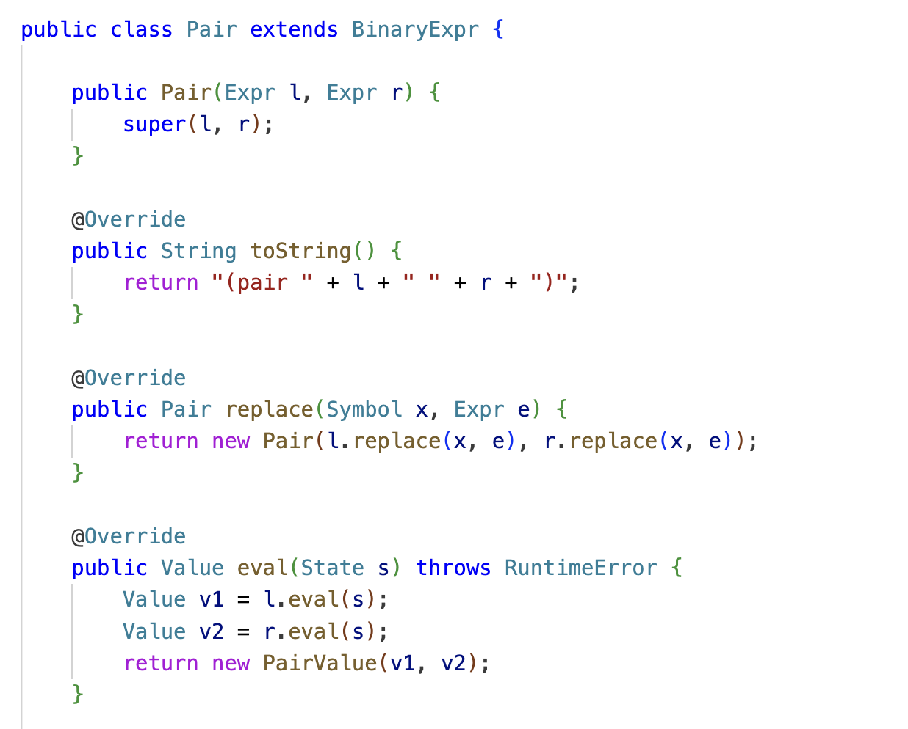
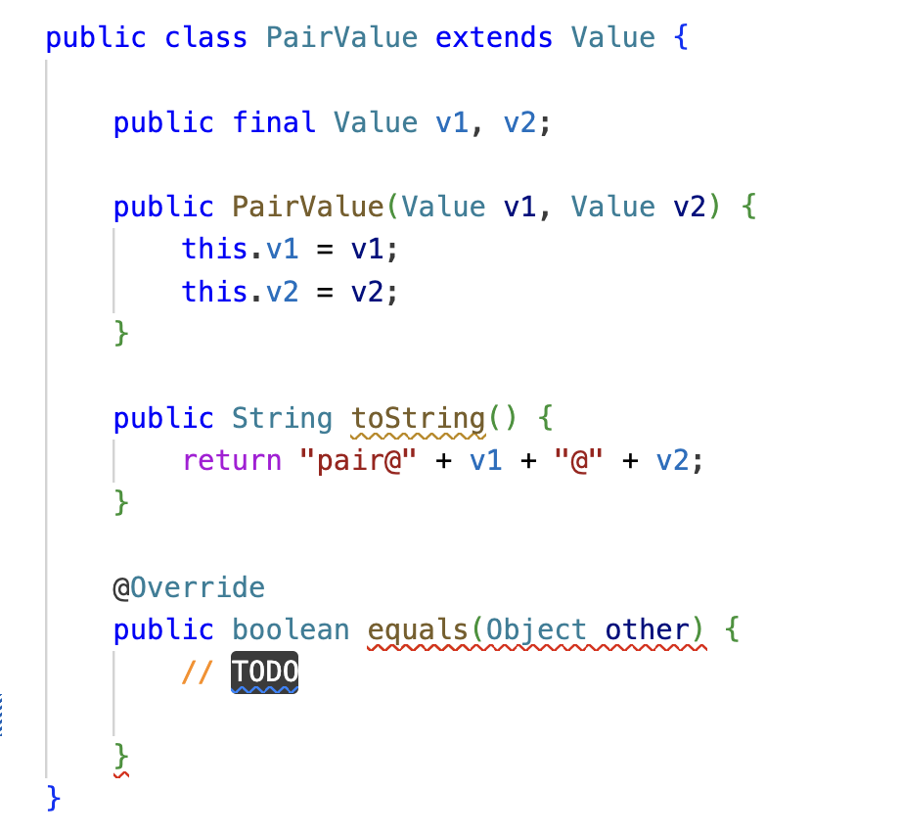
On Interpretation
Notice that Java code is executed
while the Java program is running.
Example code from the implementation of SimPL

Slide 9
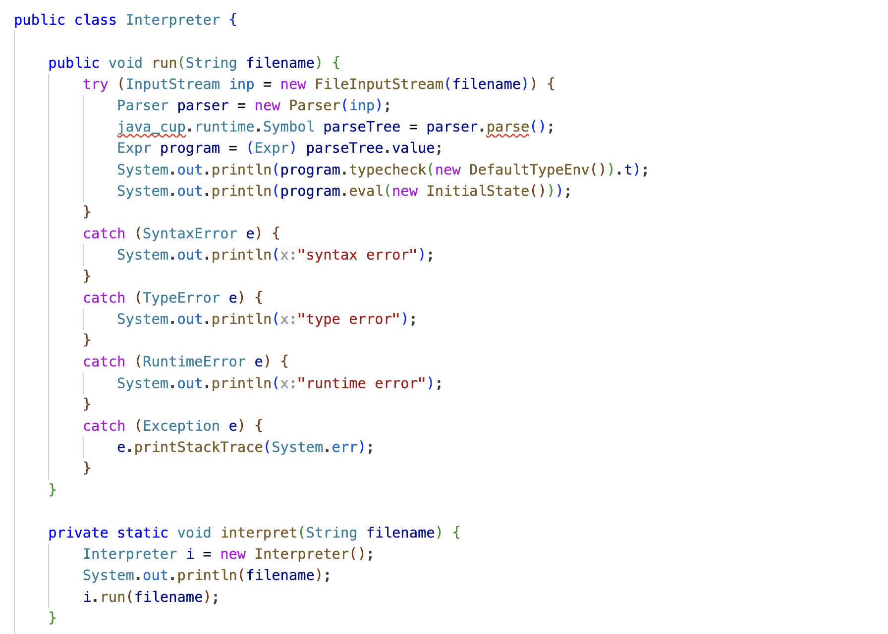
On Interpretation
Entry point to the program. Filename
Provided as a command line argument.

Slide 10
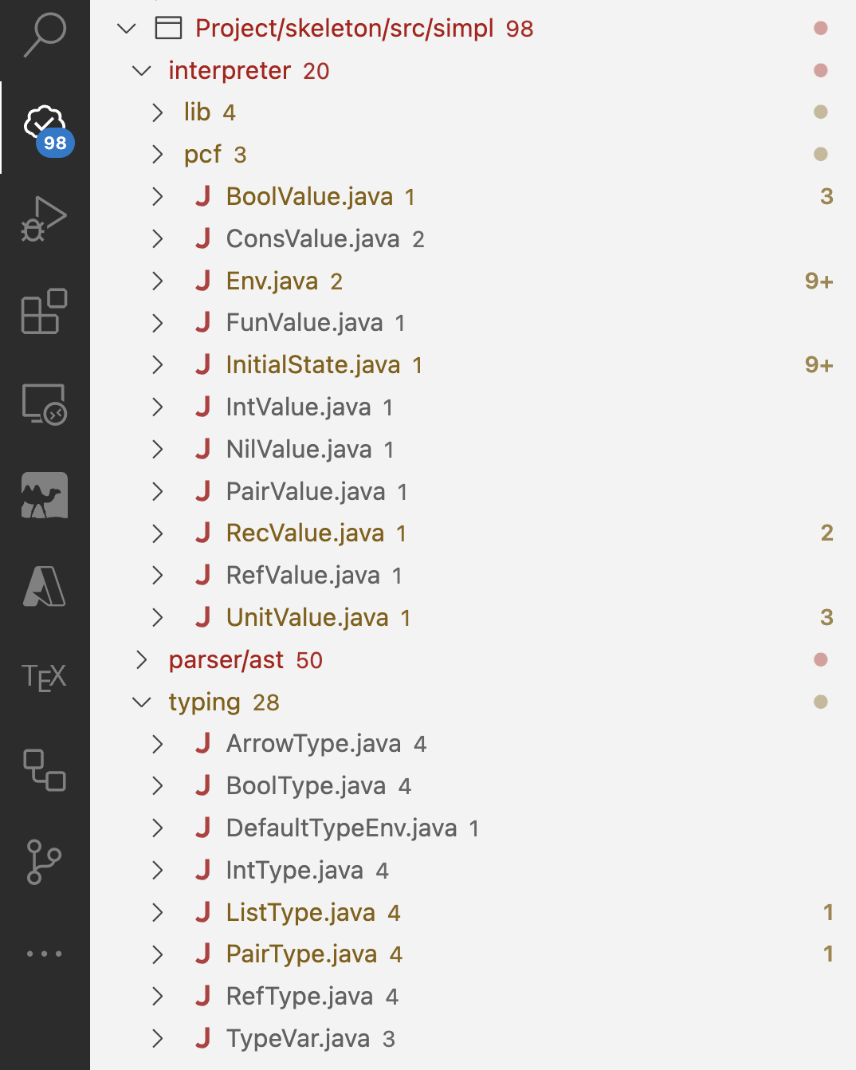
Code Skeleton
simpl
parser
interpreter
typing
Symbols & Lexer
Parser
Expression
Classes
Value Classes
Predefined Functions
EnvironmentM and E
Type Classes
Type Environment
Interpreter
Todo tree VSCode Extension

Slide 11
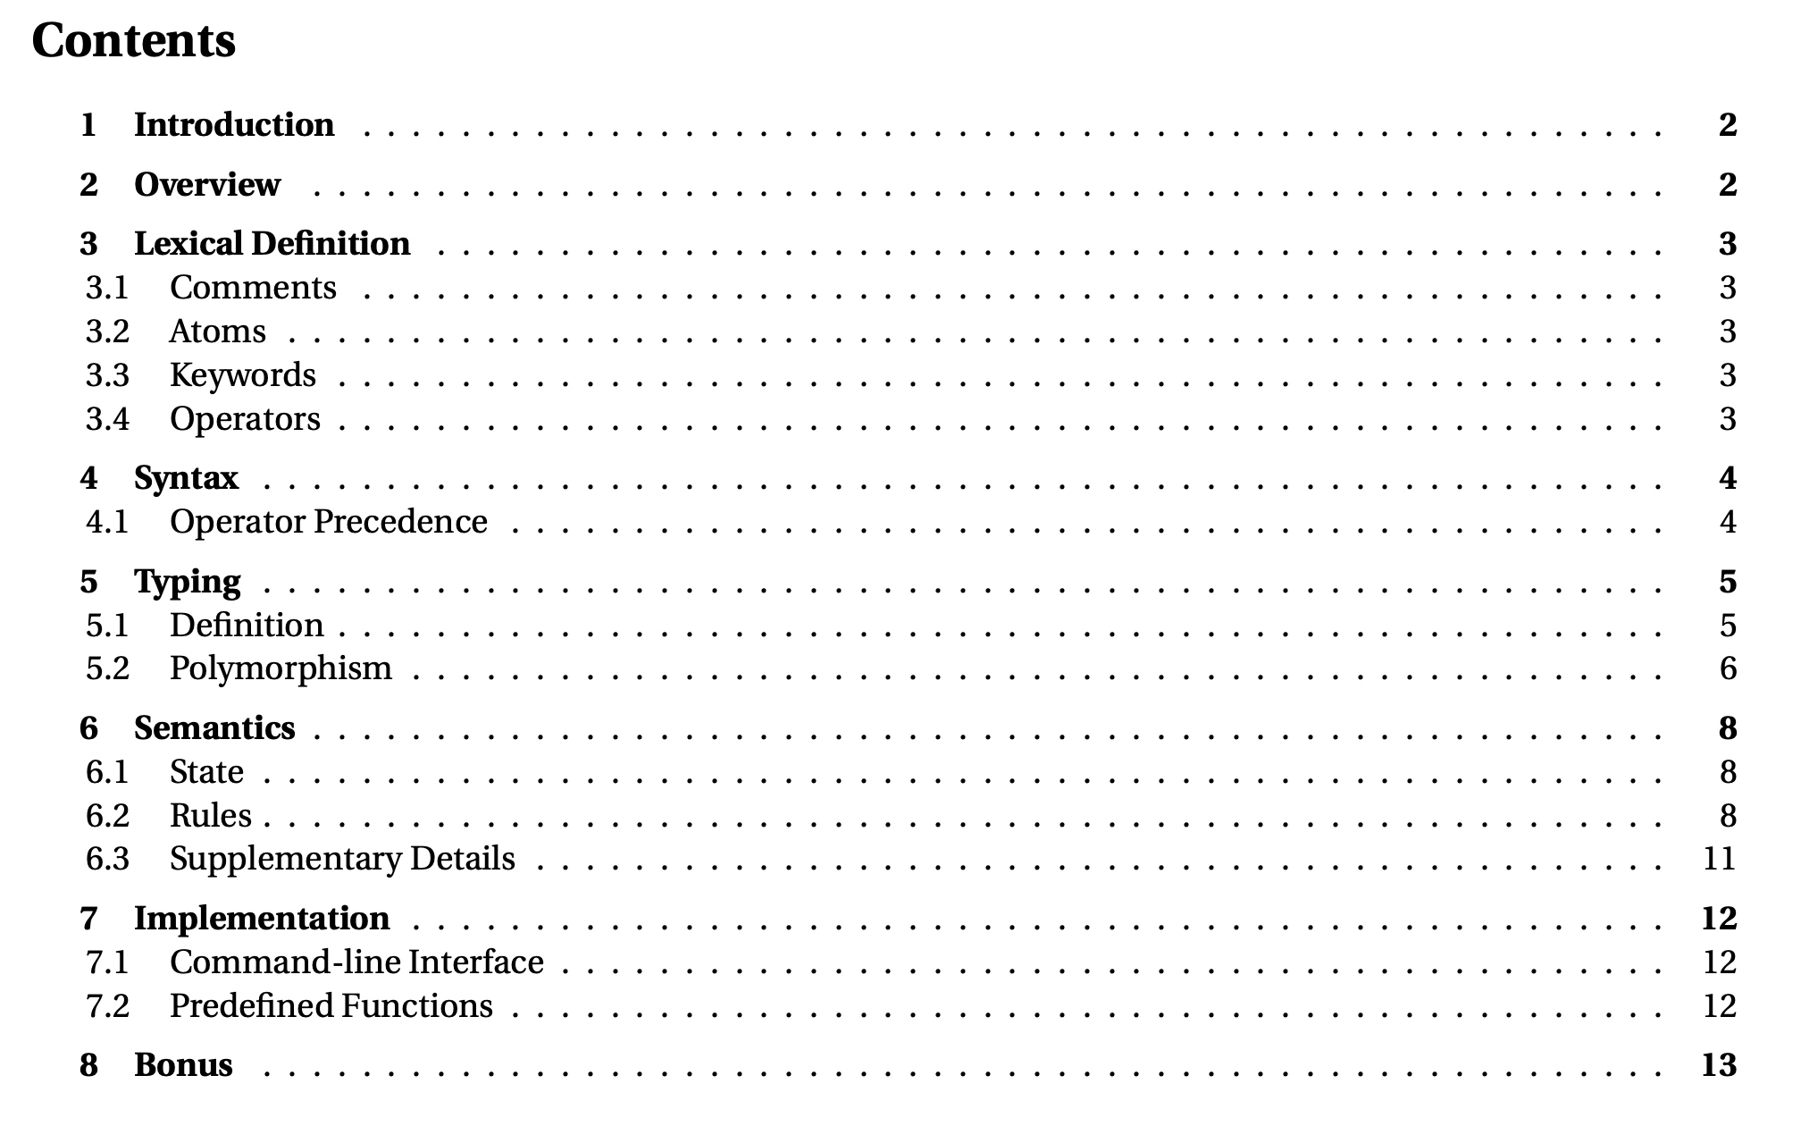
Document Overview

Slide 12
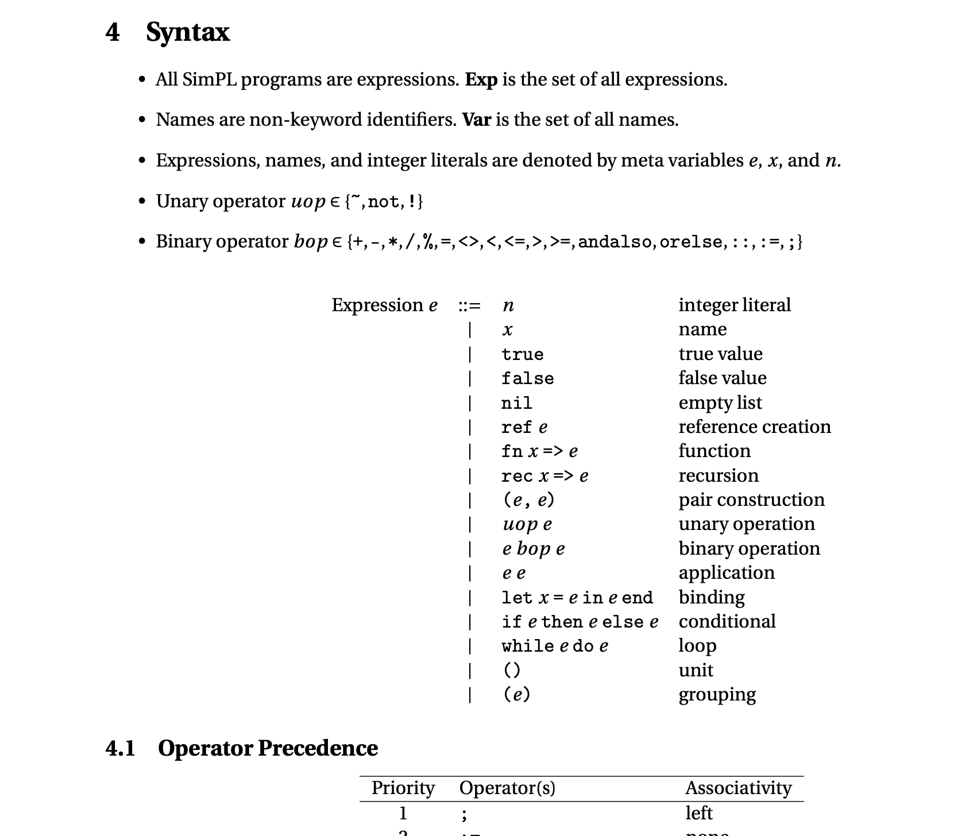
Document Overview
As if you were to implement the lexer and parser

Slide 13
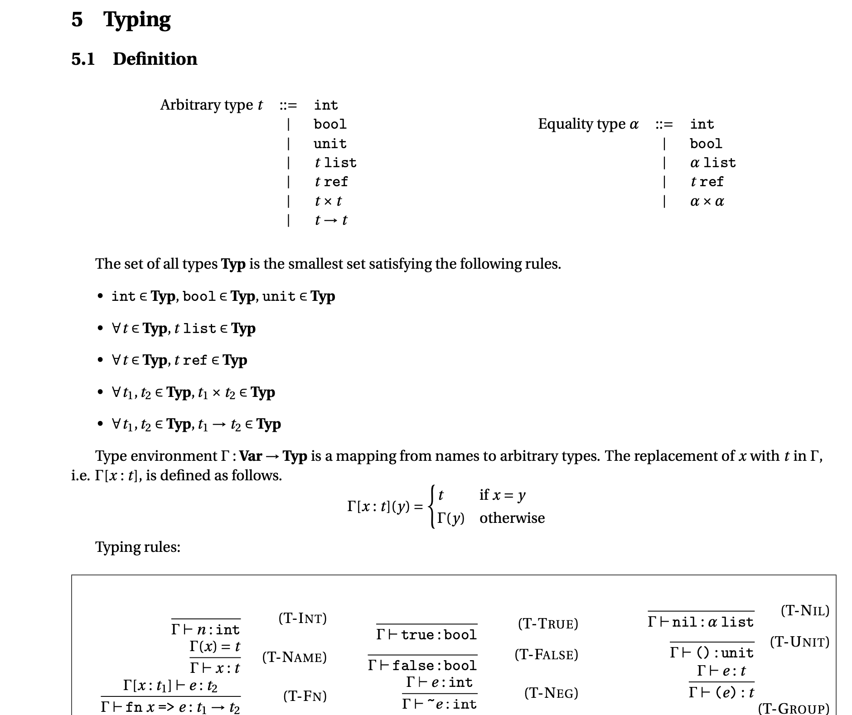
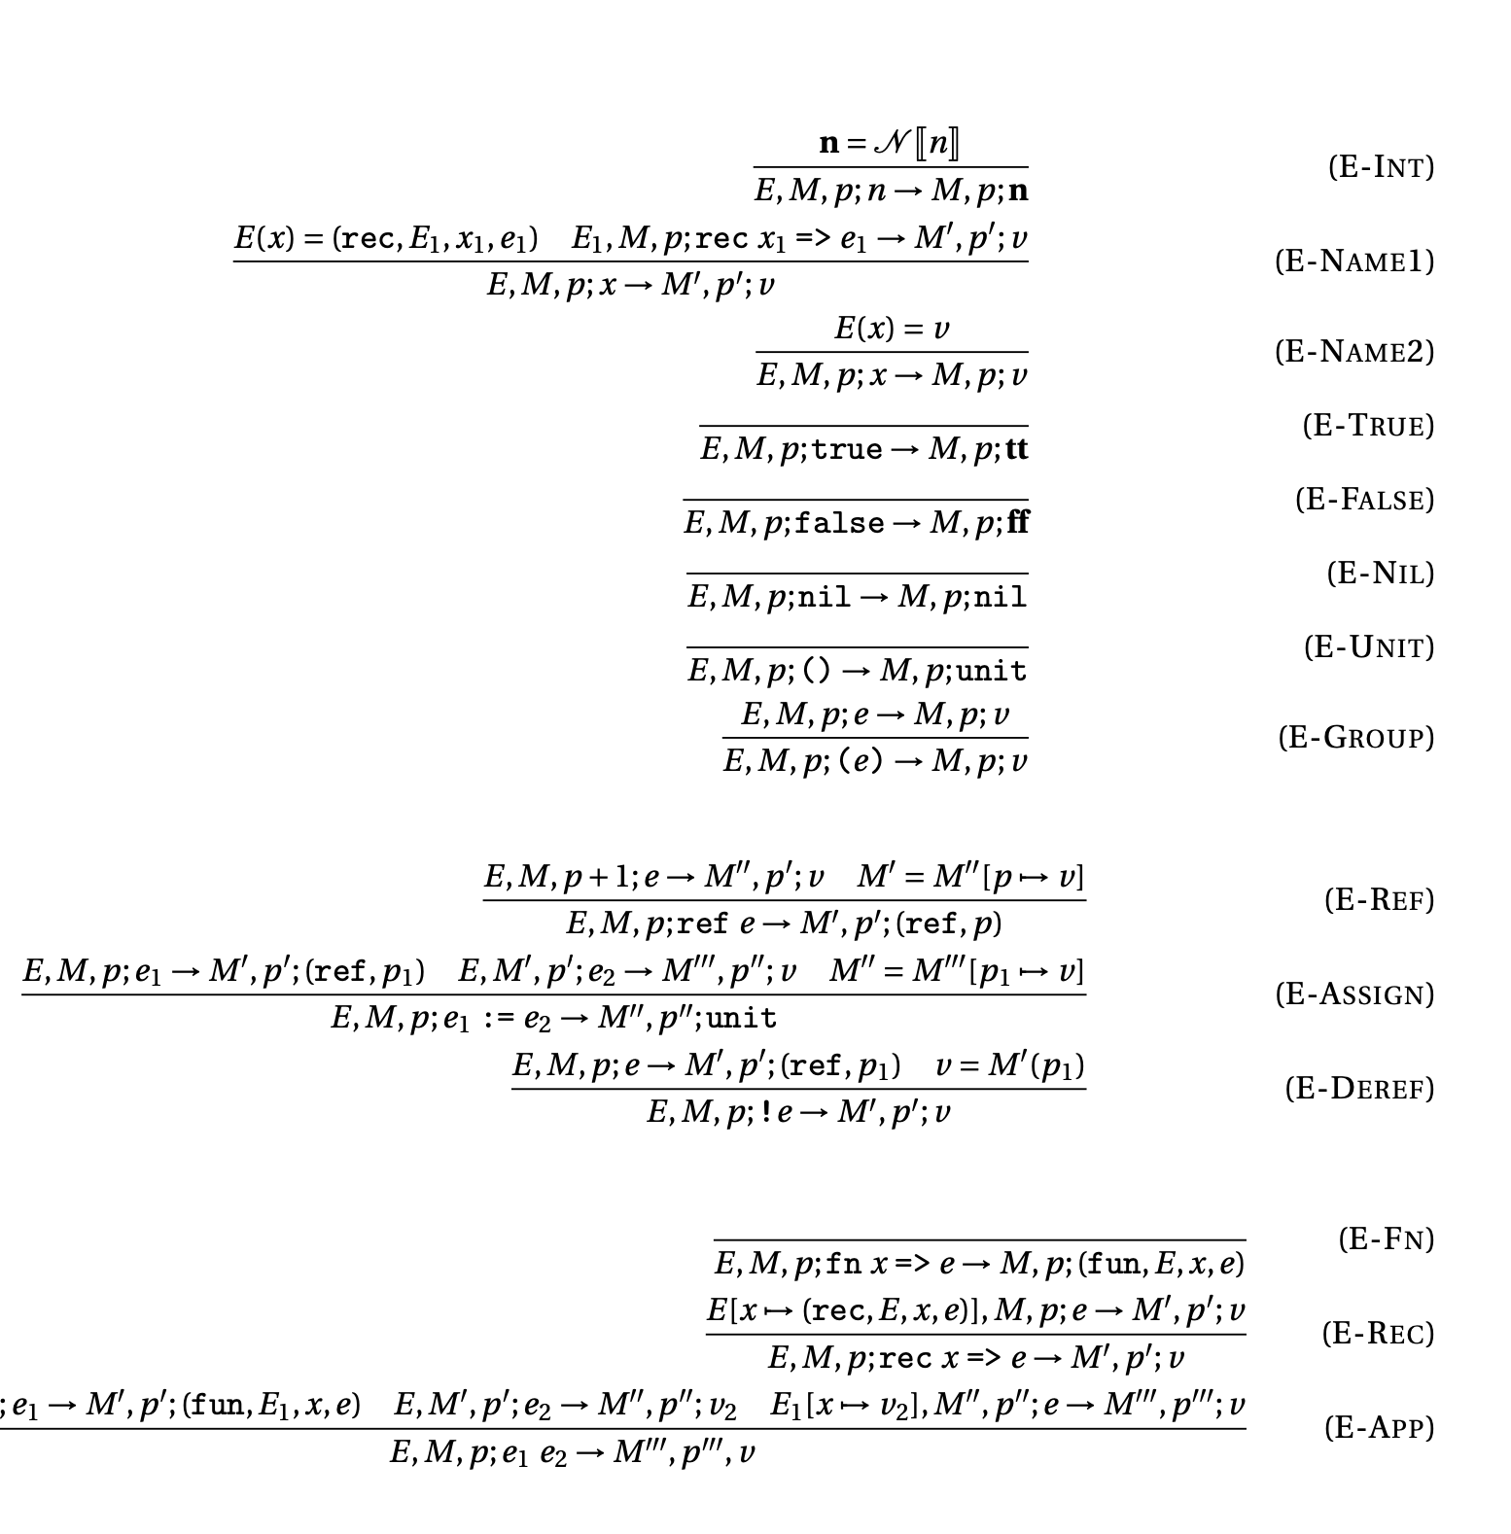
Document Overview
Semantics (Rules)

Slide 14
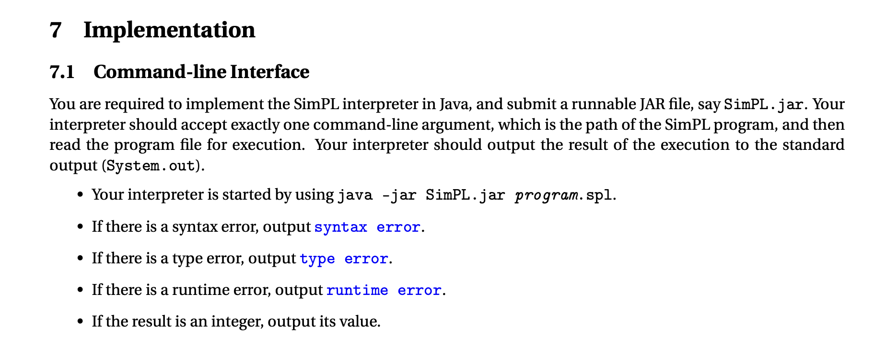
Document Overview
Can email to check!

Slide 15
Pop Quiz
Reminder in tutorials we recap on lecture, discuss assignments, discuss project or programming and solve practice problems.

Slide 16
Pop Quiz
1) To evaluate $(E, e_{1} e_{2})$……….
Evaluate $(E\left[x′↦v′\right], e_{2})$
Evaluate $(E\left[x′↦v′\right], e_{1})$
Evaluate $(E′\left[x′↦v′\right], e_{2})$
$\text{Evaluate} (E′\left[x′↦v′\right], e_{1})$

Slide 17
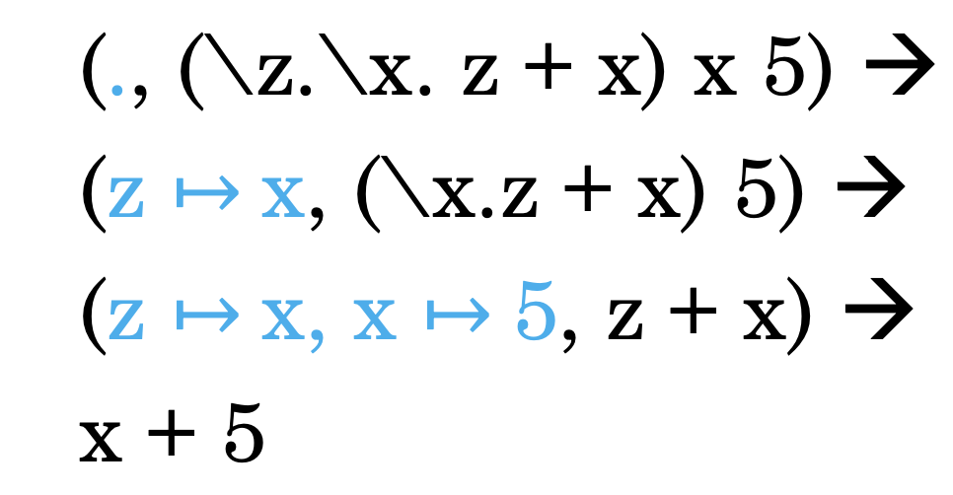
Pop Quiz
2) One of the properties of the environment model……….
Does double the work searching for the variable and later evaluating it
Requires explicit handling of types in the environment
Requires space complexity
Capturing problem

Slide 18
Pop Quiz
3) To evaluate $(E, {let x=e}_{1} in e_{2})$……….
Evaluate $(E\left[x′↦v′\right], e_{2})$
Evaluate $(E\left[x′↦v′\right], e_{1})$
Evaluate $(E′\left[x′↦v′\right], e_{2})$
$\text{Evaluate} (E′\left[x′↦v′\right], e_{1})$

Slide 19
Pop Quiz
4) All of these are impure features except……….
Assignment to mutable variables
Input/Output to screen
Modifying files on the disk
Operating with lists

Slide 20
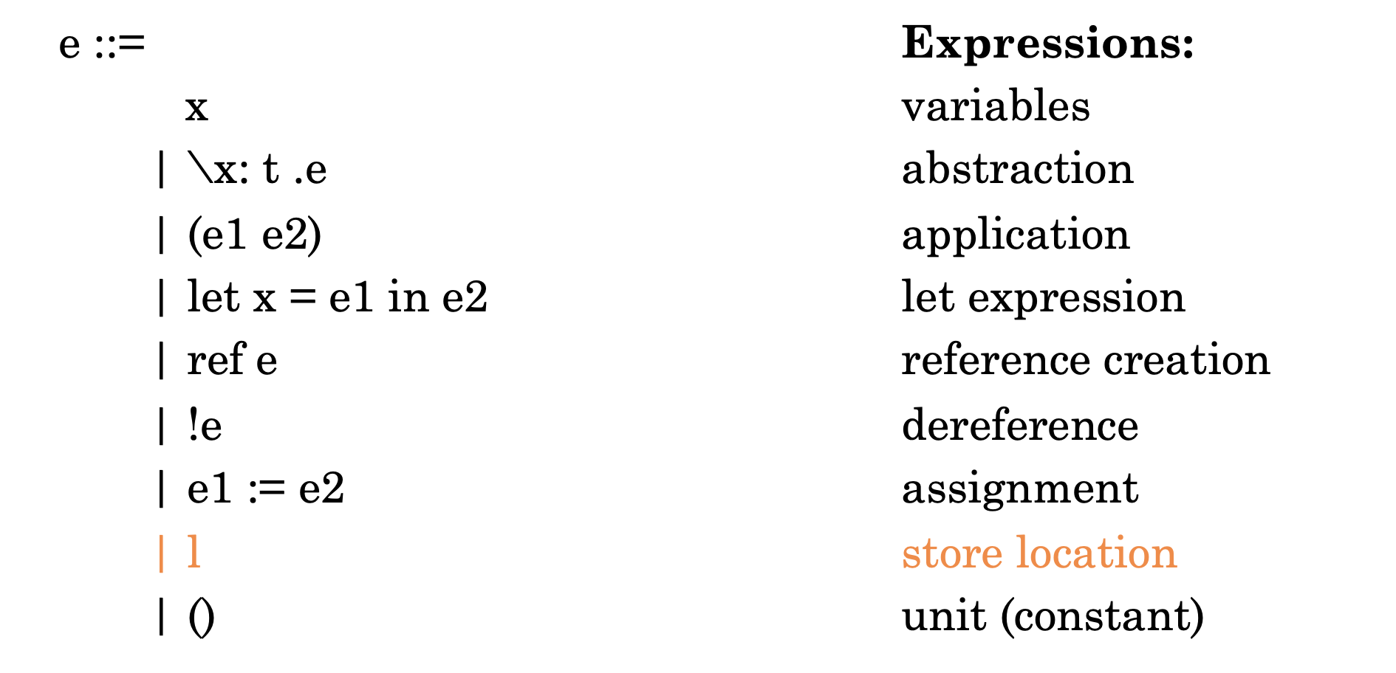
Pop Quiz
5) In Simply-typed LC with References, expressions that directly change M:
…

Slide 21
Pop Quiz
6) In while e1 do e2……….
$e_{2}$ must have type $unit$
$e_{1}$ must have type $unit$
$e_{2}$ must be $t ref$
$e_{1}$ must be $bool$

Slide 22
Assignment Solution

Slide 23
Assignment Solution
Church encoding in Lambda Calculus:
Represent any integer as a pair where $fst p$ can be $tru$ or $fls$ and denotes the sign and $snd p$ is the church encoding.
With this, $pair fls (λf.λx.ffx)$ is equivalent to $−2$

Slide 24
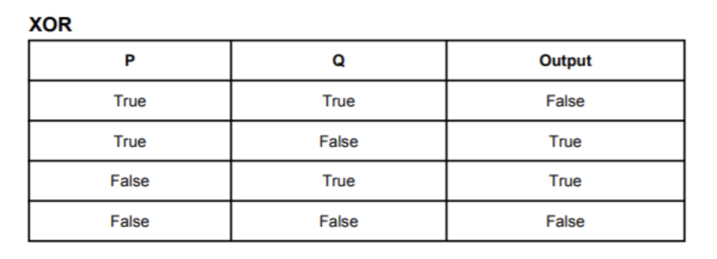
Assignment Solution
$$λp.λq. and \left(or p q\right)\left(not (and p q)\right)$$
Alternatively, we can observe from the table:
If $p$ is true then return not $q$
If $p$ is false then $q$
Thus, we can write:
$$λp.λq. p \left(not q\right) q$$

Slide 25
Assignment Solution
Construct a new pair where the first item is the XOR of signs and the second item uses ordinary multiplication:
$$λm.λn. pair (xor (fst m) (fst n)) (multi (snd m) (snd n))$$

Slide 26
Assignment Solution
Recap:
In recursion, you are used to writing $f\left(a,b,..\right)=…f\left(a^{′},b^{′},.. \right) if C_{1} else A$
Lambda calculus does not support variable assignments so we proceed by:
Define wrapper $g$ as $λf.(λa$. $λb. …f\left(a^{′},b^{′},..\right))$ // What happens if we pass to this what’s in orange?
With this, the original recursive function is tantamount to $fix g$ (i.e., $f\left(a,b,..\right)$= $fix g a b…$)
Holds because $fix g→^{∗}g\left(fix g\right)→^{∗}λa\text{.} λb. …fix g \left(a^{′},b^{′},..\right)$
In other words, if we denote $fix g$ as $h$ then $h→^{∗}λa\text{.} λb. …h\left(a^{′},b^{′},..\right)$
Notes:
- If the expression is a variable, then the relation holds if the variable-type mapping is in the
sequence held in Γ (e.g., it has been added in the definition of some lambda abstraction)
- If the expression is 𝑡𝑟𝑢𝑒, then the relation holds where the type is 𝑏𝑜𝑜𝑙
If the expression is 𝑓𝑎𝑙𝑠𝑒, then the relation holds where the type is 𝑏𝑜𝑜𝑙
If the expression is an if-condition where the condition has type 𝑏𝑜𝑜𝑙 and both the then and else statements each have type 𝑡 then the ifelse statement has type 𝑡.
- If the expression is a lambda abstraction the expression has type 𝑡1 → 𝑡2 if after adding the mapping 𝑥: 𝑡1 to Γ, we can deduce by these rules that 𝑒2 has type 𝑡2.
If the expression is a function call (redex) then it has type 𝑡𝑏 if 𝑒1 has type 𝑡𝑎 → 𝑡𝑏 and 𝑒1 has type 𝑡𝑏

Slide 27
Assignment Solution
Thereby:
Classically (outside of LC), $fib\left(n\right)=fib\left(n−2\right)+fib\left(n−1\right) if n>1 else n$
Define wrapper: $_fib=λf.(λn$. $f\left(n−2\right)+f\left(n−1\right) if n>1 else n)$ (what is the type?)
Now it holds that $fib=fix _fib where fix=λf. (λx. f(λy. x x y))(λx. f(λy. x x y))$
That is, for instance, evaluating $fix _fib 3$should yield $2$
$fix{}_{ }^{ }{_f}ib 3→h h 3→_fib\left(λy. h h y\right)→_fib z 3$ # plug _fib into fix then plug 2nd h into first h
_$fib z 3→\left(λn\text{.} z\left(n−2\right)+z\left(n−1\right) if n>1 else n\right) 3→\left(λn\text{.} z\left(1\right)+z\left(2\right) if 3>1 else 3\right) 3$
Where $h=λx. _fib\left(λy. x x y\right)$ and $z=λy. h h y$
$$h h 1$$
$$h h 2$$
Notes:
- If the expression is a variable, then the relation holds if the variable-type mapping is in the
sequence held in Γ (e.g., it has been added in the definition of some lambda abstraction)
- If the expression is 𝑡𝑟𝑢𝑒, then the relation holds where the type is 𝑏𝑜𝑜𝑙
If the expression is 𝑓𝑎𝑙𝑠𝑒, then the relation holds where the type is 𝑏𝑜𝑜𝑙
If the expression is an if-condition where the condition has type 𝑏𝑜𝑜𝑙 and both the then and else statements each have type 𝑡 then the ifelse statement has type 𝑡.
- If the expression is a lambda abstraction the expression has type 𝑡1 → 𝑡2 if after adding the mapping 𝑥: 𝑡1 to Γ, we can deduce by these rules that 𝑒2 has type 𝑡2.
If the expression is a function call (redex) then it has type 𝑡𝑏 if 𝑒1 has type 𝑡𝑎 → 𝑡𝑏 and 𝑒1 has type 𝑡𝑏

Slide 28
Assignment Solution
Any program in lambda calculus is an expression (possibly with many subexpressions)
Let our program be $e_{p}$ then we evaluate it by evaluating $(E, e_{p})$ which may require evaluation of subexpressions $\left(E^{′}, e_{s}\right)$.
There are four forms $(E, e)$ can take; one for each possible LC expression:
Expression | Evaluation
Variable $(E, x)$ | $\left(E, x\right)→E[x]$
Abstraction $(E, λx.e)$ | $\left(E, λx.e\right)→\{λx.e, E\}$
Let $(E, {let x=e_{1}}_{ }in e_{2} )$ | $$\left(1\right) \left(E, e_{1}\right)→v_{1}$$ $$\left(2\right) \left(E[x↦v_{1}], e_{2}\right)→v$$ $(E, {let x=e}_{1} in e_{2} )$ $→v$
App $(E, e_{1} e_{2})$ | $$\left(1\right) \left(E, e_{1}\right)→\{λx_{b}.e_{b},E_{b}\}$$ $$\left(2\right) Extract x_{b},e_{b}, E_{b}$$ $$\left(3\right) \left(E,e_{2}\right)→v_{b}$$ $$\left(4\right) \left(E_{b}[x_{b}↦v_{b}], e_{b}\right)→v$$ $\left(5\right)$ $\left(E, e_{1} e_{2}\right)→v$

Slide 29
Assignment Solution
We can rewrite this as:
$$e_{o}=\left(let x=2 in e_{1}\right) \\ e_{1}=\left(let y=4 in e_{2}\right) \\ e_{2}=\left(let f_{1}=λx.λy.\left(x+2y\right) in e_{3}\right) \\ e_{3}=\left(let f_{2}=λx.λy.\left(2x−y\right) in e_{4}\right) \\ e_{4}=e_{5} 3 \\ e_{5}=f_{2} e_{6} \\ e_{6}=e_{7} x \\ e_{7}=f_{1} y$$

Slide 30
Assignment Solution
$$e_{o}=\left(let x=2 in e_{1}\right) \\ e_{1}=\left(let y=4 in e_{2}\right) \\ e_{2}=\left(let f_{1}=λx.λy.\left(x+2y\right) in e_{3}\right) \\ e_{3}=\left(let f_{2}=λx.λy.\left(2x−y\right) in e_{4}\right) \\ e_{4}=e_{5} 3 \\ e_{5}=f_{2} e_{6} \\ e_{6}=e_{7} x \\ e_{7}=f_{1} y$$
$$(., e_{o})$$
$$(.,\left(let x=2 in e_{1}\right))$$
$$\left(1\right) \left(E=., 2\right)→2$$ $$\left(2\right) result is \left(.[x↦2], e_{1}\right)$$
Expression | Evaluation
Variable $(E, x)$ | $\left(E, x\right)→E[x]$
Abstraction $(E, λx.e)$ | $\left(E, λx.e\right)→\{λx.e, E\}$
Let $(E, {let x=e_{1}}_{ }in e_{2} )$ | $$\left(1\right) \left(E, e_{1}\right)→v_{1}$$ $$\left(2\right) \left(E[x↦v_{1}], e_{2}\right)→v$$ $(E, {let x=e}_{1} in e_{2} )$ $→v$

Slide 31
Assignment Solution
$$e_{o}=\left(let x=2 in e_{1}\right) \\ e_{1}=\left(let y=4 in e_{2}\right) \\ e_{2}=\left(let f_{1}=λx.λy.\left(x+2y\right) in e_{3}\right) \\ e_{3}=\left(let f_{2}=λx.λy.\left(2x−y\right) in e_{4}\right) \\ e_{4}=e_{5} 3 \\ e_{5}=f_{2} e_{6} \\ e_{6}=e_{7} x \\ e_{7}=f_{1} y$$
$$\left([x↦2], e_{1}\right)$$
$$([x↦2],\left(let y=4 in e_{2}\right))$$
$$\left(1\right) \left([x↦2],4\right)→4$$ $$\left(2\right) result is \left([x↦2,y↦4],e_{2}\right)$$
Expression | Evaluation
Variable $(E, x)$ | $\left(E, x\right)→E[x]$
Abstraction $(E, λx.e)$ | $\left(E, λx.e\right)→\{λx.e, E\}$
Let $(E, {let x=e_{1}}_{ }in e_{2} )$ | $$\left(1\right) \left(E, e_{1}\right)→v_{1}$$ $$\left(2\right) \left(E[x↦v_{1}], e_{2}\right)→v$$ $(E, {let x=e}_{1} in e_{2} )$ $→v$

Slide 32
Assignment Solution
$$e_{o}=\left(let x=2 in e_{1}\right) \\ e_{1}=\left(let y=4 in e_{2}\right) \\ e_{2}=\left(let f_{1}=λx.λy.\left(x+2y\right) in e_{3}\right) \\ e_{3}=\left(let f_{2}=λx.λy.\left(2x−y\right) in e_{4}\right) \\ e_{4}=e_{5} 3 \\ e_{5}=f_{2} e_{6} \\ e_{6}=e_{7} x \\ e_{7}=f_{1} y$$
$$\left([x↦2,y↦4],e_{2}\right)$$
$$\left([x↦2,y↦4],\left(let f_{1}=λx.λy.\left(x+2y\right) in e_{3}\right)\right)$$
$$\left(1\right) \left([x↦2,y↦4],λx.λy.\left(x+2y\right)\right)→C_{f1}$$ Where $C_{f1}=\{λx.λy.\left(x+2y\right),[x↦2,y↦4]\}$ $$\left(2\right) result is \left([x↦2,y↦4, f_{1}↦C_{f1}],e_{3}\right)$$
Expression | Evaluation
Variable $(E, x)$ | $\left(E, x\right)→E[x]$
Abstraction $(E, λx.e)$ | $\left(E, λx.e\right)→\{λx.e, E\}$
Let $(E, {let x=e_{1}}_{ }in e_{2} )$ | $$\left(1\right) \left(E, e_{1}\right)→v_{1}$$ $$\left(2\right) \left(E[x↦v_{1}], e_{2}\right)→v$$ $(E, {let x=e}_{1} in e_{2} )$ $→v$

Slide 33
Assignment Solution
$$e_{o}=\left(let x=2 in e_{1}\right) \\ e_{1}=\left(let y=4 in e_{2}\right) \\ e_{2}=\left(let f_{1}=λx.λy.\left(x+2y\right) in e_{3}\right) \\ e_{3}=\left(let f_{2}=λx.λy.\left(2x−y\right) in e_{4}\right) \\ e_{4}=e_{5} 3 \\ e_{5}=f_{2} e_{6} \\ e_{6}=e_{7} x \\ e_{7}=f_{1} y$$
$$\left([x↦2,y↦4, f_{1}↦C_{f1}],e_{3}\right)$$
$$\left([x↦2,y↦4, f_{1}↦C_{f1}],\left(let f_{2}=λx.λy.\left(2x−y\right) in e_{4}\right)\right)$$
$$\left(1\right) \left(\left[x↦2,y↦4, f_{1}↦C_{f1}\right],λx.λy.\left(2x−y\right)\right)→C_{f2}$$ Where $C_{f2}=\left\{λx.λy.\left(2x−y\right),\left[x↦2,y↦4, f↦C_{f1}\right]\right\}$ $$\left(2\right) result is \left([x↦2,y↦4, f_{1}↦C_{f_{1}},f_{2}↦C_{f_{2}}],e_{4}\right)$$
Expression | Evaluation
Variable $(E, x)$ | $\left(E, x\right)→E[x]$
Abstraction $(E, λx.e)$ | $\left(E, λx.e\right)→\{λx.e, E\}$
Let $(E, {let x=e_{1}}_{ }in e_{2} )$ | $$\left(1\right) \left(E, e_{1}\right)→v_{1}$$ $$\left(2\right) \left(E[x↦v_{1}], e_{2}\right)→v$$ $(E, {let x=e}_{1} in e_{2} )$ $→v$

Slide 34
Assignment Solution
$$e_{o}=\left(let x=2 in e_{1}\right) \\ e_{1}=\left(let y=4 in e_{2}\right) \\ e_{2}=\left(let f_{1}=λx.λy.\left(x+2y\right) in e_{3}\right) \\ e_{3}=\left(let f_{2}=λx.λy.\left(2x−y\right) in e_{4}\right) \\ e_{4}=e_{5} 3 \\ e_{5}=f_{2} e_{6} \\ e_{6}=e_{7} x \\ e_{7}=f_{1} y$$
$$\left([x↦2,y↦4, f_{1}↦C_{f_{1}},f_{2}↦C_{f_{2}}],e_{4}\right)$$
$$\left([x↦2,y↦4, f_{1}↦C_{f_{1}},f_{2}↦C_{f_{2}}],e_{5} 3 \right)$$
$$\left(1\right) \left(x↦2,y↦4, f_{1}↦C_{f_{1}},f_{2}↦C_{f_{2}}, e_{5}\right)→…$$ Let’s backtrack after evaluating this (a)
Variable $(E, x)$ | $\left(E, x\right)→E[x]$
Abstraction $(E, λx.e)$ | $\left(E, λx.e\right)→\{λx.e, E\}$
App $(E, e_{1} e_{2})$ | $$\left(1\right) \left(E, e_{1}\right)→\{λx_{b}.e_{b},E_{b}\}$$ $$\left(2\right) Extract x_{b},e_{b}, E_{b}$$ $$\left(3\right) \left(E,e_{2}\right)→v_{b}$$ $$\left(4\right) \left(E_{b}[x_{b}↦v_{b}], e_{b}\right)→v$$ $\left(5\right)$ $\left(E, e_{1} e_{2}\right)→v$

Slide 35
Assignment Solution
$$e_{o}=\left(let x=2 in e_{1}\right) \\ e_{1}=\left(let y=4 in e_{2}\right) \\ e_{2}=\left(let f_{1}=λx.λy.\left(x+2y\right) in e_{3}\right) \\ e_{3}=\left(let f_{2}=λx.λy.\left(2x−y\right) in e_{4}\right) \\ e_{4}=e_{5} 3 \\ e_{5}=f_{2} e_{6} \\ e_{6}=e_{7} x \\ e_{7}=f_{1} y$$
$$\left([x↦2,y↦4, f_{1}↦C_{f_{1}},f_{2}↦C_{f_{2}}], e_{5}\right)$$
$$\left([x↦2,y↦4, f_{1}↦C_{f_{1}},f_{2}↦C_{f_{2}}],f_{2} e_{6}\right)$$
$$\left(1\right) \left(\left[x↦2,y↦4, f_{1}↦C_{f_{1}},f_{2}↦C_{f_{2}}\right], f_{2} \right)→C_{f_{2}}=\left\{λx.λy.\left(2x−y\right),\left[x↦2,y↦4, f↦C_{f1}\right]\right\}$$ $$\left(2\right) x_{b}=x, e_{b}=λy.\left(2x−y\right),E_{b}=\left[x↦2,y↦4, f↦C_{f1}\right]$$ $$\left(3\right) \left(\left[x↦2,y↦4, f_{1}↦C_{f_{1}},f_{2}↦C_{f_{2}}\right],e_{6}\right)→…$$ Let’s backtrack after evaluating this (b)
Variable $(E, x)$ | $\left(E, x\right)→E[x]$
Abstraction $(E, λx.e)$ | $\left(E, λx.e\right)→\{λx.e, E\}$
App $(E, e_{1} e_{2})$ | $$\left(1\right) \left(E, e_{1}\right)→\{λx_{b}.e_{b},E_{b}\}$$ $$\left(2\right) Extract x_{b},e_{b}, E_{b}$$ $$\left(3\right) \left(E,e_{2}\right)→v_{b}$$ $$\left(4\right) \left(E_{b}[x_{b}↦v_{b}], e_{b}\right)→v$$ $\left(5\right)$ $\left(E, e_{1} e_{2}\right)→v$

Slide 36
Assignment Solution
$$e_{o}=\left(let x=2 in e_{1}\right) \\ e_{1}=\left(let y=4 in e_{2}\right) \\ e_{2}=\left(let f_{1}=λx.λy.\left(x+2y\right) in e_{3}\right) \\ e_{3}=\left(let f_{2}=λx.λy.\left(2x−y\right) in e_{4}\right) \\ e_{4}=e_{5} 3 \\ e_{5}=f_{2} e_{6} \\ e_{6}=e_{7} x \\ e_{7}=f_{1} y$$
$$\left(\left[x↦2,y↦4, f_{1}↦C_{f_{1}},f_{2}↦C_{f_{2}}\right],e_{6}\right)$$
$$\left([x↦2,y↦4, f_{1}↦C_{f_{1}},f_{2}↦C_{f_{2}}],e_{7} x \right)$$
$$\left(1\right) \left(\left[x↦2,y↦2, f_{1}↦C_{f_{1}},f_{2}↦C_{f_{2}}\right], e_{7}\right)→…$$ Let’s backtrack after evaluating this (c)
Variable $(E, x)$ | $\left(E, x\right)→E[x]$
Abstraction $(E, λx.e)$ | $\left(E, λx.e\right)→\{λx.e, E\}$
App $(E, e_{1} e_{2})$ | $$\left(1\right) \left(E, e_{1}\right)→\{λx_{b}.e_{b},E_{b}\}$$ $$\left(2\right) Extract x_{b},e_{b}, E_{b}$$ $$\left(3\right) \left(E,e_{2}\right)→v_{b}$$ $$\left(4\right) \left(E_{b}[x_{b}↦v_{b}], e_{b}\right)→v$$ $\left(5\right)$ $\left(E, e_{1} e_{2}\right)→v$

Slide 37
Assignment Solution
$$e_{o}=\left(let x=2 in e_{1}\right) \\ e_{1}=\left(let y=4 in e_{2}\right) \\ e_{2}=\left(let f_{1}=λx.λy.\left(x+2y\right) in e_{3}\right) \\ e_{3}=\left(let f_{2}=λx.λy.\left(2x−y\right) in e_{4}\right) \\ e_{4}=e_{5} 3 \\ e_{5}=f_{2} e_{6} \\ e_{6}=e_{7} x \\ e_{7}=f_{1} y$$
$$\left(\left[x↦2,y↦4, f_{1}↦C_{f_{1}},f_{2}↦C_{f_{2}}\right], e_{7}\right)$$
$$\left([x↦2,y↦4, f_{1}↦C_{f_{1}},f_{2}↦C_{f_{2}}],f_{1} y\right)$$
$$\left(1\right) \left(\left[x↦2,y↦4, f_{1}↦C_{f_{1}},f_{2}↦C_{f_{2}}\right], f_{1}\right)→C_{f_{1}}==\left\{λx.λy.\left(x+2y\right),\left[x↦2,y↦4\right]\right\} \\ \left(2\right) x_{b}=x, e_{b}=λy.\left(x+2y\right), E_{b}=\left[x↦2,y↦4\right]$$ $$\left(3\right) \left(\left[x↦2,y↦4, f_{1}↦C_{f_{1}},f_{2}↦C_{f_{2}}\right], y\right)→4 \\ \left(4\right)\left(E_{b}[x_{b}↦v_{b}], e_{b}\right)=\left(\left[x↦4,y↦4\right],λy.\left(x+2y\right)\right)→\{λy.\left(x+2y\right),\left[x↦4,y↦4\right]\}$$
Variable $(E, x)$ | $\left(E, x\right)→E[x]$
Abstraction $(E, λx.e)$ | $\left(E, λx.e\right)→\{λx.e, E\}$
App $(E, e_{1} e_{2})$ | $$\left(1\right) \left(E, e_{1}\right)→\{λx_{b}.e_{b},E_{b}\}$$ $$\left(2\right) Extract x_{b},e_{b}, E_{b}$$ $$\left(3\right) \left(E,e_{2}\right)→v_{b}$$ $$\left(4\right) \left(E_{b}[x_{b}↦v_{b}], e_{b}\right)→v$$ $\left(5\right)$ $\left(E, e_{1} e_{2}\right)→v$

Slide 38
Assignment Solution
$$\left(\left[x↦2,y↦4, f_{1}↦C_{f_{1}},f_{2}↦C_{f_{2}}\right],e_{6}\right)$$
$$\left([x↦2,y↦4, f_{1}↦C_{f_{1}},f_{2}↦C_{f_{2}}],e_{7} x \right)$$
Let’s backtrack after evaluating this (c) Done! $$\left(1\right) \left(\left[x↦2,y↦4, f_{1}↦C_{f_{1}},f_{2}↦C_{f_{2}}\right], e_{7}\right)→\{λy.\left(x+2y\right),\left[x↦4,y↦4\right]\}$$ $$\left(2\right) x_{b}=y,e_{b}=\left(x+2y\right), E_{b}=\left[x↦4,y↦4\right] \\ \left(3\right) \left(\left[x↦2,y↦4, f_{1}↦C_{f_{1}},f_{2}↦C_{f_{2}}\right], x\right)→2 \\ \left(4\right)\left(\left[x↦4,y↦2\right],\left(x+2y\right)\right)→8 (result)$$
$$e_{o}=\left(let x=2 in e_{1}\right) \\ e_{1}=\left(let y=4 in e_{2}\right) \\ e_{2}=\left(let f_{1}=λx.λy.\left(x+2y\right) in e_{3}\right) \\ e_{3}=\left(let f_{2}=λx.λy.\left(2x−y\right) in e_{4}\right) \\ e_{4}=e_{5} 3 \\ e_{5}=f_{2} e_{6} \\ e_{6}=e_{7} x \\ e_{7}=f_{1} y$$
Variable $(E, x)$ | $\left(E, x\right)→E[x]$
Abstraction $(E, λx.e)$ | $\left(E, λx.e\right)→\{λx.e, E\}$
App $(E, e_{1} e_{2})$ | $$\left(1\right) \left(E, e_{1}\right)→\{λx_{b}.e_{b},E_{b}\}$$ $$\left(2\right) Extract x_{b},e_{b}, E_{b}$$ $$\left(3\right) \left(E,e_{2}\right)→v_{b}$$ $$\left(4\right) \left(E_{b}[x_{b}↦v_{b}], e_{b}\right)→v$$ $\left(5\right)$ $\left(E, e_{1} e_{2}\right)→v$

Slide 39
Assignment Solution
$$\left([x↦2,y↦4, f_{1}↦C_{f_{1}},f_{2}↦C_{f_{2}}], e_{5}\right)$$
$$\left([x↦2,y↦4, f_{1}↦C_{f_{1}},f_{2}↦C_{f_{2}}],f_{2} e_{6}\right)$$
$$\left(1\right) \left(\left[x↦2,y↦4, f_{1}↦C_{f_{1}},f_{2}↦C_{f_{2}}\right], f_{2} \right)→C_{f_{2}}=\left\{λx.λy.\left(2x−y\right),\left[x↦2,y↦4, f↦C_{f1}\right]\right\}$$ $$\left(2\right) x_{b}=x, e_{b}=λy.\left(2x−y\right),E_{b}=\left[x↦2,y↦4, f↦C_{f1}\right]$$ $\text{Let}\text{’}\text{s} \text{backtrack} \text{after} \text{evaluating} \text{this}\text{ (}\text{b}\text{)}$ Done! $$\left(3\right) \left(\left[x↦2,y↦4, f_{1}↦C_{f_{1}},f_{2}↦C_{f_{2}}\right],e_{6}\right)→8 \\ \left(4\right) \left(\left[x↦8,y↦4, f↦C_{f1}\right],λy.\left(2x−y\right)\right)→\{λy.\left(2x−y\right),\left[x↦8,y↦4, f↦C_{f1}\right]\}$$
$$e_{o}=\left(let x=2 in e_{1}\right) \\ e_{1}=\left(let y=4 in e_{2}\right) \\ e_{2}=\left(let f_{1}=λx.λy.\left(x+2y\right) in e_{3}\right) \\ e_{3}=\left(let f_{2}=λx.λy.\left(2x−y\right) in e_{4}\right) \\ e_{4}=e_{5} 3 \\ e_{5}=f_{2} e_{6} \\ e_{6}=e_{7} x \\ e_{7}=f_{1} y$$
Variable $(E, x)$ | $\left(E, x\right)→E[x]$
App $(E, e_{1} e_{2})$ | $$\left(1\right) \left(E, e_{1}\right)→\{λx_{b}.e_{b},E_{b}\}$$ $$\left(2\right) Extract x_{b},e_{b}, E_{b}$$ $$\left(3\right) \left(E,e_{2}\right)→v_{b}$$ $$\left(4\right) \left(E_{b}[x_{b}↦v_{b}], e_{b}\right)→v$$ $\left(5\right)$ $\left(E, e_{1} e_{2}\right)→v$

Slide 40
Assignment Solution
$$e_{o}=\left(let x=2 in e_{1}\right) \\ e_{1}=\left(let y=4 in e_{2}\right) \\ e_{2}=\left(let f_{1}=λx.λy.\left(x+2y\right) in e_{3}\right) \\ e_{3}=\left(let f_{2}=λx.λy.\left(2x−y\right) in e_{4}\right) \\ e_{4}=e_{5} 3 \\ e_{5}=f_{2} e_{6} \\ e_{6}=e_{7} x \\ e_{7}=f_{1} y$$
$$\left([x↦2,y↦4, f_{1}↦C_{f_{1}},f_{2}↦C_{f_{2}}],e_{4}\right)$$
$$\left([x↦2,y↦4, f_{1}↦C_{f_{1}},f_{2}↦C_{f_{2}}],e_{5} 3 \right)$$
$\left(1\right) \left([x↦2,y↦4, f_{1}↦C_{f_{1}},f_{2}↦C_{f_{2}}], e_{5}\right)→\left\{λy.\left(2x−y\right),\left[x↦8,y↦4, f↦C_{f1}\right]\right\}$ Let’s backtrack after evaluating this (a) done! $$\left(2\right) x_{b}=y, e_{b}=\left(2x−y\right), E_{b}=\left[x↦8,y↦4, f↦C_{f1}\right] \\ \left(3\right) \left(\left[x↦2,y↦4, f_{1}↦C_{f_{1}},f_{2}↦C_{f_{2}}\right], 3\right)→3 \\ \left(4\right)\left(E_{b}[x_{b}↦v_{b}], e_{b}\right)=\left(\left[x↦8,y↦3, f↦C_{f1}\right],\left(2x−y\right)\right)→13$$
Variable $(E, x)$ | $\left(E, x\right)→E[x]$
Abstraction $(E, λx.e)$ | $\left(E, λx.e\right)→\{λx.e, E\}$
App $(E, e_{1} e_{2})$ | $$\left(1\right) \left(E, e_{1}\right)→\{λx_{b}.e_{b},E_{b}\}$$ $$\left(2\right) Extract x_{b},e_{b}, E_{b}$$ $$\left(3\right) \left(E,e_{2}\right)→v_{b}$$ $$\left(4\right) \left(E_{b}[x_{b}↦v_{b}], e_{b}\right)→v$$ $\left(5\right)$ $\left(E, e_{1} e_{2}\right)→v$

Slide 41
Assignment Solution
$$\left(.,\left(let x=2 in e_{1}\right)\right)$$
$$\left(\left[x↦2\right],\left(let y=4 in e_{2}\right)\right)$$
$$\left([x↦2,y↦4],\left(let f_{1}=λx.λy.\left(x+2y\right) in e_{3}\right)\right)$$
$$\left([x↦2,y↦4, f_{1}↦C_{f1}],\left(let f_{2}=λx.λy.\left(2x−y\right) in e_{4}\right)\right)$$
$$\left([x↦2,y↦4, f_{1}↦C_{f_{1}},f_{2}↦C_{f_{2}}],e_{5} 3 \right) [a;need e_{5}]$$
$$\left([x↦2,y↦4, f_{1}↦C_{f_{1}},f_{2}↦C_{f_{2}}],f_{2} e_{6}\right) \left[b;need e_{6}\right]$$
$$\left([x↦2,y↦4, f_{1}↦C_{f_{1}},f_{2}↦C_{f_{2}}],e_{7} x \right) [c;need e_{7}]$$
$$\left([x↦2,y↦4, f_{1}↦C_{f_{1}},f_{2}↦C_{f_{2}}],f_{1} y\right)→\{λy.\left(x+2y\right),\left[x↦4,y↦4\right]\}$$
$$c:\left([x↦2,y↦4, f_{1}↦C_{f_{1}},f_{2}↦C_{f_{2}}],e_{7} x \right)→8$$
$$b:\left([x↦2,y↦4, f_{1}↦C_{f_{1}},f_{2}↦C_{f_{2}}],f_{2} e_{6}\right)→\left\{λy.\left(2x−y\right),\left[x↦8,y↦4, f↦C_{f1}\right]\right\} \\ a:\left([x↦2,y↦4, f_{1}↦C_{f_{1}},f_{2}↦C_{f_{2}}],e_{5} 3 \right)→13$$
$$e_{o}=\left(let x=2 in e_{1}\right) \\ e_{1}=\left(let y=4 in e_{2}\right) \\ e_{2}=\left(let f_{1}=λx.λy.\left(x+2y\right) in e_{3}\right) \\ e_{3}=\left(let f_{2}=λx.λy.\left(2x−y\right) in e_{4}\right) \\ e_{4}=e_{5} 3 \\ e_{5}=f_{2} e_{6} \\ e_{6}=e_{7} x \\ e_{7}=f_{1} y$$

Slide 42
Thank You

