Slide 1
Programming Language Concepts Tutorials
Become a Programming Languages Designer
Supervised by Dr. Kenny Zhu
TAs: Essam Abdelghany

Slide 2
Pop Quiz
Reminder in tutorials we recap on lecture, discuss assignments, discuss project or programming and solve practice problems.

Slide 3
Pop Quiz
1) One example valid use of sums in lambda calculus……….
$\left(λa: int + bool case a of inl x_{1} ⇒ x_{1} + 1 \right| inr x_{2} ⇒1 if x_{1} else 0) 5$
$(λa: int + bool case a of inl x_{1} ⇒ x_{1} + 1 | inr x_{2} ⇒1 if x_{1} else 0) (inr 5)$
$(λa: int + bool case a of inl x_{1} ⇒ x_{1} + 1 | inr x_{2} ⇒1 if x_{1} else 0) (inl 5)$
$(λa: int + bool case a of inl x_{1} ⇒ x_{1} + 1 | inr x_{2} ⇒1 if x_{1} else 0) true$

Slide 4
Pop Quiz
2) Sums as defined the previous slide:
a) Do not impose a problem for types
b) Breaks type uniqueness of lambda calculus
c) Violates type safety but not uniqueness
d) Violates uniqueness of types
Also, suggest a fix!

Slide 5
Pop Quiz
3) In dynamic scoping:
a) The valid association for a name X purely depends on its position in code
b) The valid association for a name X is generally the most recent association
c) The valid association for a name X is the most recent active association
d) All scopes are equivalent to a static global scope

Slide 6
Pop Quiz
4) Static substitution to evaluate e1 e2 is inefficient because:
a) Effectively does double the work
b) Searching takes a lot of time
c) Need to search entire e2 for e1
d) Evaluation takes time

Slide 7
Pop Quiz
5) Given the function 𝑍 = 𝜆𝑓. (𝜆𝑥. 𝑓(𝜆𝑦. 𝑥 𝑥 𝑦))(𝜆𝑥. 𝑓(𝜆𝑦. 𝑥 𝑥 𝑦)):
a) It holds for any $g$ that $Z g→^{∗}g(Z)$
b) It holds for any $g$ that $g Z→^{∗}g(Z g)$
c) It holds for any $g$ that $Z g→^{∗}g(Z g)$
d) It holds for any $g$ that $Z g→^{∗}g\left(g\left(g\left(Z\right)\right)\right)$

Slide 8
Assignment Solution

Slide 9
Quiz Solution
Recap:
In recursion, you are used to writing $f\left(a,b,..\right)=…f\left(a^{′},b^{′},.. \right) if C_{1} else A$
Lambda calculus does not support variable assignments so we proceed by:
Define wrapper $g$ as $λf.(λa$. $λb. …f\left(a^{′},b^{′},..\right))$ // What happens if we pass to this what’s in orange?
With this, the original recursive function is tantamount to $fix g$ (i.e., $f\left(a,b,..\right)$= $fix g a b…$)
Holds because $fix g→^{∗}g\left(fix g\right)→^{∗}λa\text{.} λb. …fix g \left(a^{′},b^{′},..\right)$
In other words, if we denote $fix g$ as $h$ then $h→^{∗}λa\text{.} λb. …h\left(a^{′},b^{′},..\right)$
Notes:
- If the expression is a variable, then the relation holds if the variable-type mapping is in the
sequence held in Γ (e.g., it has been added in the definition of some lambda abstraction)
- If the expression is 𝑡𝑟𝑢𝑒, then the relation holds where the type is 𝑏𝑜𝑜𝑙
If the expression is 𝑓𝑎𝑙𝑠𝑒, then the relation holds where the type is 𝑏𝑜𝑜𝑙
If the expression is an if-condition where the condition has type 𝑏𝑜𝑜𝑙 and both the then and else statements each have type 𝑡 then the ifelse statement has type 𝑡.
- If the expression is a lambda abstraction the expression has type 𝑡1 → 𝑡2 if after adding the mapping 𝑥: 𝑡1 to Γ, we can deduce by these rules that 𝑒2 has type 𝑡2.
If the expression is a function call (redex) then it has type 𝑡𝑏 if 𝑒1 has type 𝑡𝑎 → 𝑡𝑏 and 𝑒1 has type 𝑡𝑏

Slide 10
Quiz Solution
Thereby:
Classically (outside of LC), $sum\left(n\right)=n+sum\left(n−1\right) if n>1 else 1$ (e.g., try n=3)
Define wrapper: $_sum=λf.(λn$. $n+f\left(n−1\right) if n>1 else 1)$ (what is the type?)
Now it holds that $sum=fix _sum where fix=λf. (λx. f(λy. x x y))(λx. f(λy. x x y))$
That is, for instance, evaluating $fix _sum 4$should yield $10$
This pattern should work for any recursive function!
Notes:
- If the expression is a variable, then the relation holds if the variable-type mapping is in the
sequence held in Γ (e.g., it has been added in the definition of some lambda abstraction)
- If the expression is 𝑡𝑟𝑢𝑒, then the relation holds where the type is 𝑏𝑜𝑜𝑙
If the expression is 𝑓𝑎𝑙𝑠𝑒, then the relation holds where the type is 𝑏𝑜𝑜𝑙
If the expression is an if-condition where the condition has type 𝑏𝑜𝑜𝑙 and both the then and else statements each have type 𝑡 then the ifelse statement has type 𝑡.
- If the expression is a lambda abstraction the expression has type 𝑡1 → 𝑡2 if after adding the mapping 𝑥: 𝑡1 to Γ, we can deduce by these rules that 𝑒2 has type 𝑡2.
If the expression is a function call (redex) then it has type 𝑡𝑏 if 𝑒1 has type 𝑡𝑎 → 𝑡𝑏 and 𝑒1 has type 𝑡𝑏

Slide 11
From MindYourDecisions on YouTube

Slide 12
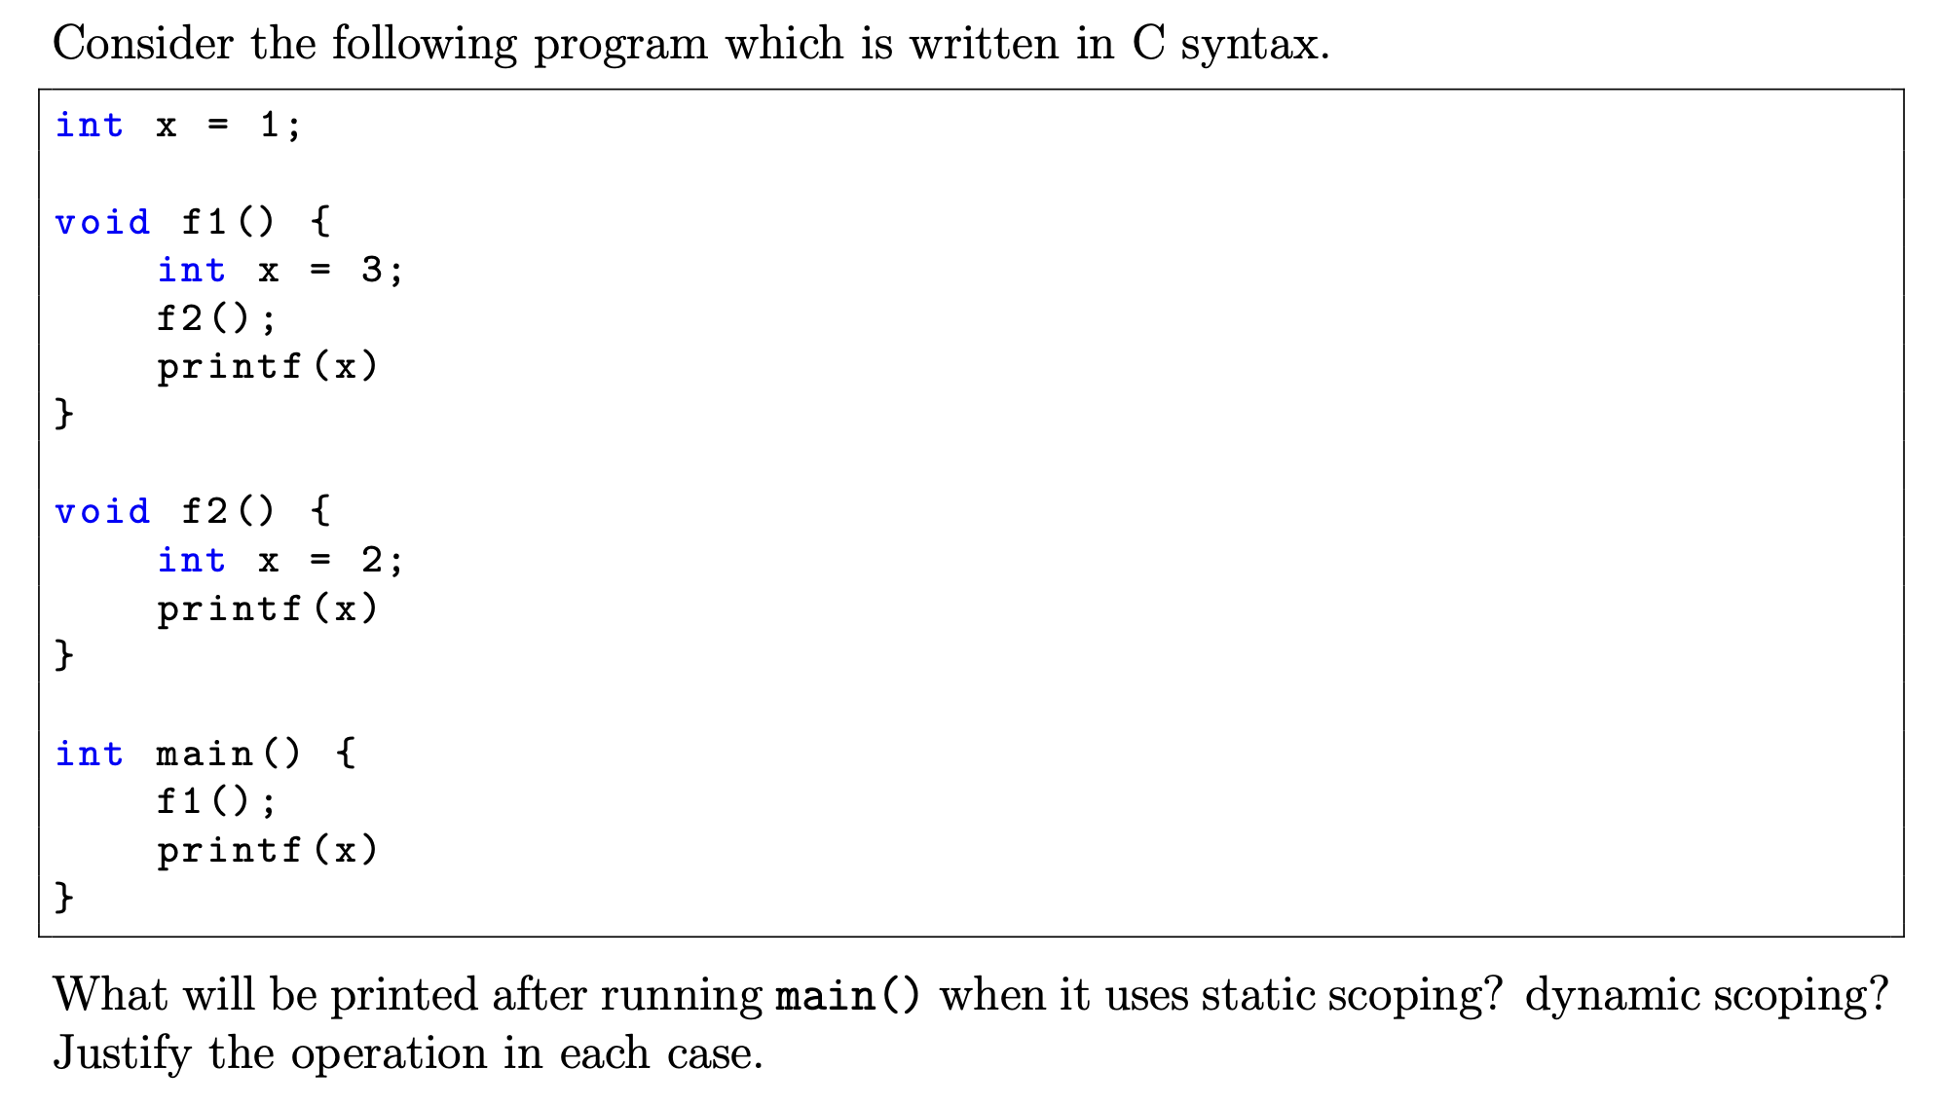
Assignment Solution
Overwrite x for scope
Any changes are local
x=3 association dies
x=2 association dies
Thus, output is 2 3 1
Only access to global main & global scope

Slide 13
Assignment Solution
Overwrite x
Association x=2 no longer active
Overwrite x
Thus, output is 2 3 1
Association x=3 no longer active
Most recent active association is 1

Slide 14
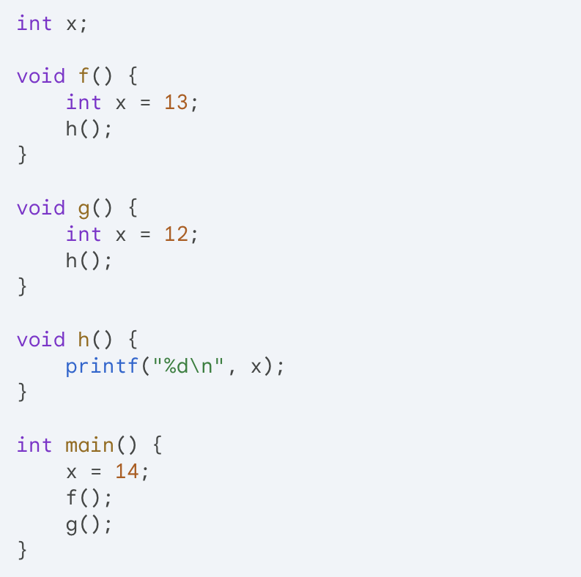
Assignment Solution
In static scoping, upon declaration, use association in current or outer scope
Thus, output is 14 14

Slide 15
Assignment Solution
When we get in here, x=13 is still active!
In dynamic scoping, use most recent active association
Thus, output is 13 12

Slide 16
Assignment Solution

Slide 17
Assignment Solution
Let’s remember tuples:

Slide 18
Assignment Solution
Let’s generalize into records:
$$j$$

Slide 19
Assignment Solution
Typing Semantics (Bonus):
Tuples—how to assign type to each new expression
Generalizing
to Records
Your syntax!

Slide 20
Assignment Solution
Bad decision as it violates call-by-value. Equivalence only holds when $t_{1}$ is certainly a value

Slide 21
Thank You

