Slide 1
Programming Language Concepts Tutorials
Become a Programming Languages Designer
Supervised by Dr. Kenny Zhu
TAs: Essam Abdelghany

Slide 2
Pop Quiz
Reminder in tutorials we recap on lecture, discuss assignments, discuss project or programming and solve practice problems.

Slide 3
Pop Quiz
1) To define a function that takes multiple variables in untyped lambda calculus……….
a) $λx. λy.x+y$
b) $λx. x+λy.y$
c) $λx. (x+λy.y)$
d) Impossible

Slide 4
Pop Quiz
2) The implementation $λc_{1}. λc_{2}. c_{1} tru c_{2}$:
a) Corresponds to $and$ operator
b) Corresponds to $or$operator
c) Corresponds to $not$operator
d) Corresponds to $if−else$ operator

Slide 5
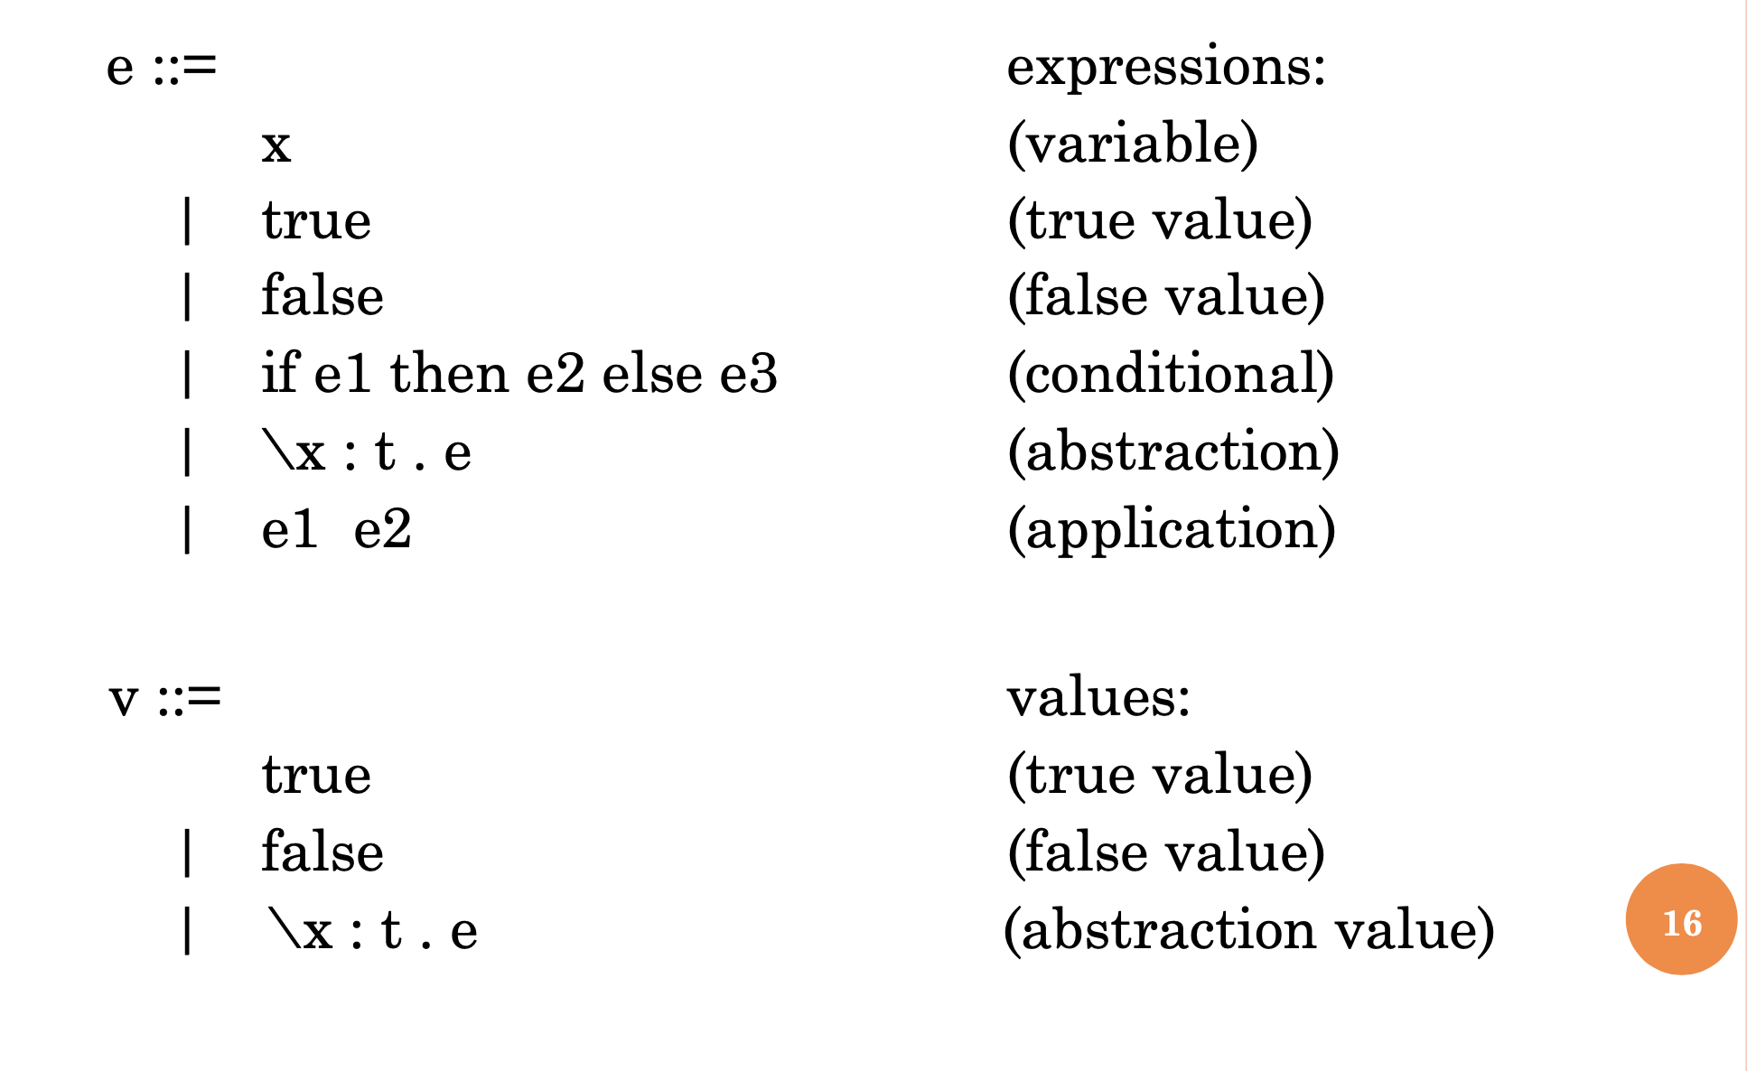
Pop Quiz
3) In simply-typed lambda calculus, values are……….
a) Classes, Objects and Interfaces
b) Variables
c) Functions or Booleans only
d) Functions only

Slide 6
Pop Quiz
4) After a step of evaluation of a well-typed expression of type t, the result must be a well-typed expression of type t
a) Progress theorem
b) Preservation theorem
c) Type safety theorem
d) Type checking theorem

Slide 7
Assignment Solution

Slide 8
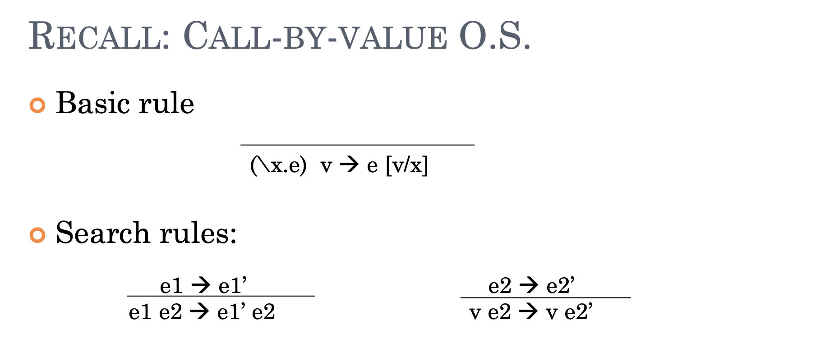
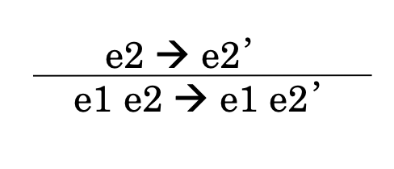
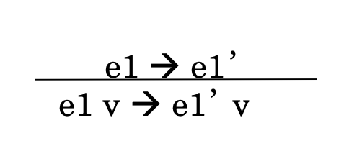
Quiz Solution

Slide 9
Quiz Solution
$$\left(λx.λthen.λelse. x then else\right) \left(λt.λf.f\right) a b$$
$$\left(λthen.λelse.(λt.λf.f) then else\right) a b$$
$$\left(\left(λt.λf.f\right) a b\right)$$
$$\left(b\right)$$

Slide 10
Assignment Solution
Gentle Reminder: Call-by-name VS. Call-by-value

Slide 11
Assignment Solution
Solution:
$$λx.\left(\left(λy.x+z+3\right) 3\right) 5→\left(λy.5+z+3\right) 3→5+z+3$$
How about$λz.\left(λx.\left(\left(λy.x+z+3\right) 3\right) 5\right)?$ Nothing evaluates!

Slide 12
Assignment Solution
$$Yg= λf. (λx. f( x x))(λx. f( x x )) g$$
$$Yg= (λx.g( x x))(λx.g( x x ))$$
$$Yg= \left(λx.g\left( xx \right)\right) \left(λx.g\left( x x \right)\right)$$
$Yg$ = $g\left( xx \right)[λx.g\left( x x \right)/x]$
$Yg$ = $g\left(λx.g\left( x x \right)λx.g\left( x x \right)\right)=g(Y g)$

Slide 13
Quiz Solution
Church encoding in Lambda Calculus:
How do we define $succ$ in Lambda calculus (e.g., $succ 2=3$)?
Observe that if $g_{n}=λf.λx. f^{n}x$ then:
$$g_{n} f x=f^{n} x$$ | $$g_{n} f z=f^{n} z$$ | $$g_{n} h ={λx. h}^{n} x$$
Input | $$g_{n}=λf.λx.f^{n} x$$
Output | $$g_{n+1}=λf.λx.{ff}^{n} x$$
Function | $$λg.(λf.λx. …)$$

Slide 14
Quiz Solution
Church encoding in Lambda Calculus:
How do we define $succ$ in Lambda calculus (e.g., $succ 2=3$)?
Observe that if $g_{n}=λf.λx. f^{n}x$ then:
$$g_{n} f x=f^{n} x$$ | $$g_{n} f z=f^{n} z$$ | $$g_{n} h ={λx. h}^{n} x$$
Input | $$g_{n}=λf.λx.f^{n} x$$
Output | $$g_{n+1}=λf.λx.{ff}^{n} x$$
Function | $$λg.(λf.λx.f(g f x))$$

Slide 15
Assignment Solution
How do we define $add$ in Lambda calculus (e.g., $add 2 3=5$)?
Observe that if $g_{n}=λf.λx. f^{n}x$ then:
$$g_{n} f x=f^{n} x$$ | $$g_{n} f z=f^{n} z$$ | $$g_{n} h ={λx. h}^{n} x$$
Input | $$g_{n_{1}}=λf.λx.f^{n_{1}} x and{ g}_{n_{2}}=λf.λx.f^{n_{2}} x$$
Output | $$g_{n_{1}+n_{2}}=λf.λx.{f^{n_{1}}f}^{n_{2}} x$$
Function | $$λg_{1}.λg_{2}.(λf.λx.…)$$

Slide 16
Assignment Solution
How do we define $add$ in Lambda calculus (e.g., $add 2 3=5$)?
Observe that if $g_{n}=λf.λx. f^{n}x$ then:
$$g_{n} f x=f^{n} x$$ | $$g_{n} f z=f^{n} z$$ | $$g_{n} h ={λx. h}^{n} x$$
Input | $$g_{n_{1}}=λf.λx.f^{n_{1}} x and{ g}_{n_{2}}=λf.λx.f^{n_{2}} x$$
Output | $$g_{n_{1}+n_{2}}=λf.λx.{f^{n_{1}}f}^{n_{2}} x=λf.λx.{f^{n_{1}}z}^{ } where z=f^{n_{2}}x$$
Function | $$λg_{1}.λg_{2}.\left(λf.λx.g_{1} f z\right) where z=f^{n_{2}}x⟹λg_{1}.λg_{2}.\left(λf.λx.g_{1} f (g_{2} f x)\right)$$
Thus, define $add=λg_{1}.λg_{2}.\left(λf.λx.g_{1} f (g_{2} f x)\right)$
Can similarly intuitively define $mul=λg_{1}.λg_{2}.λf.g_{1}(g_{2} f)$ using the third property.

Slide 17
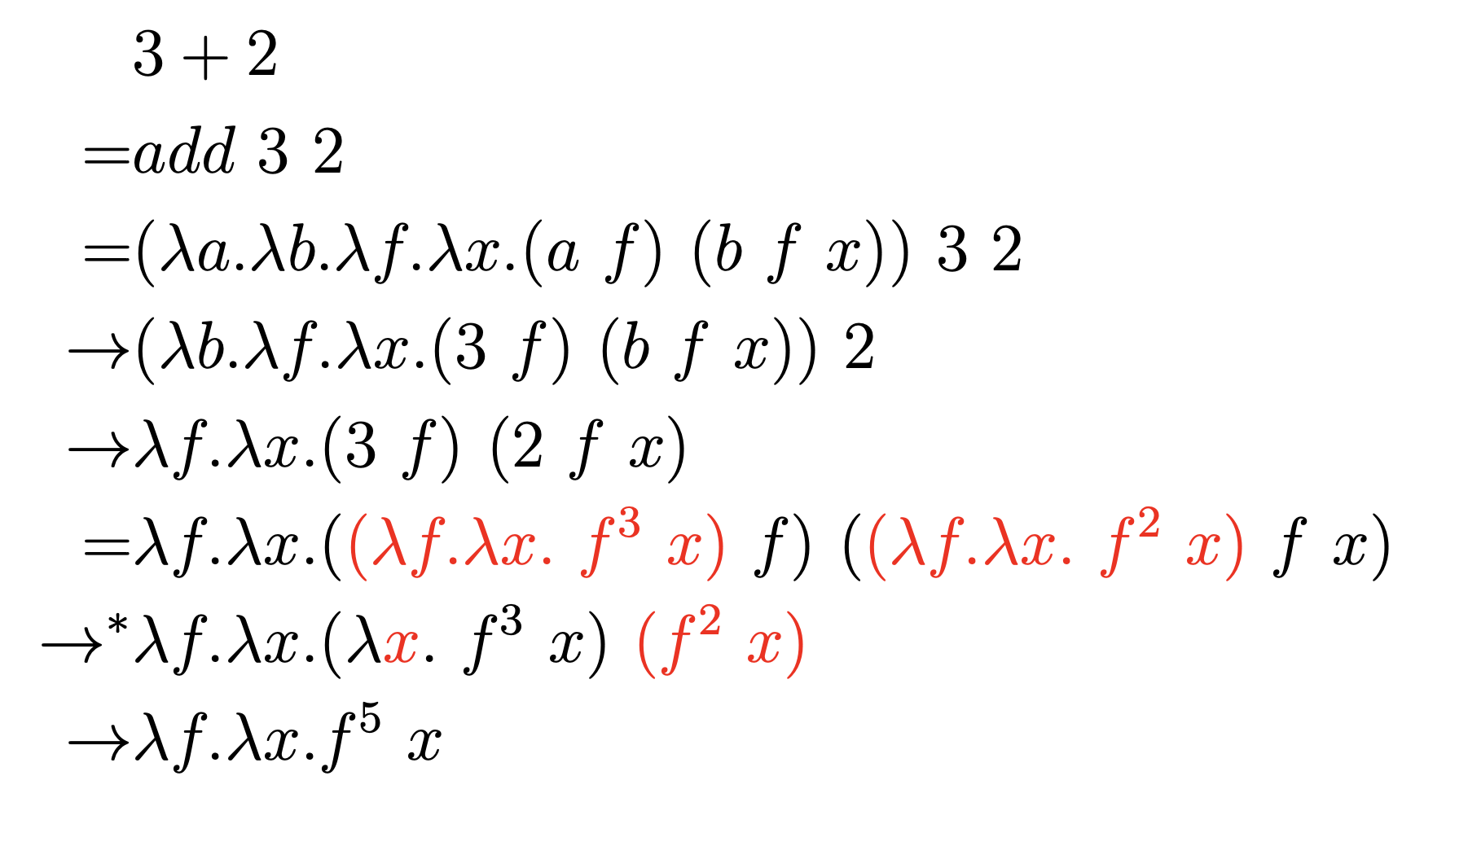
Assignment Solution
$add=λg_{1}.λg_{2}.\left(λf.λx.g_{1} f (g_{2} f x)\right)$ let’s evaluate add 3 2
$$\left(λg_{1}.λg_{2}.\left(λf.λx.g_{1} f \left(g_{2} f x\right)\right)\right) 3 2$$
$\left(\left(λf.λx.3 f \left(2 f x\right)\right)\right)$
$$\left(\left(λf.λx.3 f \left(2 f x\right)\right)\right)→\left(\left(λf.λx.f^{3} \left(2 f x\right)\right)\right)→\left(\left(λf.λx.f^{3} \left(f^{2} x\right)\right)\right)$$
$$\left(\left(λf.λx.f^{5}\left(x\right)\right)\right)$$
$$g_{n} f x=f^{n} x$$ | $$g_{n} f z=f^{n} z$$

Slide 18
Assignment Solution
$mul=λg_{1}.λg_{2}.λf.g_{1}(g_{2} f)$ let’s evaluate mul 3 2
$$\left(λg_{1}.λg_{2}.λf.g_{1}\left(g_{2} f\right)\right) 3 2$$
$λf.3 \left(2 f\right)→λf.λx. {\left(2 f\right)}^{3}x→λf.λx. {\left(λf.(λx. f^{2}x) f\right)}^{3}x$ $→λf.λx. {\left(λx. f^{2}x\right)}^{3}x$
$$→λf.λx. (λx. f^{2}x)\left(λx. f^{2}x\right)\left(λx. f^{2}x\right) x$$
$$→λf.λx. f^{2}\left(λx. f^{2}x\right)\left(λx. f^{2}x\right) x→λf.λx. f^{2}f^{2}\left(λx. f^{2}x\right) x$$
$$λf.λx. f^{2}f^{2}\left(f^{2}x\right)→λf.λx. f^{6}x$$
$$g_{n} h ={λx. h}^{n} x$$

Slide 19
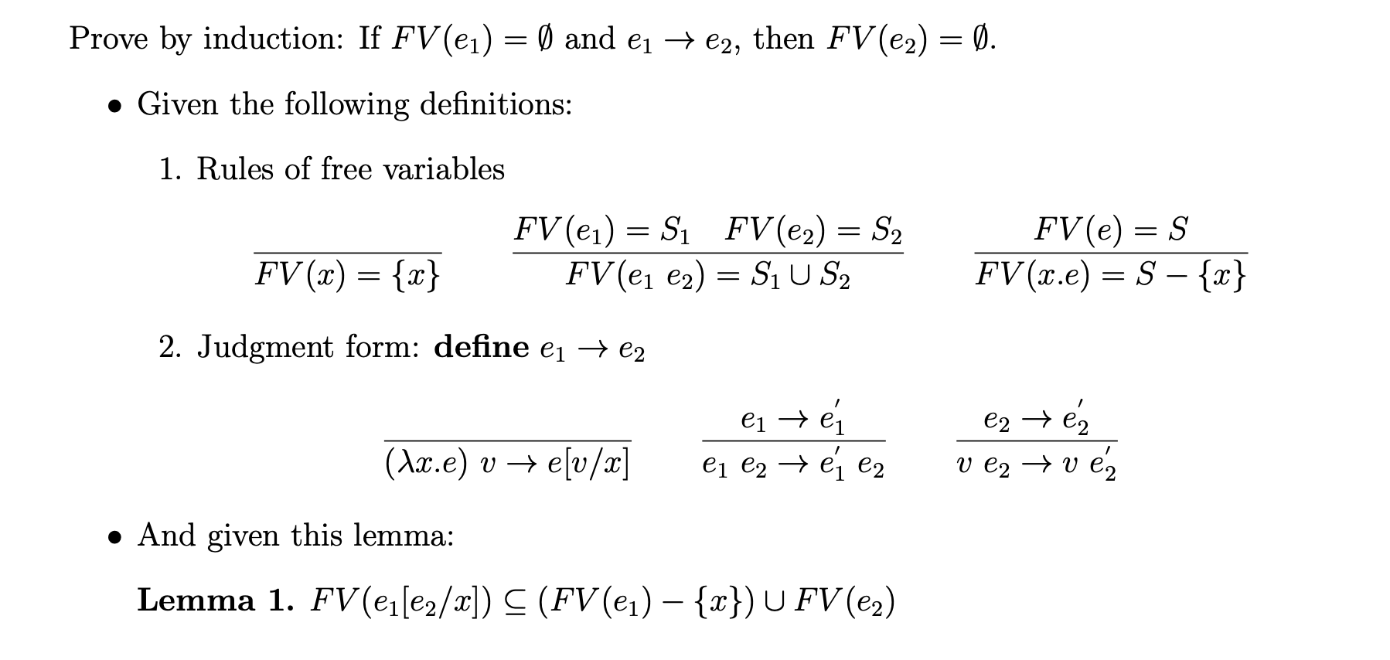
Assignment Solution
Assumption
& Rules
Lemma!
Our target!

Slide 20
Assignment Solution
Observation:
Want to show
$FV\left(e_{1}^{′}\right)=∅$
&
$FV\left(e_{2}\right)=∅$
Our target!

Slide 21
Assignment Solution
Observation:
Want to show
$FV\left(v\right)=∅$
&
$FV\left({e′}_{2}\right)=∅$
Our target!

Slide 22
Thank You

