Slide 1
Programming Language Concepts Tutorials
Become a Programming Languages Designer
Supervised by Dr. Kenny Zhu
TAs: Essam Abdelghany

Slide 2
Pop Quiz
Reminder in tutorials we recap on lecture, discuss assignments, discuss project or programming and solve practice problems.

Slide 3
Pop Quiz
1) True facts related to polymorphism include………..
Universal polymorphism allows functions to operate on any type
Universal polymorphism helps constraining types in an interface
An interface can be viewed as an existential statement regarding some type
An instance of the interface is a proof to the statement referred to in (c)

Slide 4
Pop Quiz
2) Type T1<=T2 means……….
T1 is a subtype of T2
All operations supported by T2 are supported by T1
Code that uses variables of type T2 will still work if they become of type T1
Code that uses variables of type T1 will still work if they become of type T2
(b) Implies that T1 will support at least as much operations

Slide 5
Pop Quiz
3) The term let $id=λx. x$in ($id 25$, $id true$) ……….
Is not well typed because it can be assigned multiple types
Is not well typed because $λx. x$can’t be both $int→int$ and $bool→bool$
Can be well-typed if modify rule to replace id with its definition
Can be well-typed if we use the top type and subsumption
Another solution, universal polymorphism:
$$let id=∀T.\left(λx:T. x\right) in (id\left[int\right] 25, id\left[bool\right] true)$$

Slide 6
Pop Quiz
4) Suppose Q’ is the tuple Q after adding n elements of specific types……….
Q <= Q’
Q’ <= Q
All operations permitted by Q are permitted by Q’ but not vice versa
The wider tuple Q’ is more specific

Slide 7
Pop Quiz
5) Modifications that if made to sums do not violate progress……….
Adding more types to the sum
Deducting some types from the sum
Replacing each type with one of its subtype
Replacing each type with one of its supertypes

Slide 8
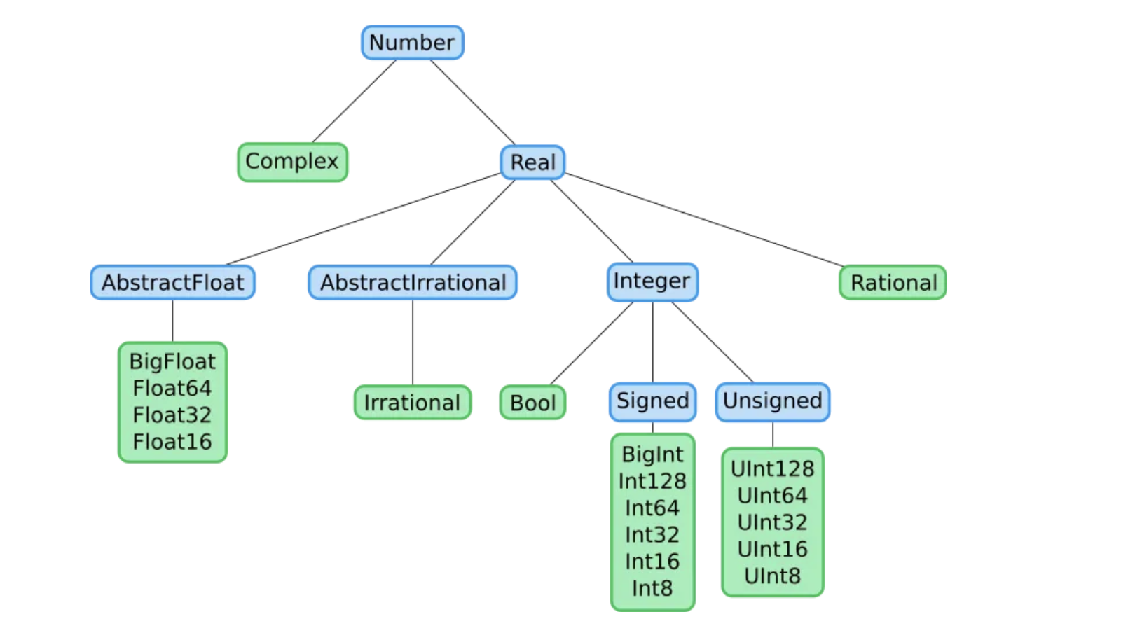
Pop Quiz
Julia numerical
Typing System

Slide 9
Pop Quiz
6) Suppose a function F1 takes a function F2 of type T1->T2……….
$F_{1} F_{3}$works if $F_{3}:T_{1}’→T_{2}$and $T_{1}’<=T_{1}$ (input more specific)
$F_{1} F_{3}$works if $F_{3}:T_{1}→T_{2}’$and $T_{2}<=T_{2}’$ (output more general)
$F_{1} F_{3}$works if $F_{3}:T_{1}→T_{2}’$and $T_{2}’<=T_{2}$ (output more specific)
$F_{1} F_{3}$works if $F_{3}:T_{1}’→T_{2} \text{and} T_{1}<={T′}_{1}$ (input more general)
If some code uses a function F2 that takes rational numbers and outputs an integer, then it will still work (type-check) if we replace it with a function F3 that takes real numbers and outputs a count.
F3 is subtype of F2 (i.e., F2 input shrinks and output widens over F3)

Slide 10
Quiz Solution

Slide 11
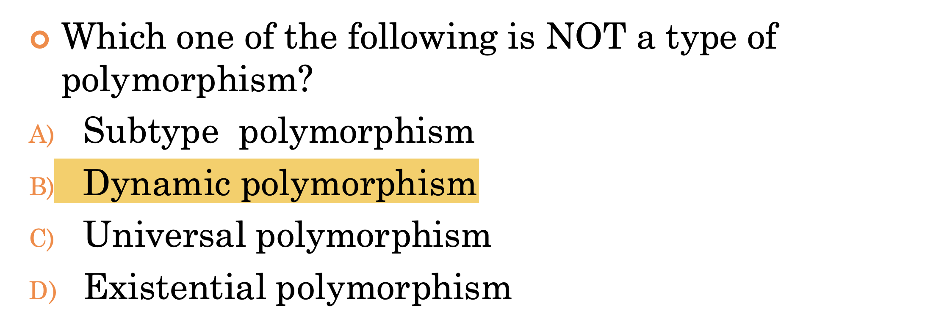
Quiz Solution
As in the pop quiz section, we saw examples of subtype, universal and existential polymorphism

Slide 12
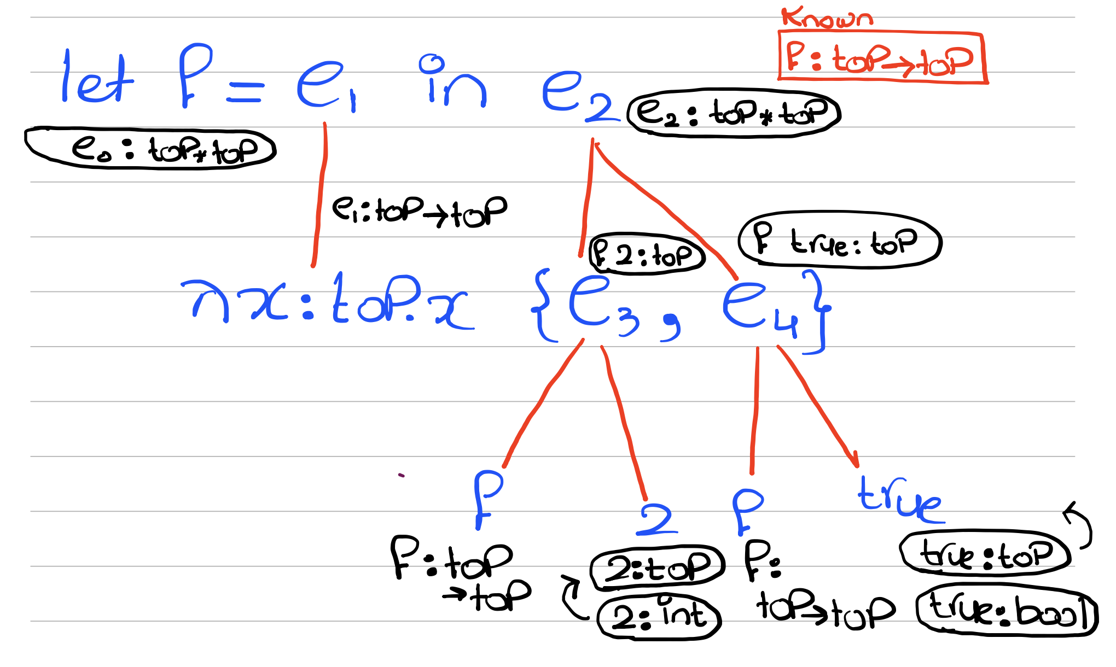
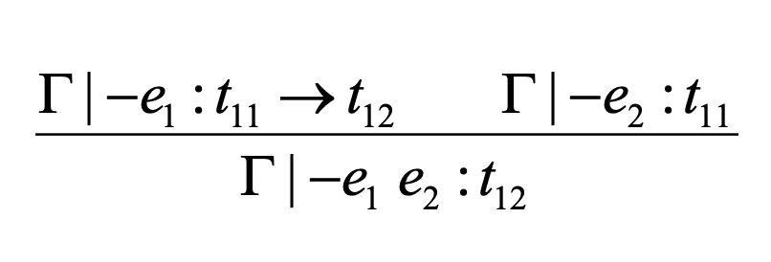
Quiz Solution
Reminder lecture problem:
Progress!!!

Slide 13
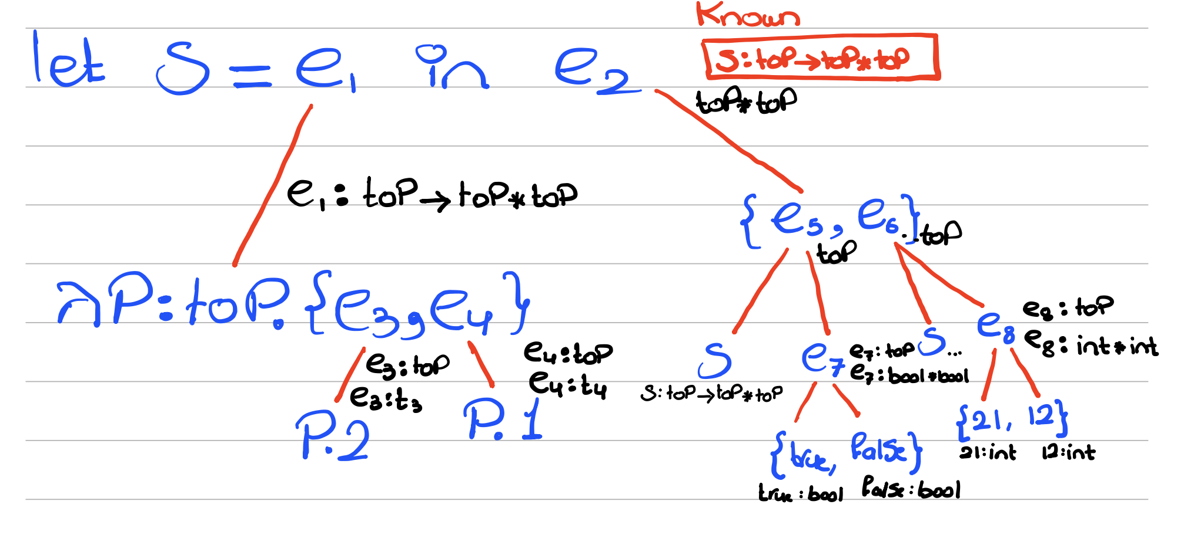
Quiz Solution

Slide 14
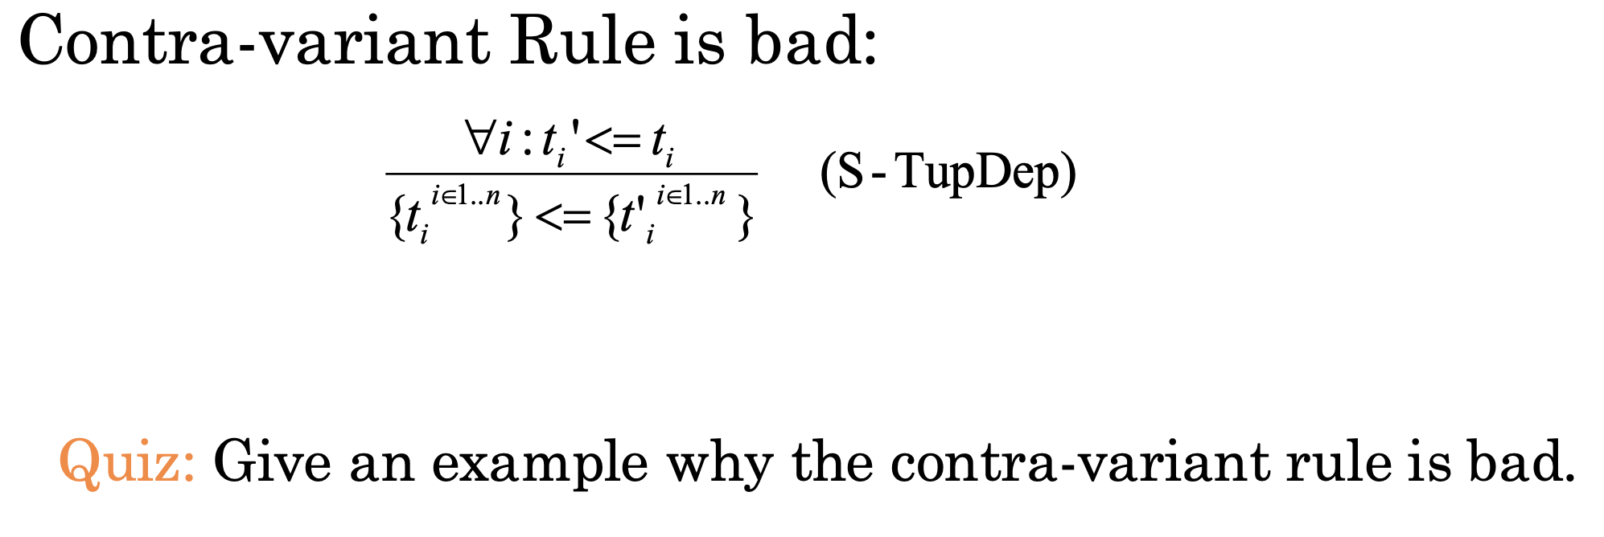
Quiz Solution
This rule states that if ${t′}_{1}≤t_{1},{t^{′}}_{2}≤t_{2},…,{t′}_{n}≤t_{n}$ then $t_{1}×{ t}_{2} ×…×t_{n}≤{t′}_{1}×{ t′}_{2} ×…×{t′}_{n}$
In other words, if the type of each element becomes more general then the type of the whole tuple is more specific
In other words, if we have code using a tuple and we make each element type more general it should still work

Slide 15
Quiz Solution
In other words, if we have code using a tuple and we make each element type more general it should still work
Wrong:
Consider $\left(λx:int×int×int.\left(x.1+x.2+x.3\right)\right) (\{2, 4, 6\})$ # works $(int×int×int)$
After widening $\left(λx:int×int×int.\left(x.1+x.2+x.3\right)\right) (\{2, 4, bool\})$ # fails $(int×int×Top)$

Slide 16
Assignment Solution
$$\left(S,\left\{int=int\right\} U q\right)→ \left(S, q\right) [1]$$ | $$\left(S,\left\{bool=bool\right\}U q\right)→\left(S, q\right) [2]$$ | $$\left(S,\left\{a=a\right\}U q\right)→\left(S, q\right) [3]$$
$$\left(S,\left\{s_{a}→s_{b}= s_{c}→s_{d}\right\} U q\right)→\left(S, \left\{s_{a} = s_{c}, s_{b} = s_{d}\right\} U q\right) [4]$$ |  | $$\left(S,\left\{s=a\right\}U q\right)→\left(\left[a=s\right]o S, q\left[\frac{s}{a}\right]\right)\left[5\right] \\ where a∉FV(s)$$

Slide 17
Assignment Solution
$$\left(I,\left\{X=Int,Y=X→X,Z=Z\right\}\right)→^{\left[3\right]}\left(I,\left\{X=Int,Y=X→X\right\}\right)→^{\left[5\right]}\left(\left[X=Int\right],\left\{Y=Int→Int\right\}\right) \\ →^{\left[5\right]}\left(\left[X=Int,Y=Int→Int\right],\left\{ \right\}\right)$$
$$\left(S,\left\{int=int\right\} U q\right)→ \left(S, q\right) [1]$$ | $$\left(S,\left\{bool=bool\right\}U q\right)→\left(S, q\right) [2]$$ | $$\left(S,\left\{a=a\right\}U q\right)→\left(S, q\right) [3]$$
$$\left(S,\left\{s_{a}→s_{b}= s_{c}→s_{d}\right\} U q\right)→\left(S, \left\{s_{a} = s_{c}, s_{b} = s_{d}\right\} U q\right) [4]$$ |  | $$(S,\{s=a\} U q)→([a=s] o S, q[s/a])[5]$$

Slide 18
Assignment Solution
$$\left(I,\left\{Int→Int=Z→X\right\}\right)→^{\left[4\right]}\left(I,\left\{Int=Z, Int=X\right\}\right)→^{\left[5\right]\left[5\right]}\left([Z=Int, X=Int], \{\}\right)$$
$$\left(S,\left\{int=int\right\} U q\right)→ \left(S, q\right) [1]$$ | $$\left(S,\left\{bool=bool\right\}U q\right)→\left(S, q\right) [2]$$ | $$\left(S,\left\{a=a\right\}U q\right)→\left(S, q\right) [3]$$
$$\left(S,\left\{s_{a}→s_{b}= s_{c}→s_{d}\right\} U q\right)→\left(S, \left\{s_{a} = s_{c}, s_{b} = s_{d}\right\} U q\right) [4]$$ |  | $$(S,\{s=a\} U q)→([a=s] o S, q[s/a])[5]$$

Slide 19
Assignment Solution
$\left(I,\left\{Z→Y=Y→X, X=U→W\right\}\right)→^{\left[4\right]}$ $\left(I,\left\{Z=Y,Y=X, X=U→W\right\}\right)→^{\left[5\right]}\left([Z=Y],\left\{Y=X, X=U→W\right\}\right)$ $→^{\left[5\right]}\left([Z=Y,Y=X],\left\{X=U→W\right\}\right)→^{\left[5\right]}$ $\left([Z=Y,Y=X,X=X=U→W],\left\{ \right\}\right)$
$$\left(S,\left\{int=int\right\} U q\right)→ \left(S, q\right) [1]$$ | $$\left(S,\left\{bool=bool\right\} U q\right)→\left(S, q\right) [2]$$ | $$\left(S,\left\{a=a\right\}U q\right)→\left(S, q\right) [3]$$
$$\left(S,\left\{s_{a}→s_{b}= s_{c}→s_{d}\right\} U q\right)→\left(S, \left\{s_{a} = s_{c}, s_{b} = s_{d}\right\} U q\right) [4]$$ |  | $$(S,\{s=a\} U q)→([a=s] o S, q[s/a])[5]$$

Slide 20
Assignment Solution
$$4) No rule can be applied (fails occur check:Int∉FV(Int→X). Stuck. No solution. \\ 5) S=I$$
$$\left(S,\left\{int=int\right\} U q\right)→ \left(S, q\right) [1]$$ | $$\left(S,\left\{bool=bool\right\} U q\right)→\left(S, q\right) [2]$$ | $$\left(S,\left\{a=a\right\}U q\right)→\left(S, q\right) [3]$$
$$\left(S,\left\{s_{a}→s_{b}= s_{c}→s_{d}\right\} U q\right)→\left(S, \left\{s_{a} = s_{c}, s_{b} = s_{d}\right\} U q\right) [4]$$ |  | $$(S,\{s=a\} U q)→([a=s] o S, q[s/a])[5]$$

Slide 21
Assignment Solution
Can write this as:
$$e_{o}=case a of nil⇒nil | e_{1}⇒e_{2}$$
$$e_{1}=h∷t$$
$$e_{2}=c (e_{3},e_{4})$$
$$e_{3}=m\left(t,g\right) \\ e_{4}=g(h)$$
Bindings:
$$a:A$$ | $$g:G$$ |  | $$m:\left(A∗G\right)→R$$
 |  |  | $$c:\left(List Z∗Z\right)→List Z$$
Constraints:

Slide 22
Assignment Solution
$$\frac{G├{ u}_{1}→e_{1}:t_{1},q_{1} G├{ u}_{2}→e_{2}:t_{2},q_{2}}{G├{ u}_{1}{ u}_{2}→e_{1}{ e}_{2}:(a,q_{1}∪q_{2}∪\left\{t_{1}=t_{2}→a\right\}) }$$
Arguments first!
Can write this as:
$$e_{o}=case a of nil⇒nil | e_{1}⇒e_{2}$$
$$e_{1}=h∷t$$
$$e_{2}=c (e_{3},e_{4})$$
$$e_{3}=m\left(t,g\right) \\ e_{4}=g(h)$$
Bindings:
$$a:A$$ | $$g:G$$ |  | $$m:\left(A∗G\right)→R$$
$$h:H$$ | $$e_{4}:E_{4}$$ |  | $$c:\left(List Z∗Z\right)→List Z$$
Constraints:
$$G=H→E_{4}$$

Slide 23
Assignment Solution
$$\frac{G├{ u}_{1}→e_{1}:t_{1},q_{1} G├{ u}_{2}→e_{2}:t_{2},q_{2}}{G├{ u}_{1}{ u}_{2}→e_{1}{ e}_{2}:(a,q_{1}∪q_{2}∪\left\{t_{1}=t_{2}→a\right\}) }$$
Arguments first!
Can write this as:
$$e_{o}=case a of nil⇒nil | e_{1}⇒e_{2}$$
$$e_{1}=h∷t$$
$$e_{2}=c (e_{3},e_{4})$$
$$e_{3}=m\left(t,g\right) \\ e_{4}=g(h)$$
Bindings:
$$a:A$$ | $$g:G$$ |  | $$m:\left(A∗G\right)→R$$
$$h:H$$ | $$e_{4}:E_{4}$$ | $$t:T$$ | $$c:\left(List Z∗Z\right)→List Z$$
$$e_{3}:E_{3}$$
Constraints:
$$G=H→E_{4}$$ | $$M=(T∗G)→E_{3}$$

Slide 24
Assignment Solution
$$\frac{G├{ u}_{1}→e_{1}:t_{1},q_{1} G├{ u}_{2}→e_{2}:t_{2},q_{2}}{G├{ u}_{1}{ u}_{2}→e_{1}{ e}_{2}:(a,q_{1}∪q_{2}∪\left\{t_{1}=t_{2}→a\right\}) }$$
Arguments first!
Can write this as:
$$e_{o}=case a of nil⇒nil | e_{1}⇒e_{2}$$
$$e_{1}=h∷t$$
$$e_{2}=c (e_{3},e_{4})$$
$$e_{3}=m\left(t,g\right) \\ e_{4}=g(h)$$
Bindings:
$$a:A$$ | $$g:G$$ |  | $$m:\left(A∗G\right)→R$$
$$h:H$$ | $$e_{4}:E_{4}$$ | $$t:T$$ | $$c:\left(List Z∗Z\right)→List Z$$
$$e_{3}:E_{3}$$ | $$e_{2}:E_{2}$$
Constraints:
$$G=H→E_{4}$$ | $$M=(T∗G)→E_{3}$$
$$C=(E_{3}∗E_{4})→E_{2}$$

Slide 25
Assignment Solution
Can write this as:
$$e_{o}=case a of nil⇒nil | e_{1}⇒e_{2}$$
$$e_{1}=h∷t$$
$$e_{2}=c (e_{3},e_{4})$$
$$e_{3}=m\left(t,g\right) \\ e_{4}=g(h)$$
Bindings:
$$a:A$$ | $$g:G$$ |  | $$m:\left(A∗G\right)→R$$
$$h:H$$ | $$e_{4}:E_{4}$$ | $$t:T$$ | $$c:\left(List Z∗Z\right)→List Z$$
$$e_{3}:E_{3}$$ | $$e_{2}:E_{2}$$ | $$e_{1}:E_{1}$$
Constraints:
$$G=H→E_{4}$$ | $$M=(T∗G)→E_{3}$$
$$C=(E_{3}∗E_{4})→E_{2}$$ | $$E_{1}=T=H List$$

Slide 26
Assignment Solution
Bindings:
Can write this as:
$$e_{o}=case a of nil⇒nil | e_{1}⇒e_{2}$$
$$e_{1}=h∷t$$
$$e_{2}=c (e_{3},e_{4})$$
$$e_{3}=m\left(t,g\right) \\ e_{4}=g(h)$$
$$a:A$$ | $$g:G$$ |  | $$m:\left(A∗G\right)→R$$
$$h:H$$ | $$e_{4}:E_{4}$$ | $$t:T$$ | $$c:\left(List Z∗Z\right)→List Z$$
$$e_{3}:E_{3}$$ | $$e_{2}:E_{2}$$ | $$e_{1}:E_{1}$$ | $$e_{o}:E_{o}$$
Constraints:
$$G=H→E_{4}$$ | $$M=(T∗G)→E_{3}$$ | $$A=List N=E_{1}$$
$$C=(E_{3}∗E_{4})→E_{2}$$ | $$E_{1}=T=H List$$ | $$E_{o}=List N′=E_{2}$$

Slide 27
Assignment Solution
Bindings:
$$a:A$$ | $$g:G$$ |  | $$m:M$$
$$h:H$$ | $$e_{4}:E_{4}$$ | $$t:T$$ | $$c:C$$
$$e_{3}:E_{3}$$ | $$e_{2}:E_{2}$$ | $$e_{1}:E_{1}$$ | $$e_{o}:E_{o}$$
Adding Type Schemes ✅
Generating Constraints ✅
Solving Constraints …
Constraints:
$$G=H→E_{4}$$ | $$M=(T∗G)→E_{3}$$ | $$A=List N=E_{1}$$
$$C=(E_{3}∗E_{4})→E_{2}$$ | $$E_{1}=T=H List$$ | $$E_{o}=List N′=E_{2}$$
$$M=(A∗G)→R$$ | $$C=\left(List Z∗Z\right)→List Z$$
Unification Algorithm:
$$(S,\{s_{a}→s_{b}= s_{c}→s_{d}\} U q)→(S, \{s_{a} = s_{c}, s_{b} = s_{d}\} U q)$$ | $$(S,\{s=a\} U q)→([a=s] o S, q[s/a])$$
Type variables: $A,G,M,H,T,C,E_{o},E_{1},E_{2},E_{3},E_{4}$

Slide 28
Assignment Solution
Constraints:
$$G=H→E_{4}$$ | $$M=(T∗G)→E_{3}$$ | $$A=List N=E_{1}$$
$$C=(E_{3}∗E_{4})→E_{2}$$ | $$E_{1}=T=H List$$ | $$E_{o}=List N′=E_{2}$$
$$M=(A∗G)→R$$ | $$C=\left(List Z∗Z\right)→List Z$$
Equate Functions M=M and C=C
$$G=H→E_{4}$$ |  | $$A=List N=E_{1}$$
$$E_{3}=List Z, E_{4}=Z, E_{2}=List Z$$ | $$E_{1}=T=H List$$ | $$E_{o}=List N′=E_{2}$$
$$A=T, R=E_{3}$$
Solve for E4=Z
$$S=[E_{4}⇒Z]$$
$$G=H→Z$$ |  | $$A=List N=E_{1}$$
$$E_{3}=List Z, E_{2}=List Z$$ | $$E_{1}=T=H List$$ | $$E_{o}=List N′=E_{2}$$
$$A=T, R=E_{3}$$

Slide 29
Assignment Solution
Solve for E4=Z
$$S=[E_{4}⇒Z]$$
$$G=H→Z$$ |  | $$A=List N=E_{1}$$
$$E_{3}=List Z, E_{2}=List Z$$ | $$E_{1}=T=H List$$ | $$E_{o}=List N′=E_{2}$$
$$A=T, R=E_{3}$$
Solve for E1 = A
$$S=[E_{4}⇒Z, E_{1}=A]$$
$$G=H→Z$$ |  | $$A= List N$$
$$E_{3}=List Z, E_{2}=List Z$$ | $$A=T=H List$$ | $$E_{o}=List N′=E_{2}$$
$$A=T, R=E_{3}$$
Solve for E2 = List Z
$$S=[E_{4}⇒Z, E_{1}=A, E_{2}=List Z]$$
$$G=H→Z$$ |  | $$A= List N$$
$$E_{3}=List Z$$ | $$A=T=H List$$ | $$E_{o}=List N^{′}=List Z$$
$$A=T, R=E_{3}$$

Slide 30
Assignment Solution
Solve for E2 = List Z
$$S=[E_{4}⇒Z, E_{1}=A, E_{2}=List Z]$$
$$G=H→Z$$ |  | $$A= List N$$
$$E_{3}=List Z$$ | $$A=T=H List$$ | $$E_{o}=List N^{′}=List Z$$
$$A=T, R=E_{3}$$
Solve for E3 = List Z
$$S=[E_{4}⇒Z, E_{1}=A, E_{2}=List Z, E_{3}=List Z]$$
$$G=H→Z$$ |  | $$A= List N$$
 | $$A=T=H List$$ | $$E_{o}=List N^{′}=List Z$$
$$A=T, R=List Z$$
Solve for E0 = List Z, R=List Z
$$S=[E_{4}⇒Z, E_{1}=A, E_{2}=List Z, E_{3}=List Z, E_{0}=List Z, R=List Z]$$
$$G=H→Z$$ |  | $$A= List N$$
 | $$A=T=H List$$ | $$List N^{′}=List Z$$
$$A=T$$

Slide 31
Assignment Solution
Solve for E0 = List Z, R=List Z
$$S=[E_{4}⇒Z, E_{1}=A, E_{2}=List Z, E_{3}=List Z, E_{0}=List Z, R=List Z]$$
$$G=H→Z$$ |  | $$A= List N$$
 | $$A=T=H List$$ | $$List N^{′}=List Z$$
$$A=T$$
Solve for A=T
$$S=[E_{4}⇒Z, E_{1}=A, E_{2}=List Z, E_{3}=List Z, E_{0}=List Z, R=List Z, A=T]$$
$$G=H→Z$$ |  | $$T= List N$$
 | $$T=H List$$ | $$List N^{′}=List Z$$
Solve for N=H, T=H List, N’=Z, G=H->Z
Generate Types:
$$S=[E_{4}⇒Z, E_{1}=A, E_{2}=List Z, E_{3}=List Z, E_{0}=List Z, R=List Z, A=T, N=H, T=H List,N^{′}=Z,G=H→Z]$$
$$m:\left(A∗G\right)→R=(H List∗\left(H→Z\right)→List Z)$$

Slide 32
Thank You

