Slide 1
Programming Language Concepts Tutorials
Become a Programming Languages Designer
Supervised by Dr. Kenny Zhu
TAs: Essam Abdelghany

Slide 2
Pop Quiz
Reminder in tutorials we recap on lecture, discuss assignments, discuss project or programming and solve practice problems.

Slide 3
Pop Quiz
1) Issues with Mark and Sweep……….
Cannot detect cycles
Causes “stop the world” events in Java
Does not handle heap fragmentation
High reduction of effective heap space

Slide 4
Pop Quiz
2) In the sweep step of mark and sweep……….
The reference graph is swept to find all allocated cells
The memory cells in the heap are scanned and compared to the marked cells
The memory cells in the fragmented area of the heap is swept
The reference graph and heap are swept together

Slide 5
Pop Quiz
3) Advantages of Copy Collection……….
Increases effective size of heap
Handles heap fragmentation
Little page faults even if program uses a lot of memory memory
Memories in BCC will not be copy collected (CCed)

Slide 6
Pop Quiz
4) A type scheme is……….
An abstract representation of type containing type variables (e.g., $α list$)
A concrete type (e.g., int)
A single type variable (e.g., $α$)
A polymorphically typed expression (e.g., $e:α list$)

Slide 7
Pop Quiz
5) We need type inference because……….
Types overly constraint our program (e.g., reversing works on all element types)
Type errors cause programs to crash
Types clutter programs and hurt programmer productivity
Machine learning is used everywhere

Slide 8
Pop Quiz
6) Steps for type inference do not include……….
Adding type schemes
Traversing and Generating constraints
Type overloading
Solving constraints
Generating types

Slide 9
Pop Quiz
7) Given two substitutions U and S……….
Either U is more specific than S or S is more specific than U
If S is more specific, then it’s equivalent to applying U followed by another substitution
If U is less general, then it’s equivalent to applying S
If S is identity, then it’s the least general

Slide 10
Quiz Solution

Slide 11
Recap
Variables & Constants
$$\frac{if G(x)=s }{G├ x→x:(s, \left\{ \right\}) }$$
$$\frac{ }{G├ true → true :\left(bool, \left\{ \right\}\right) }$$
$$\frac{ }{G├ false→false :\left(bool, \left\{ \right\}\right) }$$
$$\frac{ }{G├ 3→3:(int,\left\{ \right\}) }$$
Binary Operators
$$\frac{G\left.{{├ u}_{1}→e_{1}:(t_{1},q}_{1}\right) G\left.{{├ u}_{2}→e_{2}:(t_{2},q}_{2}\right)}{G├{ u}_{1}+u_{2}→e_{1}+ e_{2} :\left(int,{ q}_{1}∪q_{2}∪\left\{t_{1}=int,t_{2}=int\right\}\right) }$$
$$\frac{G\left.{├u}_{1}→{(e}_{1}:t_{1}\right),q_{1} G├{ u}_{2}→e_{2}:(t_{2},q_{2})}{G├{ u}_{1}<u_{2}→e_{1}<e_{2}:(bool,q_{1}∪q_{2}∪\left\{t_{1}=int,t_{2}= int\right\}) }$$
If-then-else
$$\frac{G├{ u}_{1}→e_{1}:(t_{1},q_{1}) G├ u_{2}→e_{2}:{(t}_{2},q_{2}) G├ u_{3}→e_{3} :{(t}_{3},q_{3})}{G├ if{ u}_{1} then{ u}_{2} else{ u}_{3}→if{ e}_{1} then{ e}_{2} else{ e}_{3}:(a,q_{1}∪q_{2}∪q_{3}∪\left\{t_{1}= bool, a =t_{2}, a =t_{3}\right\}) }$$
Function Calls
Function Definition
$$\frac{G├{ u}_{1}→e_{1}:t_{1},q_{1} G├{ u}_{2}→e_{2}:t_{2},q_{2}}{G├{ u}_{1}{ u}_{2}→e_{1}{ e}_{2}:(a,q_{1}∪q_{2}∪\left\{t_{1}=t_{2}→a\right\}) }$$
$$\frac{G, (f : a⟹ b), (x : a)├ u→e :(t, q) }{G├ fun(x)=u→fun(x:a):b=e:\left(a⟹b, q∪\left\{t = b\right\}\right) }$$
Arrow is a step towards type inference

Slide 12
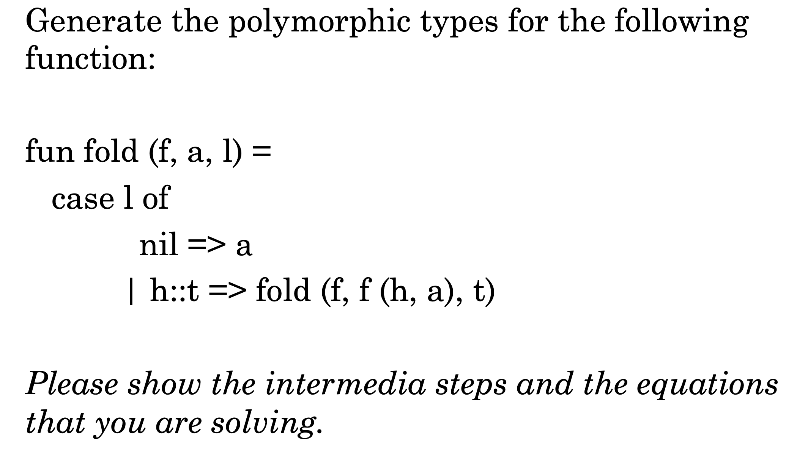
Quiz Solution

Slide 13
Quiz Solution
Can write this as:
$$e_{o}=case l of nil⇒a | x_{1}⇒e_{1}$$
$$x_{1}=h∷t$$
$$e_{1}=fold\left(f, e_{2}, t\right) \\ e_{2}=f(h,a)$$
Bindings:
$$f:F$$ | $$a:A$$ | $$l:L$$ | $$fold:\left(F∗A∗L\right)→R$$
Constraints:

Slide 14
Quiz Solution
$$\frac{G├{ u}_{1}→e_{1}:t_{1},q_{1} G├{ u}_{2}→e_{2}:t_{2},q_{2}}{G├{ u}_{1}{ u}_{2}→e_{1}{ e}_{2}:(a,q_{1}∪q_{2}∪\left\{t_{1}=t_{2}→a\right\}) }$$
Arguments first!
Can write this as:
$$e_{o}=case l of nil⇒a | x_{1}⇒e_{1}$$
$$x_{1}=h∷t$$
$$e_{1}=fold\left(f, e_{2}, t\right) \\ e_{2}=f(h,a)$$
Bindings:
$$f:F$$ | $$a:A$$ | $$l:L$$ | $$fold:\left(F∗A∗L\right)→R$$
$$h:H$$ | $$e_{2}:E_{2}$$
Constraints:
$$f=\left(H∗A\right)→E_{2}$$

Slide 15
Quiz Solution
$$\frac{G├{ u}_{1}→e_{1}:t_{1},q_{1} G├{ u}_{2}→e_{2}:t_{2},q_{2}}{G├{ u}_{1}{ u}_{2}→e_{1}{ e}_{2}:(a,q_{1}∪q_{2}∪\left\{t_{1}=t_{2}→a\right\}) }$$
Arguments first!
Can write this as:
$$e_{o}=case l of nil⇒a | x_{1}⇒e_{1}$$
$$x_{1}=h∷t$$
$$e_{1}=fold\left(f, e_{2}, t\right) \\ e_{2}=f(h,a)$$
Bindings:
$$f:F$$ | $$a:A$$ | $$l:L$$ | $$fold:\left(F∗A∗L\right)→R$$
$$h:H$$ | $$e_{2}:E_{2}$$ | $$t:T$$ | $$e_{1}:E_{1}$$
Constraints:
$$F=\left(H∗A\right)→E_{2}$$

Slide 16
Quiz Solution
$$\frac{G├{ u}_{1}→e_{1}:t_{1},q_{1} G├{ u}_{2}→e_{2}:t_{2},q_{2}}{G├{ u}_{1}{ u}_{2}→e_{1}{ e}_{2}:(a,q_{1}∪q_{2}∪\left\{t_{1}=t_{2}→a\right\}) }$$
Then add function type constr.
Can write this as:
$$e_{o}=case l of nil⇒a | x_{1}⇒e_{1}$$
$$x_{1}=h∷t$$
$$e_{1}=fold\left(f, e_{2}, t\right) \\ e_{2}=f(h,a)$$
Bindings:
$$f:F$$ | $$a:A$$ | $$l:L$$ | $$fold:\left(F∗A∗L\right)→R$$
$$h:H$$ | $$e_{2}:E_{2}$$ | $$t:T$$ | $$e_{1}:E_{1}$$
Constraints:
$$F=\left(H∗A\right)→E_{2}$$ | $$E_{2}=A$$ | $$T=L$$ | $$E_{1}=R$$
In other words, we simplified $\left(F∗A∗L\right)→R=\left(F∗E_{2}∗T\right)→E_{1}$

Slide 17
Quiz Solution
Logic…
h::t is cons(h,t)
Bindings:
Can write this as:
$$e_{o}=case l of nil⇒a | x_{1}⇒e_{1}$$
$$x_{1}=h∷t$$
$$e_{1}=fold\left(f, e_{2}, t\right) \\ e_{2}=f(h,a)$$
$$f:F$$ | $$a:A$$ | $$l:L$$ | $$fold:\left(F∗A∗L\right)→R$$
$$h:H$$ | $$e_{2}:E_{2}$$ | $$t:T$$ | $$e_{1}:E_{1}$$
$$x_{1}:H list$$
Constraints:
$$F=\left(H∗A\right)→E_{2}$$ | $$E_{2}=A$$ | $$T=L$$ | $$E_{1}=R$$
$$T=H List$$

Slide 18
Quiz Solution
Both sides should have
same type…
Bindings:
Can write this as:
$$e_{o}=case l of nil⇒a | x_{1}⇒e_{1}$$
$$x_{1}=h∷t$$
$$e_{1}=fold\left(f, e_{2}, t\right) \\ e_{2}=f(h,a)$$
$$f:F$$ | $$a:A$$ | $$l:L$$ | $$fold:\left(F∗A∗L\right)→R$$
$$h:H$$ | $$e_{2}:E_{2}$$ | $$t:T$$ | $$e_{1}:E_{1}$$
$$x_{1}:H list$$ | $$nil:N list$$
Constraints:
$$F=\left(H∗A\right)→E_{2}$$ | $$E_{2}=A$$ | $$T=L$$ | $$E_{1}=R$$
$$T=H List$$ | $$N=H$$ | $$L=H List$$ | $$E_{1}=A$$

Slide 19
Quiz Solution
Bindings:
Solving time!
$$f:F$$ | $$a:A$$ | $$l:L$$ | $$fold:\left(F∗A∗L\right)→R$$
$$h:H$$ | $$e_{2}:E_{2}$$ | $$t:T$$ | $$e_{1}:E_{1}$$
$$x_{1}:H list$$ | $$nil:N list$$
Consume:
$$E_{1}=R$$
$$E_{1}=A$$
$$E_{2}=A$$
i.e.,
$$E_{1}=E_{2}=R=A$$
Constraints:
$$F=\left(H∗A\right)→E_{2}$$ | $$E_{2}=A$$ | $$T=L$$ | $$E_{1}=R$$
$$T=H List$$ | $$N=H$$ | $$L=H List$$ | $$E_{1}=A$$

Slide 20
Quiz Solution
Bindings:
Solving time!
$$f:F$$ | $$a:A$$ | $$l:L$$ | $$fold:\left(F∗A∗L\right)→A$$
$$h:H$$ | $$e_{2}:A$$ | $$t:T$$ | $$e_{1}:A$$
$$x_{1}:H list$$ | $$nil:N list$$
Notice no trace for $E_{1}, E_{2}, R$
Consume:
$$T=L$$
$$L=H list$$
$$T=H list \\ N=H$$
Constraints:
$$F=\left(H∗A\right)→A$$ |  | $$T=L$$
$$T=H List$$ | $$N=H$$ | $$L=H List$$

Slide 21
Quiz Solution
Bindings:
Solving time!
$$f:F$$ | $$a:A$$ | $$l:H list$$ | $$fold:\left(F∗A∗H list\right)→A$$
$$h:H$$ | $$e_{2}:A$$ | $$t:H list$$ | $$e_{1}:A$$
$$x_{1}:H list$$ | $$nil:H list$$
Notice no trace for $T, L,N$
Consume:
$$F=\left(H∗A\right)→A$$
Get:
$$fold:\left(\left(H∗A\right)→A ∗A∗H list\right)→A$$
Constraints:
$$F=\left(H∗A\right)→A$$

Slide 22
Assignment Solution

Slide 23
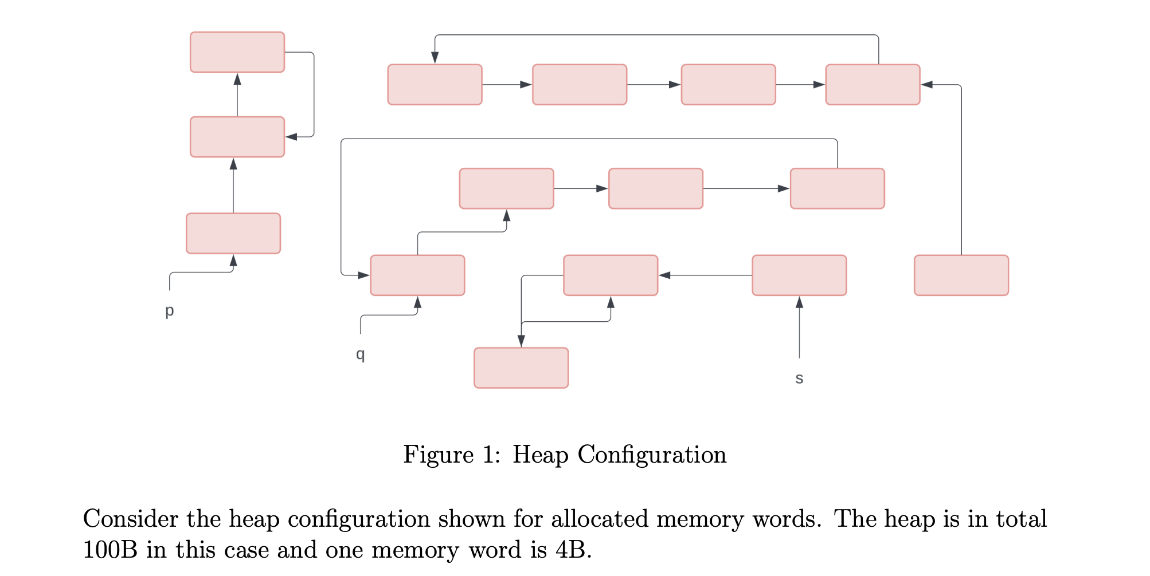
Assignment Solution
Compute the amount of memory leaked for this configuration:
Pink cells denote allocated cells
In total, 5 are unreachable by any existing reference (orphans); hence, $20B$ are leaked

Slide 24
Assignment Solution
Mark the nodes that will be added to the free list after reference counting:
Only cells that are not referenced (i.e., pointed to) will be added

Slide 25
Assignment Solution
Compute the amount of memory leaked after each of reference counting and mark and sweep
After reference counting: $4∗4B=16B$; meanwhile, mark and sweep will clear all ($0B$ leak ).

Slide 26
Assignment Solution
How does mark and sweep detect the cycle although it is not in the reference graph?
In the mark step, it will traverse the reference graph which will cover all reachable cells from the program and mark them (as shown above)
In the, sweep step it will consider any unmarked cell free (as shown above; cycles detected)

Slide 27
Assignment Solution
Overhead for Reference Counting and Mark & Sweep:
Mark and sweep: $25∗1b=25 bits$
Reference count: $25∗1B=25 bytes$
Forgave anyone who computed
over allocated only
(and awarded anyone who
did correctly)…

Slide 28
Assignment Solution
Mention a set of conditions under which reference counting could be viewed to be significantly better than mark and sweep
Cycles are sparingly used in the program or unused
Application is real-time
Each memory word is large

Slide 29
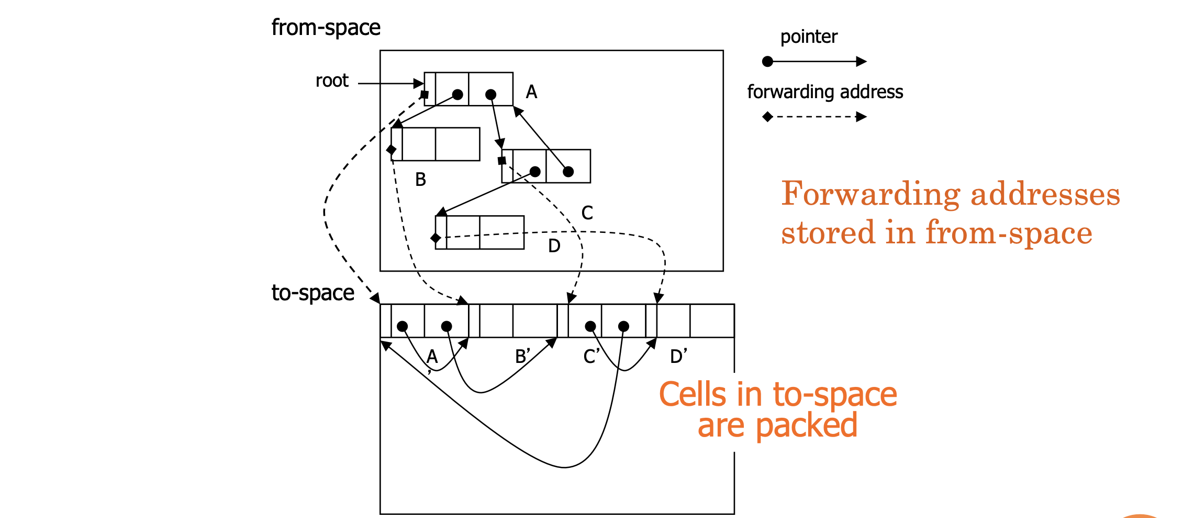
Assignment Solution
Even if estimating the forward addresses is possible while mapping for forward pointers.
It’s not possible to estimate for backward pointers (A is gone; need to look up the address).

Slide 30
Assignment Solution

Slide 31
Assignment Solution

Slide 32
Assignment Solution
Need to Proof:
$Γ├ e_{1}e_{2}:t$ and $e_{1}e_{2}→(e_{1}e_{2})′$ then $Γ├{ (e_{1}e_{2})}^{′}:t$
Inductive Hypothesis (I):
$Γ├ { e}_{1}:t_{a}→t_{b}$ and ${ e}_{1}→{ e′}_{1}$then $Γ├{{ e′}_{1}}^{ }:t_{a}→t_{b}$
Inductive Hypothesis (II):
$Γ├ { e}_{2}:t_{a}$ and ${ e}_{2}→{ e′}_{2}$then $Γ├{ e′}_{2}:t_{a}$
$$1$$ | $e_{1}$ is either value OR can take one step of evaluation. | Logic
2 | Suppose $e_{1}$ can take one step of evaluation ${ e}_{1}→{ e′}_{1}$ | Case Choice
3 | $$Γ├ { e}_{1}:t_{a}→t_{b}$$ | By assumption
$$4$$ | $$Γ├ { e′}_{1}:t_{a}→t_{b}$$ | By IH1, and (2,3)
$$5$$ | $${e′}_{1}e_{2}:t_{b}$$ | By T-App
Casing makes sense, we don’t always have ${ e}_{1}→{ e′}_{1}$
Trivial to show ${\left(e_{1}e_{2}\right)}^{′}→{e^{′}}_{1}e_{2}$ by call-by-value
Now need to consider when $e_{1}$ is a value…

Slide 33
Assignment Solution
Need to Proof:
$Γ├ e_{1}e_{2}:t$ and $e_{1}e_{2}→(e_{1}e_{2})′$ then $Γ├{ (e_{1}e_{2})}^{′}:t$
Inductive Hypothesis (I):
$Γ├ { e}_{1}:t_{a}→t_{b}$ and ${ e}_{1}→{ e′}_{1}$then $Γ├{{ e′}_{1}}^{ }:t_{a}→t_{b}$
Inductive Hypothesis (II):
$Γ├ { e}_{2}:t_{a}$ and ${ e}_{2}→{ e′}_{2}$then $Γ├{ e′}_{2}:t_{a}$
$$1$$ | $e_{1}$ is either value OR can take one step of evaluation. | Logic
2 | Suppose $e_{1}$ is a value and $e_{2}$ can take a step${ e}_{2}→{ e′}_{2}$ | Case Choice
3 | $$Γ├ { e}_{2}:t_{a}$$ | By assumption
$$4$$ | $$Γ├{ e′}_{2}:t_{a}$$ | By IH2, and (2,3)
$$5$$ | $$e_{1}{e′}_{2}:t_{b}$$ | By T-App
Casing makes sense, we don’t always have ${ e}_{2}→{ e′}_{2}$
Trivial to show ${\left(v_{1}e_{2}\right)}^{′}→v_{1}{e′}_{2}$ by call-by-value
Now need to consider when $e_{2}$ is a value (can’t take a step of evaluation)

Slide 34
Assignment Solution
Need to Proof:
$Γ├ e_{1}e_{2}:t$ and $e_{1}e_{2}→(e_{1}e_{2})′$ then $Γ├{ (e_{1}e_{2})}^{′}:t$
Inductive Hypothesis (I):
$Γ├ { e}_{1}:t_{a}→t_{b}$ and ${ e}_{1}→{ e′}_{1}$then $Γ├{{ e′}_{1}}^{ }:t_{a}→t_{b}$
Inductive Hypothesis (II):
$Γ├ { e}_{2}:t_{a}$ and ${ e}_{2}→{ e′}_{2}$then $Γ├{ e′}_{2}:t_{a}$
$$1$$ | $e_{1}$ is either value OR can take one step of evaluation. | Logic
2 | Suppose $e_{1}$ is a value and $e_{2}$ is a value | Case Choice
3 | $$e_{1}=λx.e_{x} e_{2}=v$$ | Must take this form
4 | $λx.e_{x} v→e_{x} [v/x]$ | By $\frac{ }{\left(λx:t.e_{1}\right)v→e_{1}[v/x]}$
Need $Γ├ e_{x}[v/x]:t$
By substitution theorem: If $Γ, x:t^{′}├ e_{x}:t$ and $Γ├ v:t′$ then $Γ├ e_{x}[v/x]:t$
4 | $Γ├ e_{1}e_{2}:t$ | Assumption
5 | $Γ├ λx.e_{x}:t_{a}→t$and $Γ├ v:t_{a}$ | Inversion of T-App
$$6$$ | $$Γ, x:t_{a} ├{ e}_{x}:t$$ | Inversion of T-abs: $\frac{Γ, x:t_{1} ├{ e}_{2}:t_{2} }{Γ ├ \left(λ x:t_{1}. e_{2}\right):t_{1}→t_{2}}$
$$7$$ | $$Γ├ e_{x}[v/x]:t$$ | By Substitution

Slide 35
Assignment Solution
Case $\frac{Γ├ e_{1}:bool Γ├{ e}_{2}:t Γ├{ e}_{3}:t}{Γ ├ if e_{1} then e_{2} else e_{3} :t}[T−If]:$
Need to Proof:
$Γ├if e_{1} then e_{2} else e_{3} :t$ and $if e_{1} then e_{2} else e_{3} →(if e_{1} then e_{2} else e_{3})′$ then $Γ├{ (if e_{1} then e_{2} else e_{3})}^{′}:t$
Inductive Hypothesis (I):
$Γ├ { e}_{1}:bool$and ${ e}_{1}→{ e′}_{1}$then $Γ├{{ e′}_{1}}^{ }:bool$
Inductive Hypothesis (II):
$Γ├ { e}_{2}:t$and ${ e}_{2}→{ e′}_{2}$then $Γ├{ e′}_{2}:t$
Inductive Hypothesis (III):
$Γ├ { e}_{3}:t$and ${ e}_{3}→{ e′}_{3}$then $Γ├{ e′}_{3}:t$
$$1$$ | Suppose $e_{1}$ can take one step $e_{1}→e_{1}^{′}$ | Case Choice
$$2$$ | $$e_{1}:bool$$ | By assumption
$$3$$ | $$e_{1}^{′}:bool$$ | By (1,2) & $IH1$
4 | $Γ├ { e}_{2}:t$ and $Γ├ { e}_{3}:t$ | By assumption
5 | $$Γ├ if {e^{′}}_{1} then e_{2} else e_{3} :t$$ | By T-If
6 | $$Γ├{ (if e_{1} then e_{2} else e_{3})}^{′}:t$$ | By Call-by-value

Slide 36
Assignment Solution
Case $\frac{Γ├ e_{1}:bool Γ├{ e}_{2}:t Γ├{ e}_{3}:t}{Γ ├ if e_{1} then e_{2} else e_{3} :t}[T−If]:$
Need to Proof:
$Γ├if e_{1} then e_{2} else e_{3} :t$ and $if e_{1} then e_{2} else e_{3} →(if e_{1} then e_{2} else e_{3})′$ then $Γ├{ (if e_{1} then e_{2} else e_{3})}^{′}:t$
Inductive Hypothesis (I):
$Γ├ { e}_{1}:bool$and ${ e}_{1}→{ e′}_{1}$then $Γ├{{ e′}_{1}}^{ }:bool$
Inductive Hypothesis (II):
$Γ├ { e}_{2}:t$and ${ e}_{2}→{ e′}_{2}$then $Γ├{ e′}_{2}:t$
Inductive Hypothesis (III):
$Γ├ { e}_{3}:t$and ${ e}_{3}→{ e′}_{3}$then $Γ├{ e′}_{3}:t$
$$1$$ | Suppose $e_{1}$ is a value (must be true or false) | Case Choice
$$2$$ | Then $e→e_{2}$ or $e→e_{3}$ so $e^{′}=e_{2}$or $e^{′}=e_{3}$ | By $\frac{ }{if true then e_{2} else e_{3}→e_{2} }[E−if_{1}]$ and $[E−if_{2}]$
$$3$$ | $$Either way Γ├ { e}_{2}:t and Γ├ { e}_{3}:t$$ | Assumptions
4 | $$Γ├ e′:t$$ | Simplification

Slide 37
Thank You

